Slide 1
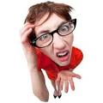
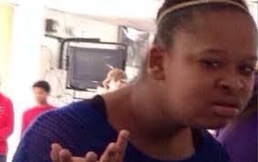
#1433 Why Do Our Joints Pop?
By: Aleah Jones

Slide 2
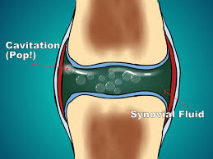
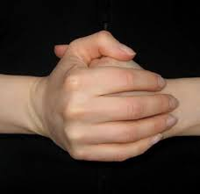
Why Do Our Joints pop?
A liquid called synovial fluid surrounds your joints. To make the sound of your joints popping you push the synovial fluid to a point where gasses in the synovial pop and make the sound of cracking noise.

Slide 3
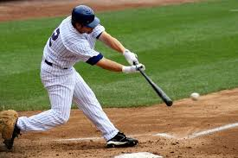
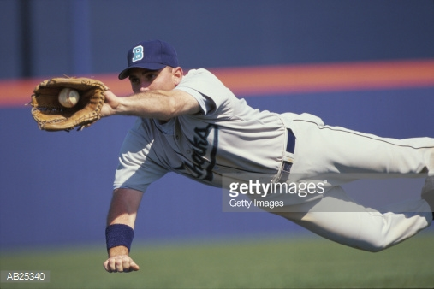
Please don’t
Say you are playing your championship game. You go to catch the ball and your joint pops . Your mom is there and she thinks something is wrong. You try to tell her that it is just the synovial fluid made the sound .Then she freaks out and takes you to the doc there the doc tells her that there is a synovial fluid that make the sound because it popped.

Slide 4
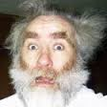
Are popping joints a Symptom of a serious condition?
Don’t worry?popping and cracking joints are usually normal and nothing to worry about (Just don’t do it a lot )
Is it serious?

Slide 5
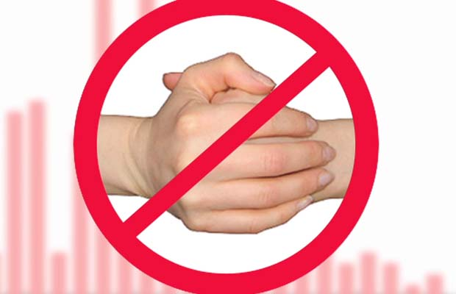
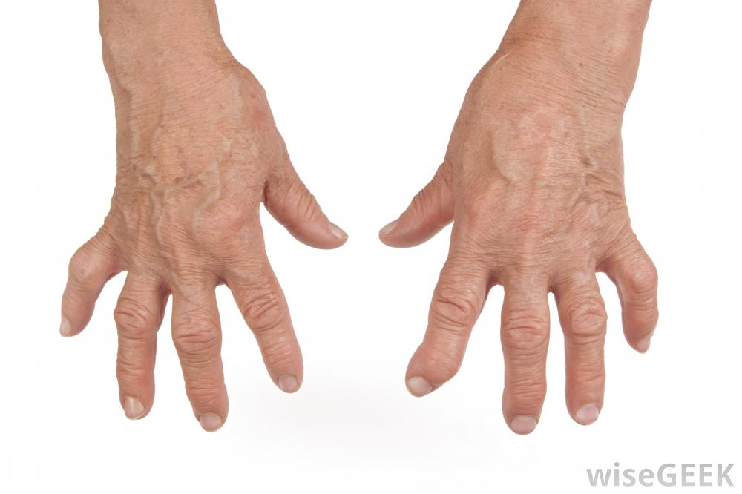
Should you crack your knuckles?
No you should not crack your knuckles because if you pop your knuckles a lot it can cause Arthritis.
Arthritis is where when you get old your finger curve up and stay that way.

Slide 6
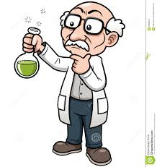
Interesting facts.
Scientists believe the joints popping and cracking isn’t necessarily harmful

Slide 7
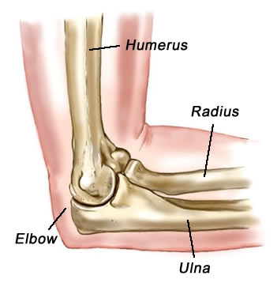
The place where two bones meet is called a what?
Joint
Tendon
Ligament
Elbow

Slide 8
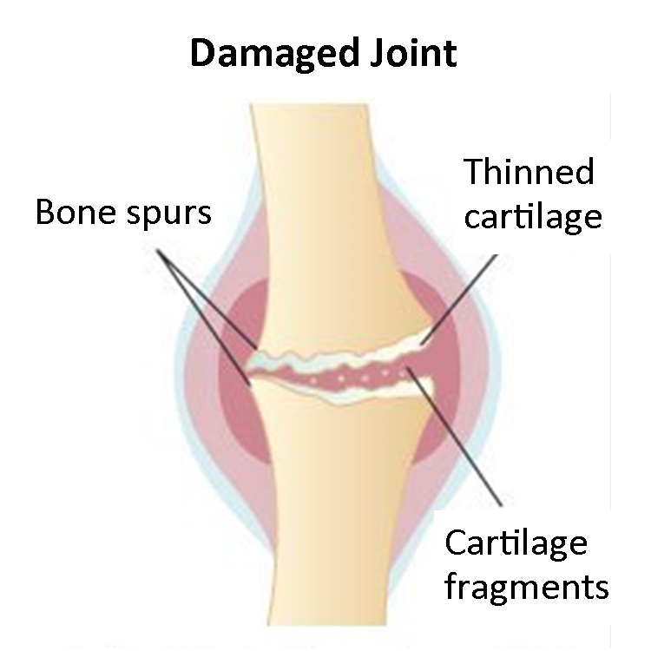
The thick liquid that surrounds your joints is called what?
water
gravy
Synovial fluid
Spinal fluid

Slide 9
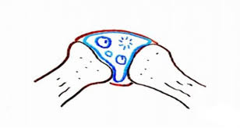
When gasses in Synovial fluid come out of solution to form bubbles, this process is known as what?
Dissolving
Substituting
Swelling
Cavitation

Slide 10
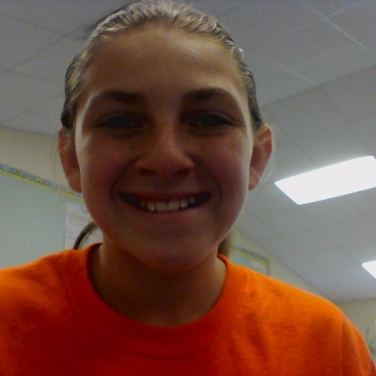
About the author
Hi, I am Aleah Jones I am 10 years old . I was born on Jan 5, 2005. My hobbies are softball and football.I picked this topic because my joints pop a lot but when I went to Wonderopolis.com it helped me know why our joints pop and you should just go there and it will answer your wonders

