Slide 1
#1504 Do black cats bring bad luck?
By: Alyssa Willis

Slide 2
Do black cats bring bad luck ?
The superstition of black cats is not real. Some people just believe that black cats bring bad luck because of the bad day people have when a black cat walks across their path.

Slide 3
How did the superstitions about black cat’s get started?
The superstitions of black cat’s got started in the middle ages.In Europe .Older women were accused of being witches and usually had black cat’s as companions.

Slide 4
Do any cultures think black cat’s bring good luck?
Some cultures like Scotland ,Britain ,Japan and Russia view black cats as good luck .

Slide 5
Egypt.
Did you know that 5,000 years ago the ancient Egyptian worshipped cats .If you got caught killing a cat the Egyptian royalty will take your life.

Slide 6
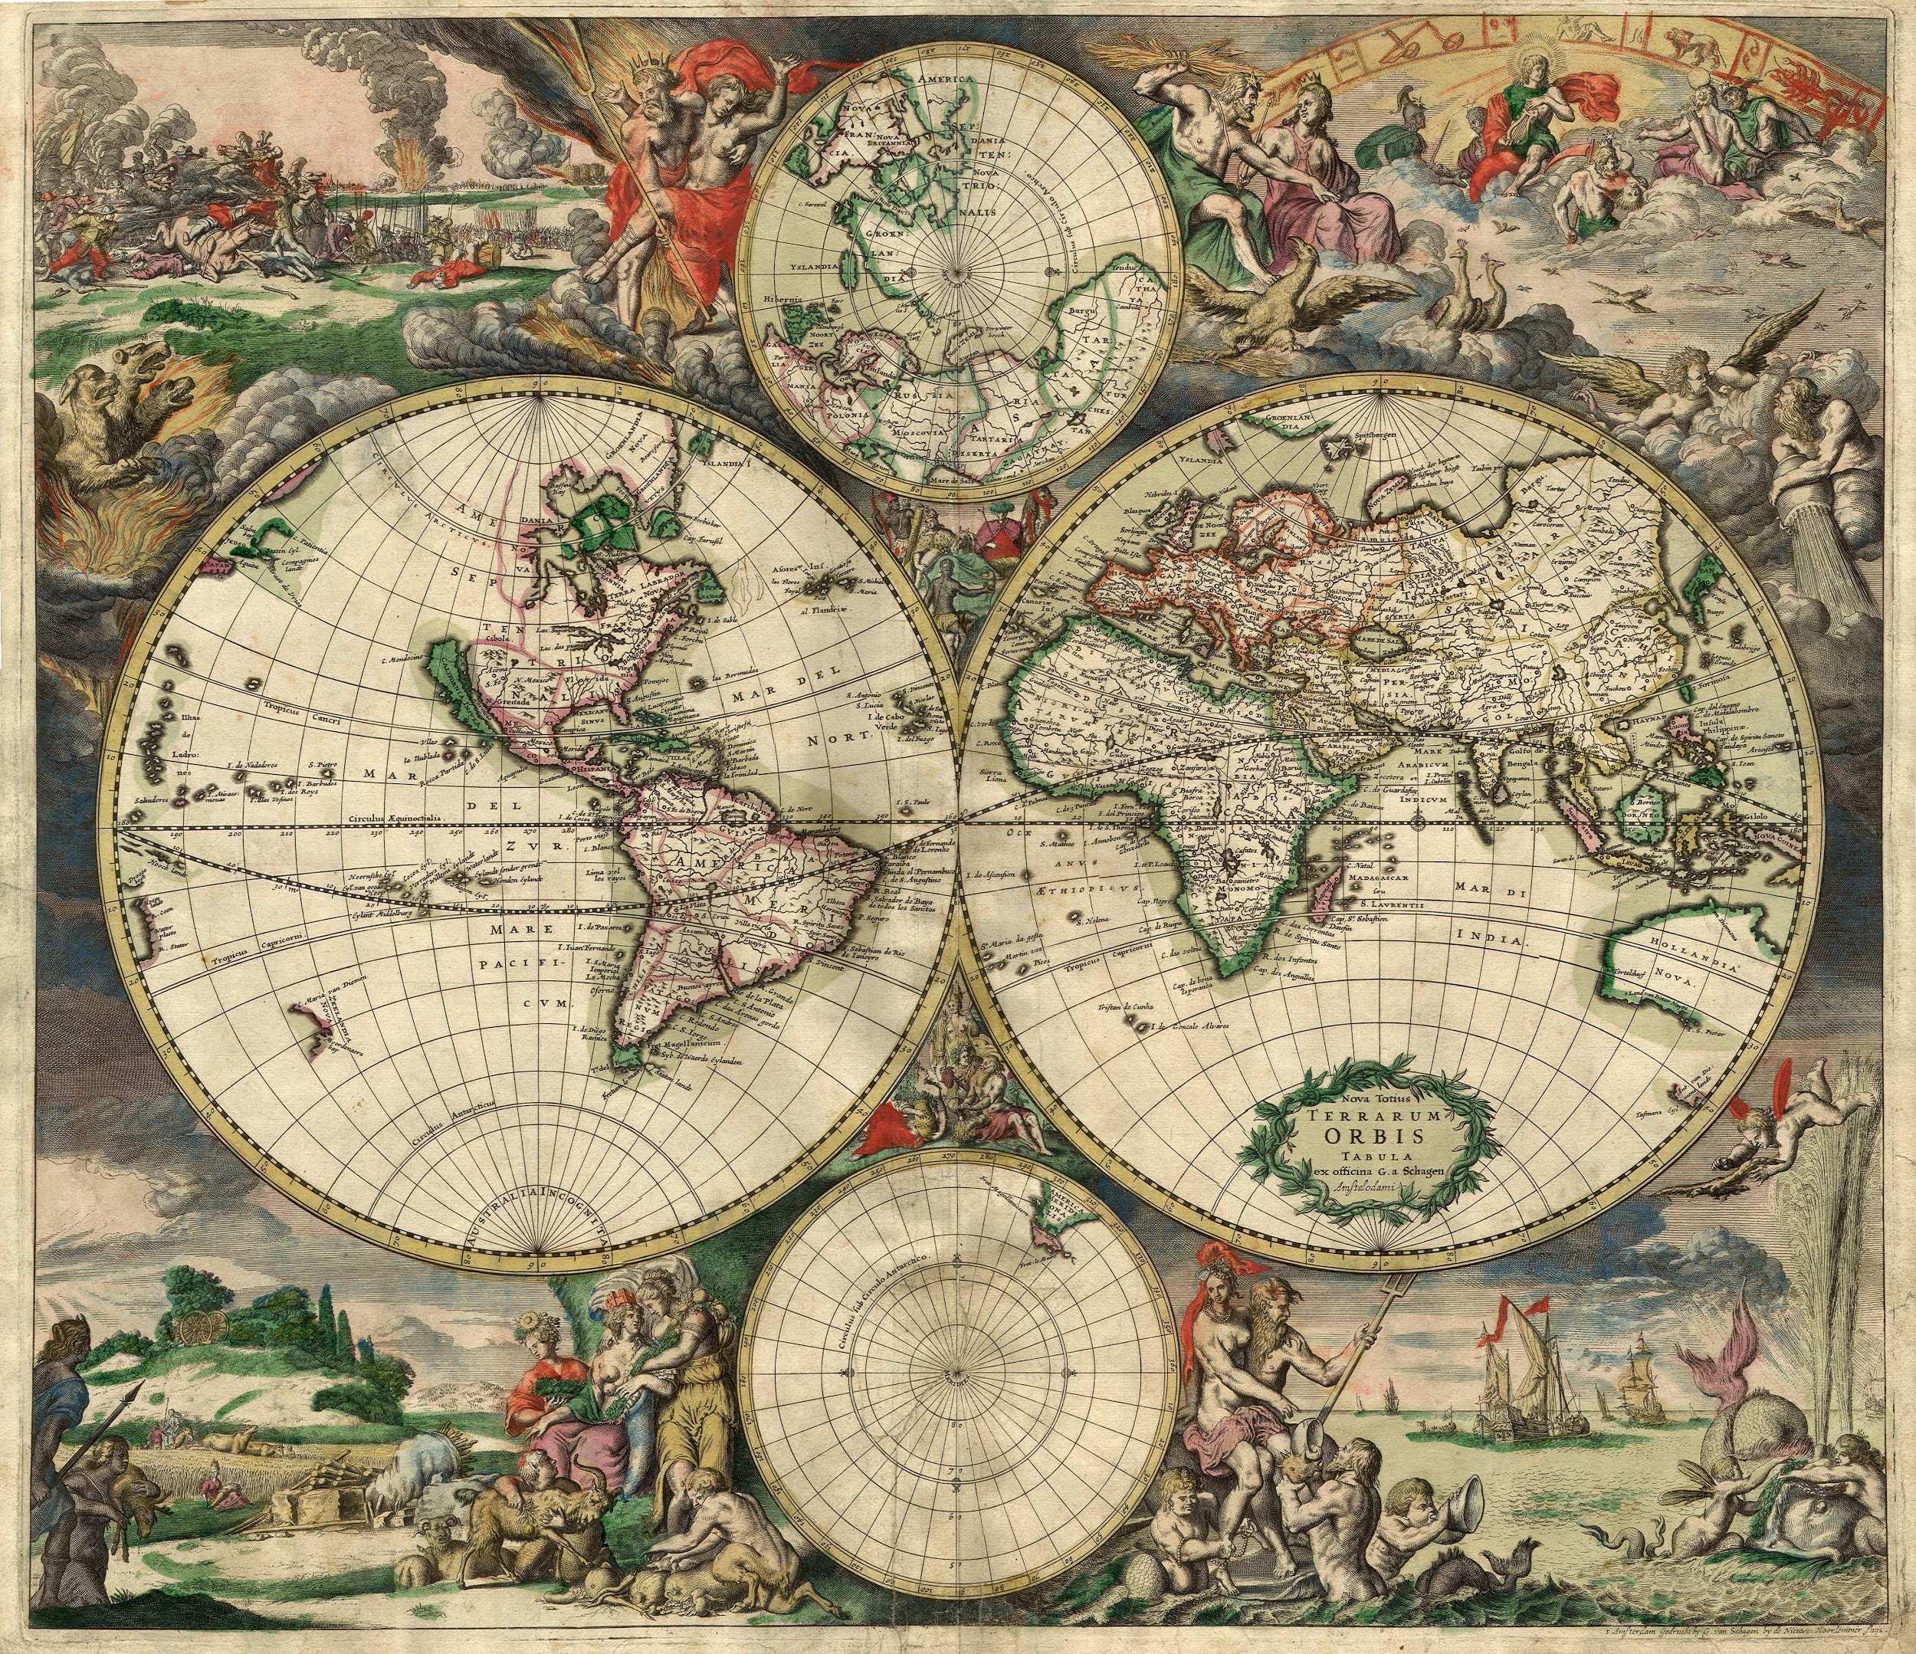
The ancient people of which country worshiped cats ?
A. Egypt
B. U.S.A
C. Canada
D. Finland

Slide 7
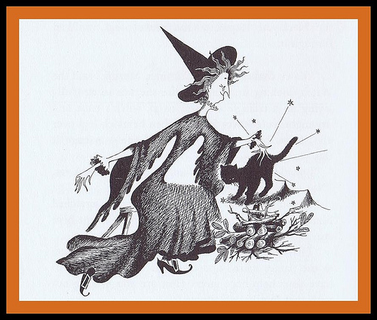
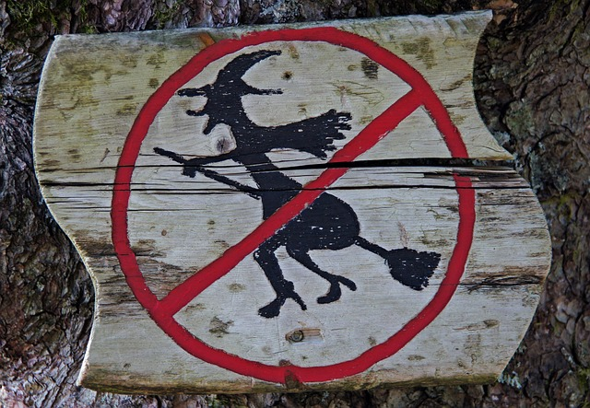
On which continent did fear of witchcraft lead to the superstition of black cats get started?
A. North America
B .South America
C. Asia
D. Europe

Slide 8
Black cats are often pictured in what holiday ?
A. Xmas
B. Hallowen
C. St. Pattys

