Slide 1
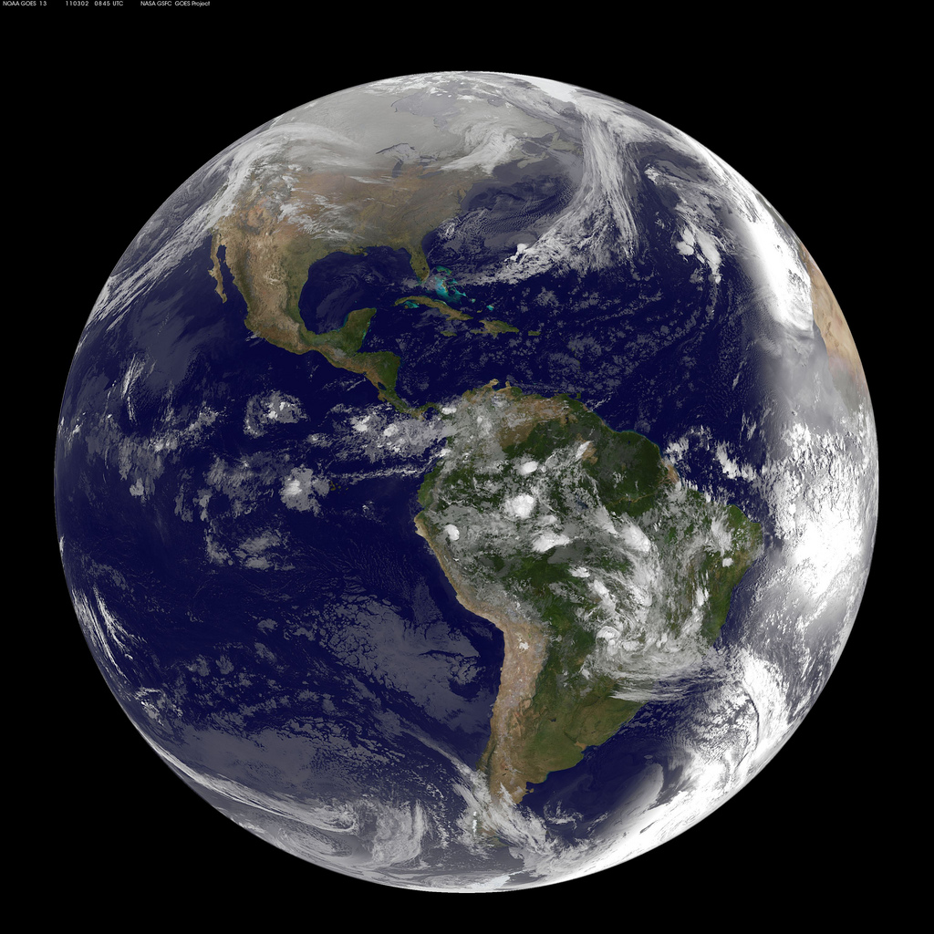
#1292 How was Earth began?
By:Anthony Parsons

Slide 2
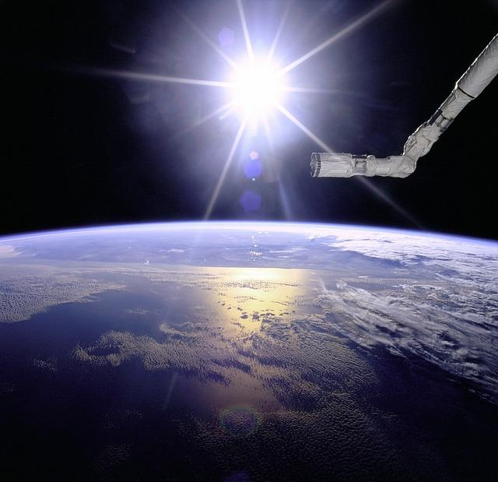
How did earth begin?
It began as a big ball of rock until it got so hot it made iron and the core.Over millions of years,Earth eventually it cooled down and its composition settled into the core,mantle,and crust as it is today.

Slide 3
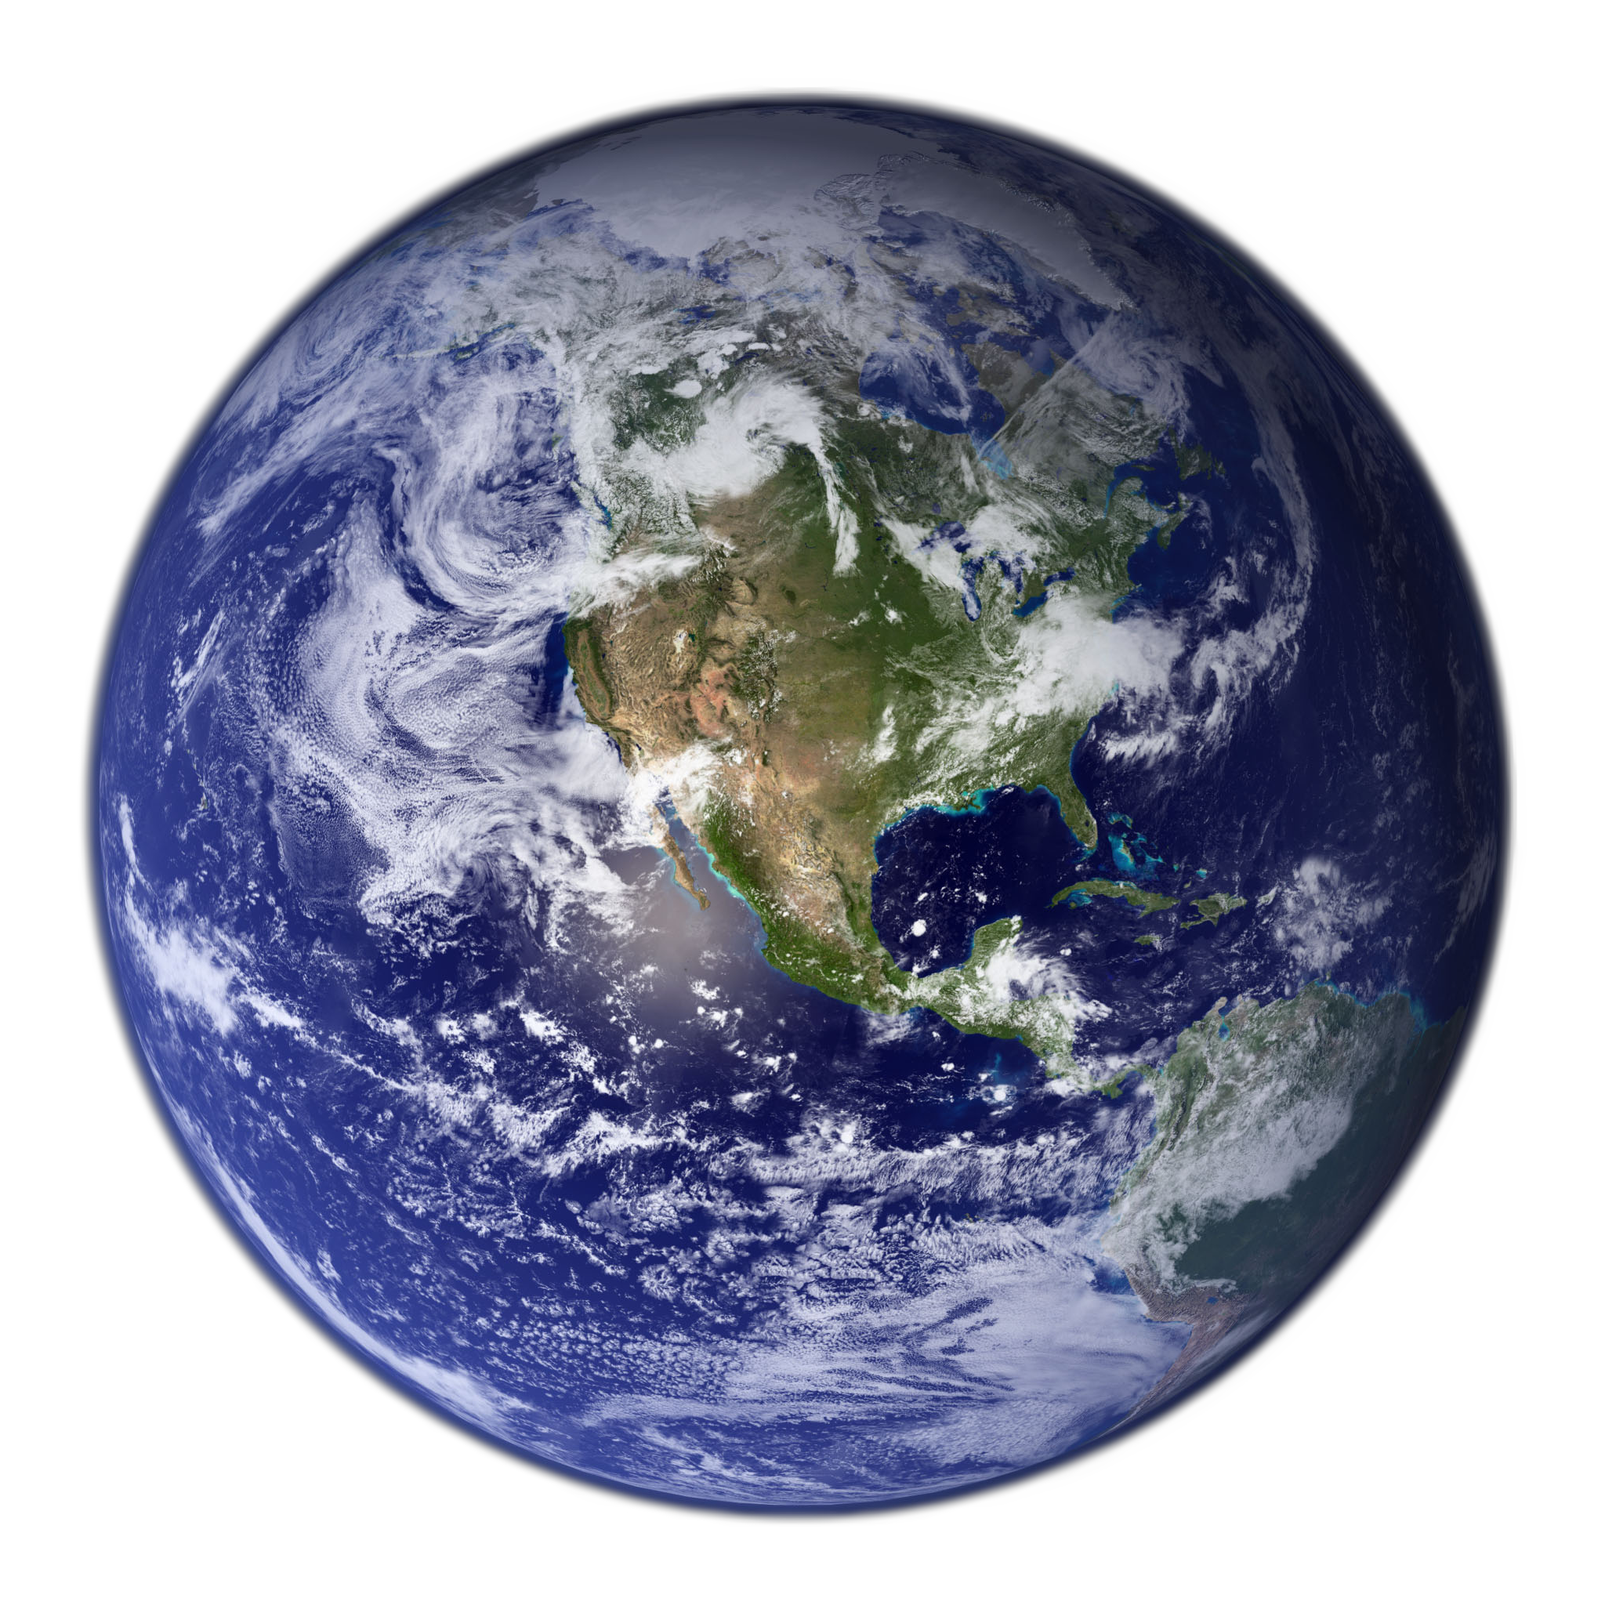
What is the big bang theory?
The big bang theory is how Earth was made.

Slide 4
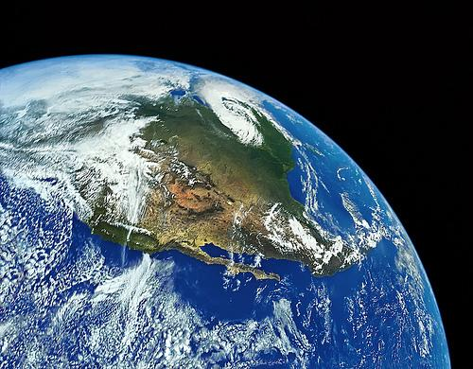
When was Earth formed?
Earth was made about 4.6 billion years ago.

Slide 5
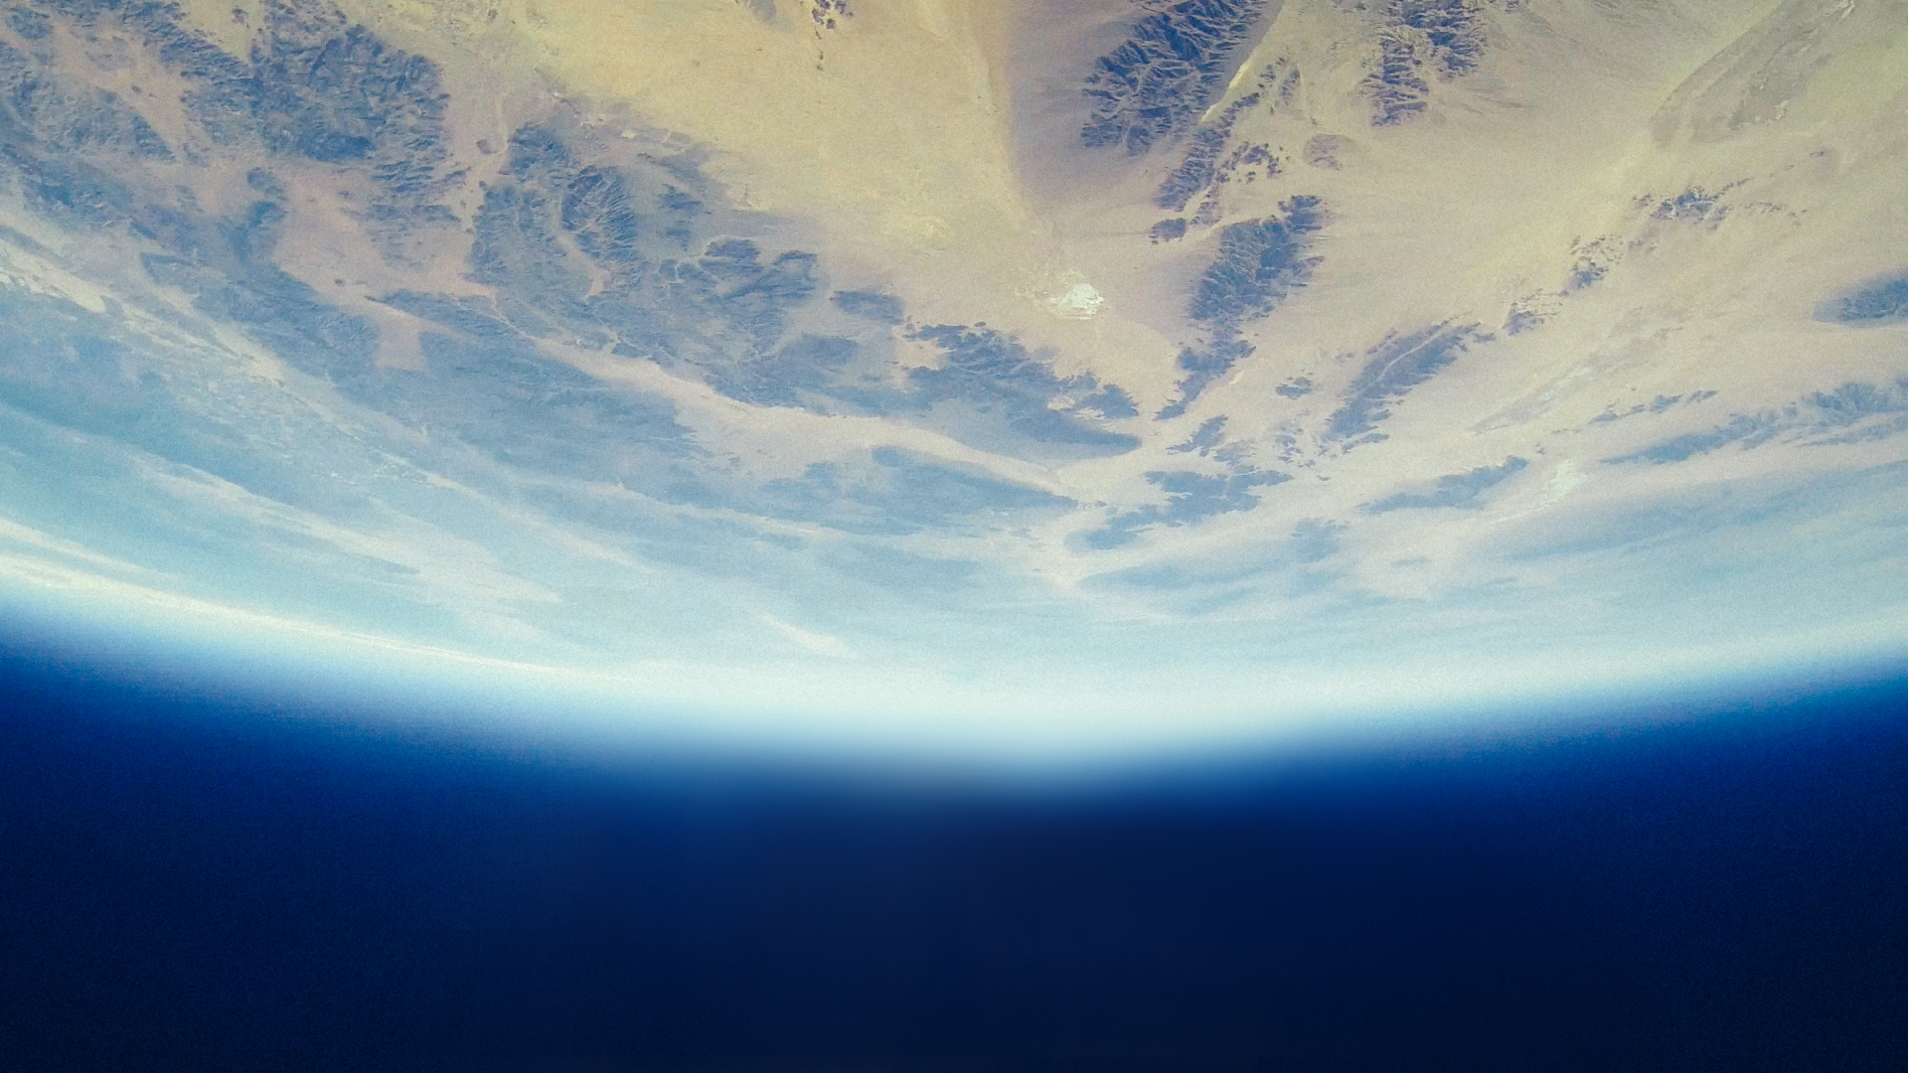
Interesting facts.
A planetesimal the size of Mars hit earth.

Slide 6

Scientists believe Earth was formed about how long ago?
A.27 years
B.4.6 billion year
C. 3 mi s

Slide 7
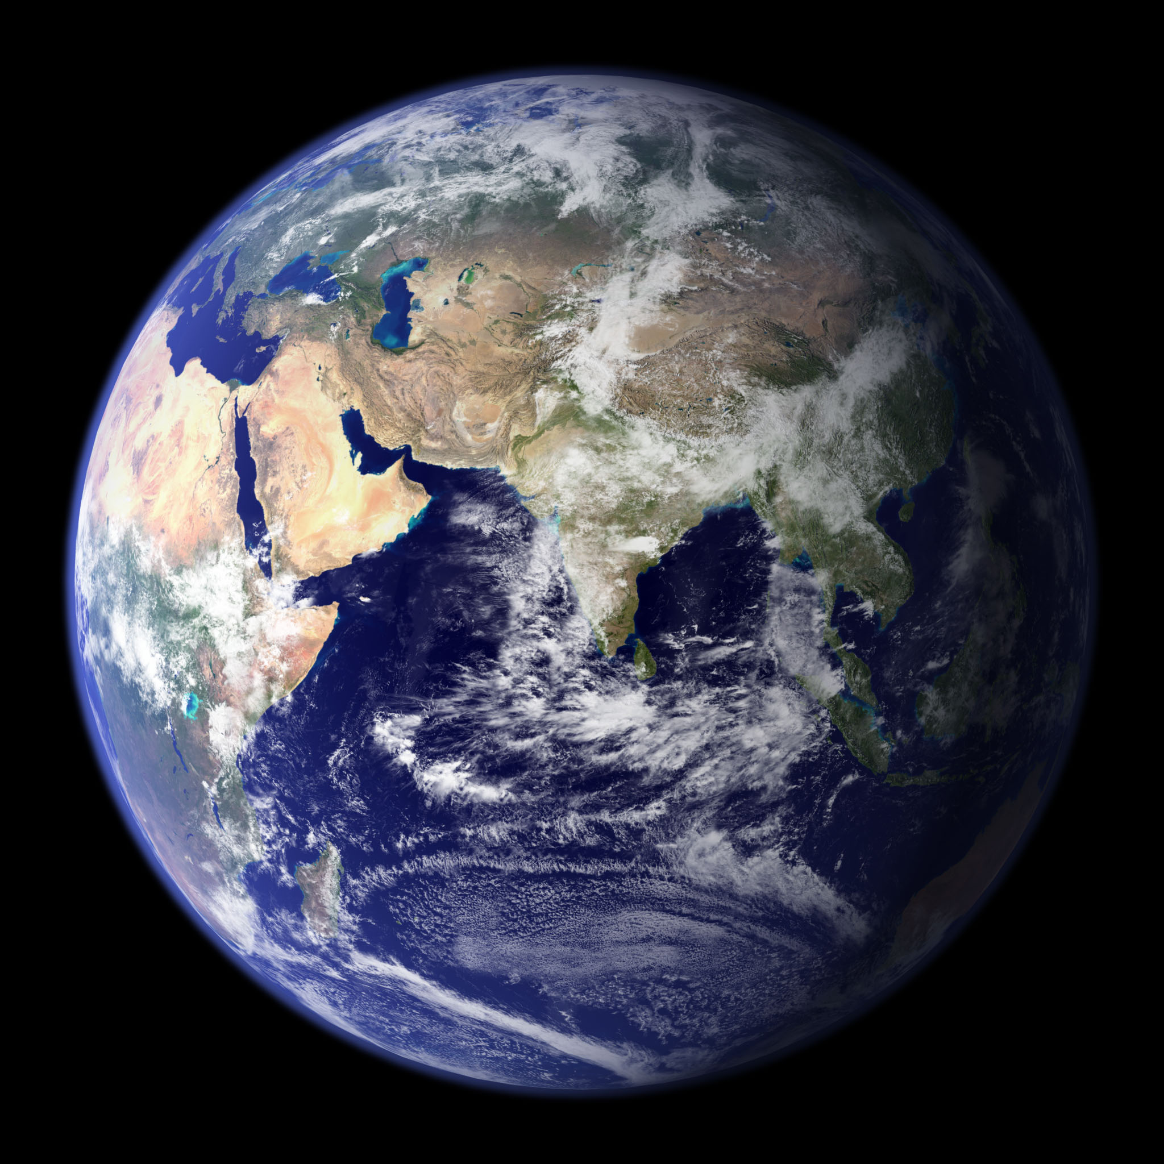
Early in the process of its formation, a planetesimal the size of Mars hit Earth, causing what?
A.a big chunk of Earth to be knocked into space, becoming our Moon
B.the angel of Earth's tilt to be changed to its current orientation
C.Pangaea to break apart
D. both a and b

Slide 8

Larger chunks of rock that eventually formed into the planets of our solar system are known as what?
A. big rocks
B. planetesimals
C. baby planets
D. planetudes.

