Slide 1
1108# ARE LIGERS REAL?
By: Ariyanna Dove

Slide 2
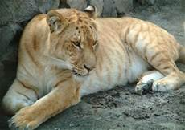
Are Ligers real ?
Ligers are real because they are born to a male lion and a female tiger.

Slide 3
What is the difference between liger and a tigon ?
The difference between a liger and a tigon is a tigon is born to a male tiger and a female lion.A liger is born to a female tiger and a male lion.

Slide 4
Do ligers occur naturally in the wild ?
Ligers do not naturally occur in the wild because tigers and lions both live in different place.Lions live in Africa and tigers live in Asia.

Slide 5
Interesting facts.
Ligers can weigh up to 900 pounds and ligers are bigger than both their parents.Like tigers ligers like to swim.Then like lions they are “sociable”.

Slide 6
The offspring of a male tiger and a female lion is called a what
(A) liger (b) liguar (c) cheeton (d) tigon

Slide 7
Ligers have almost always been the result of purpose breeding in captivity by human caretakers a practice that can be traced back to when ?
(a) 1987 (b) early 1800 (c) late 1900 (d) early 2000

Slide 8
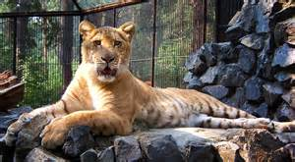
Ligers usually aren’t produced naturally in the wild because tigers are mainly found in Asia and Lions are mainly found where.
A Africa B North America C Australia D Europe

Slide 9
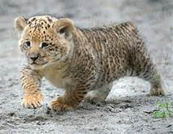
The End

