Slide 1
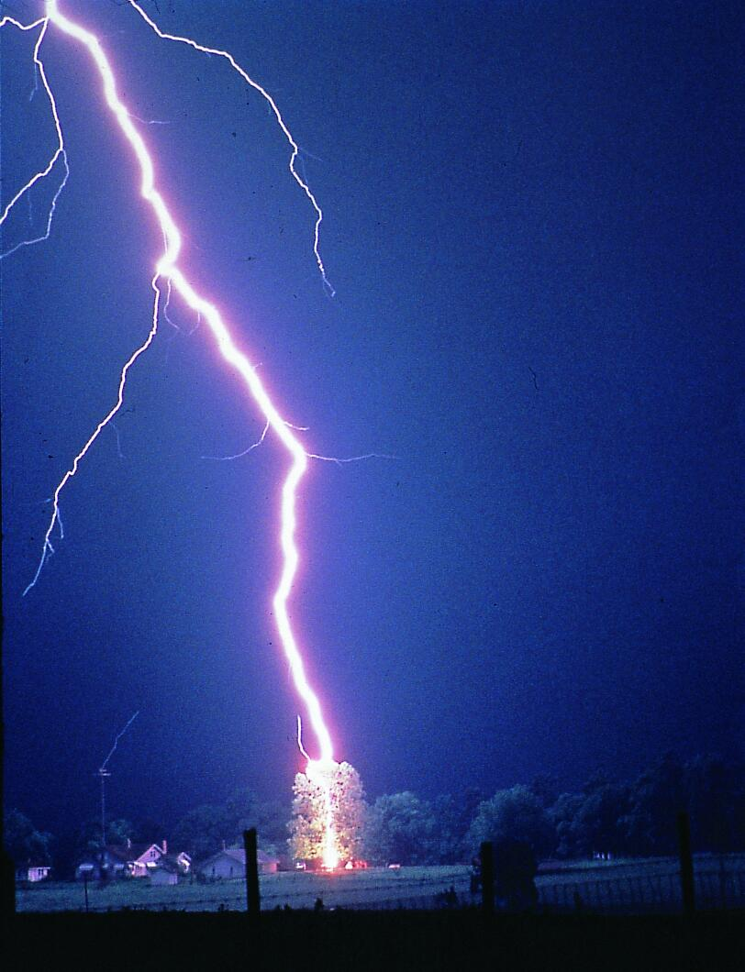
#1193 What Causes Lightning???
By: Ashlyn Hawkins

Slide 2
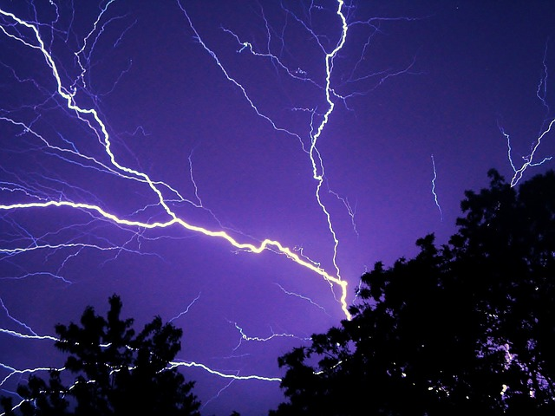
What causes lightning ?
When a thunder cloud is way up in the atmosphere ,the air is very cold.This causes the moisture in the cloud to freeze.These tiny bits of ice bump into each other as they roll around in the air a bit like bumper cars.

Slide 3
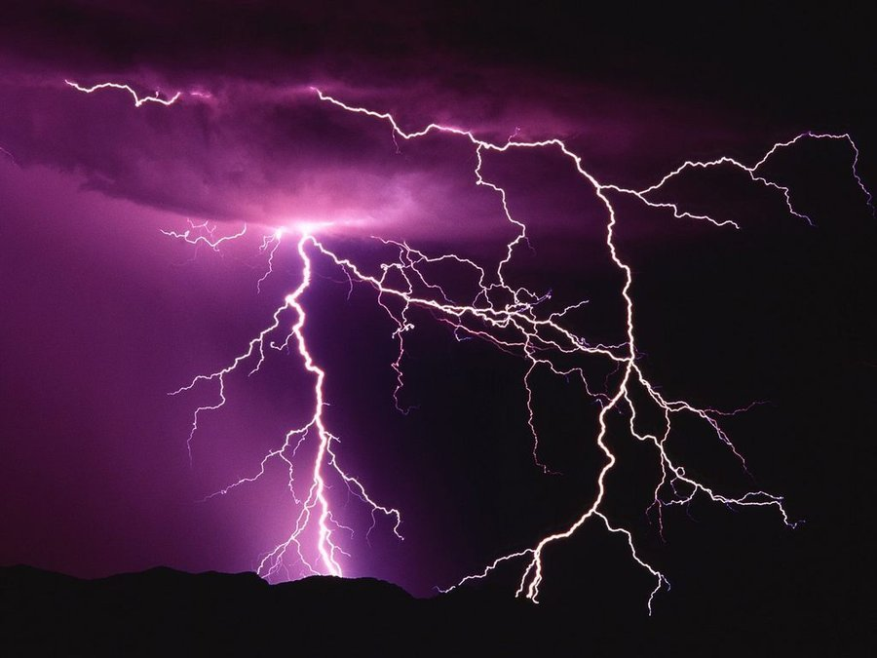
How many times does lightning strike the earth each day?
There are more than three million lightning strikes each day.
That`s about 40 strikes each second.

Slide 4
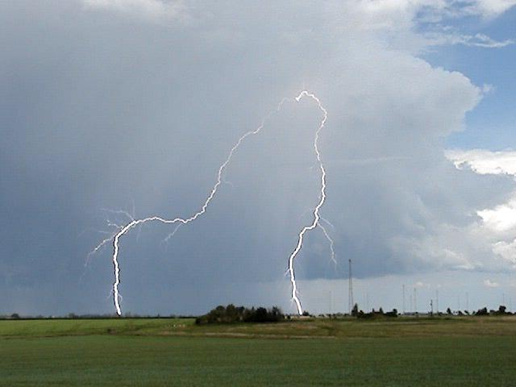
Who holds the record for having been hit by lightning the most times?
Roy sullivan of virginia holds the record as the person struck by lightning the most times.

Slide 5
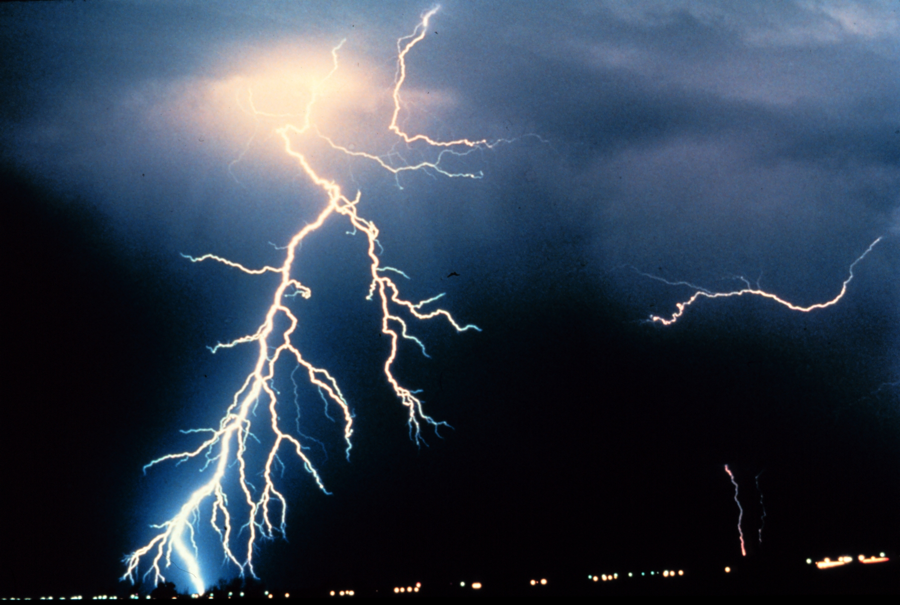
Interesting facts.
.A lightning flash is no more than an inch wide
.A bolt of lightning moves at 62,000 miles per second.
.The temperature of a lightning flash is hotter than the surface of the sun

Slide 6
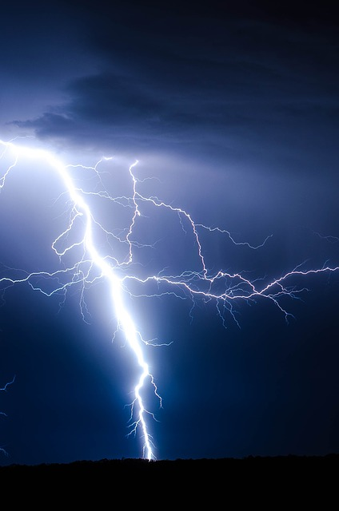
The earth's surface has what kind of charge?
A.Positive
B.Negative
C.Neutral
D.Irrelevant

Slide 7
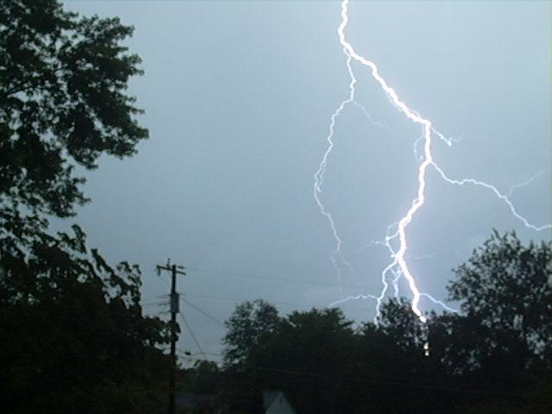
The negative charges that settle at the bottom of clouds are called what?
A.Protons
B.Neutrons
C.Neutrinos
D.Electrons

Slide 8
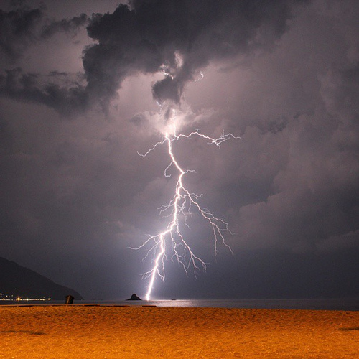
Roy sullivan has been struck by how many times in his live?
A.Five
B.Six
C.Seven
D.Eight

