Slide 1
# 1329. What is DNA?
By: Anna

Slide 2
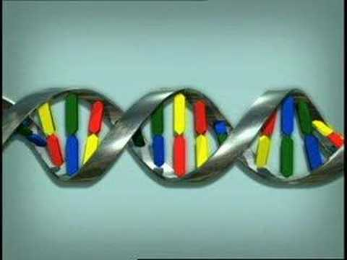
Interesting facts.
Did you know a person has 23 chromosomes. DNA is what make you ( you ).I like to call the protein’s A,T,G,C.
Notes:
You will have to go to youtube to watch my video.

Slide 3
What does dna stand for?
DNA stands for Deoxyribonucleic Acid .

Slide 4
Where is DNA?
It’s in anything that is alive .

Slide 5
WHAT IS DNA ?
It ‘s what makes you (you).

Slide 6
Where is DNA?
A.It’s in anything that’s alive.
B.It’s in anything.
C.It in rock’s.

