Slide 1
#6 Why does your hair turn grey?
By:Caleb Decker

Slide 2
Why does only elderly hair turn grey?
Your hair turns grey when you're older because you have cells that produce a chemical called Melanin. As you age the cells that produce Melanin die and lose color.
Notes:
go to lokai.com and type in pink

Slide 3
Why does hair turn grey and not other colors?
It turns grey because the Melanin cells die and grey, white, silver, etc. Colors start to appear. They are all base colors with no contrast. When the cells die the contrast and color dies and changes to a base color.

Slide 4
Why is Melanin important?
Melanin is important because it shields off sun rays and protects your root, shaft and scalp. For example ...your teeth don’t have Melanin so you have enamel instead so the teeth can’t take charge of their color. If you had Melanin on your teeth then you wouldn’t have cavities and plaque. Melanin can be found in very salty water.

Slide 5
Interesting facts.
-Melanin is one of the most important parts of your hair.
-Most hair turns grey from the age of 60-75 depending on how it is cared for.

Slide 6
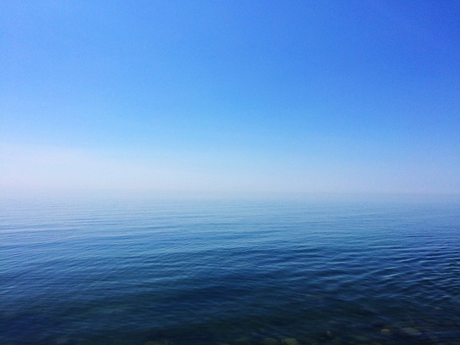
Your hair consists of two parts, a root and a what?
A. Hat
B. Melanin
C. Stem
D. Shaft

Slide 7
Hair follicles contain pigment cells that produce a chemical called what?
A. Melanin
B. DNA
C. Oxygen
D. Colorin

Slide 8
Which of the following is not responsible for its color?
A. Hair
B. Skin
C. Eyes
D. Teeth

