Slide 1
#1259 Where Do Dragons Live?
By: Casady

Slide 2
Where do dragons live?
Komodo dragons live in India and Bearded dragons live in Texas.Chinese water dragons live in China. Dragonflies live everywhere!

Slide 3
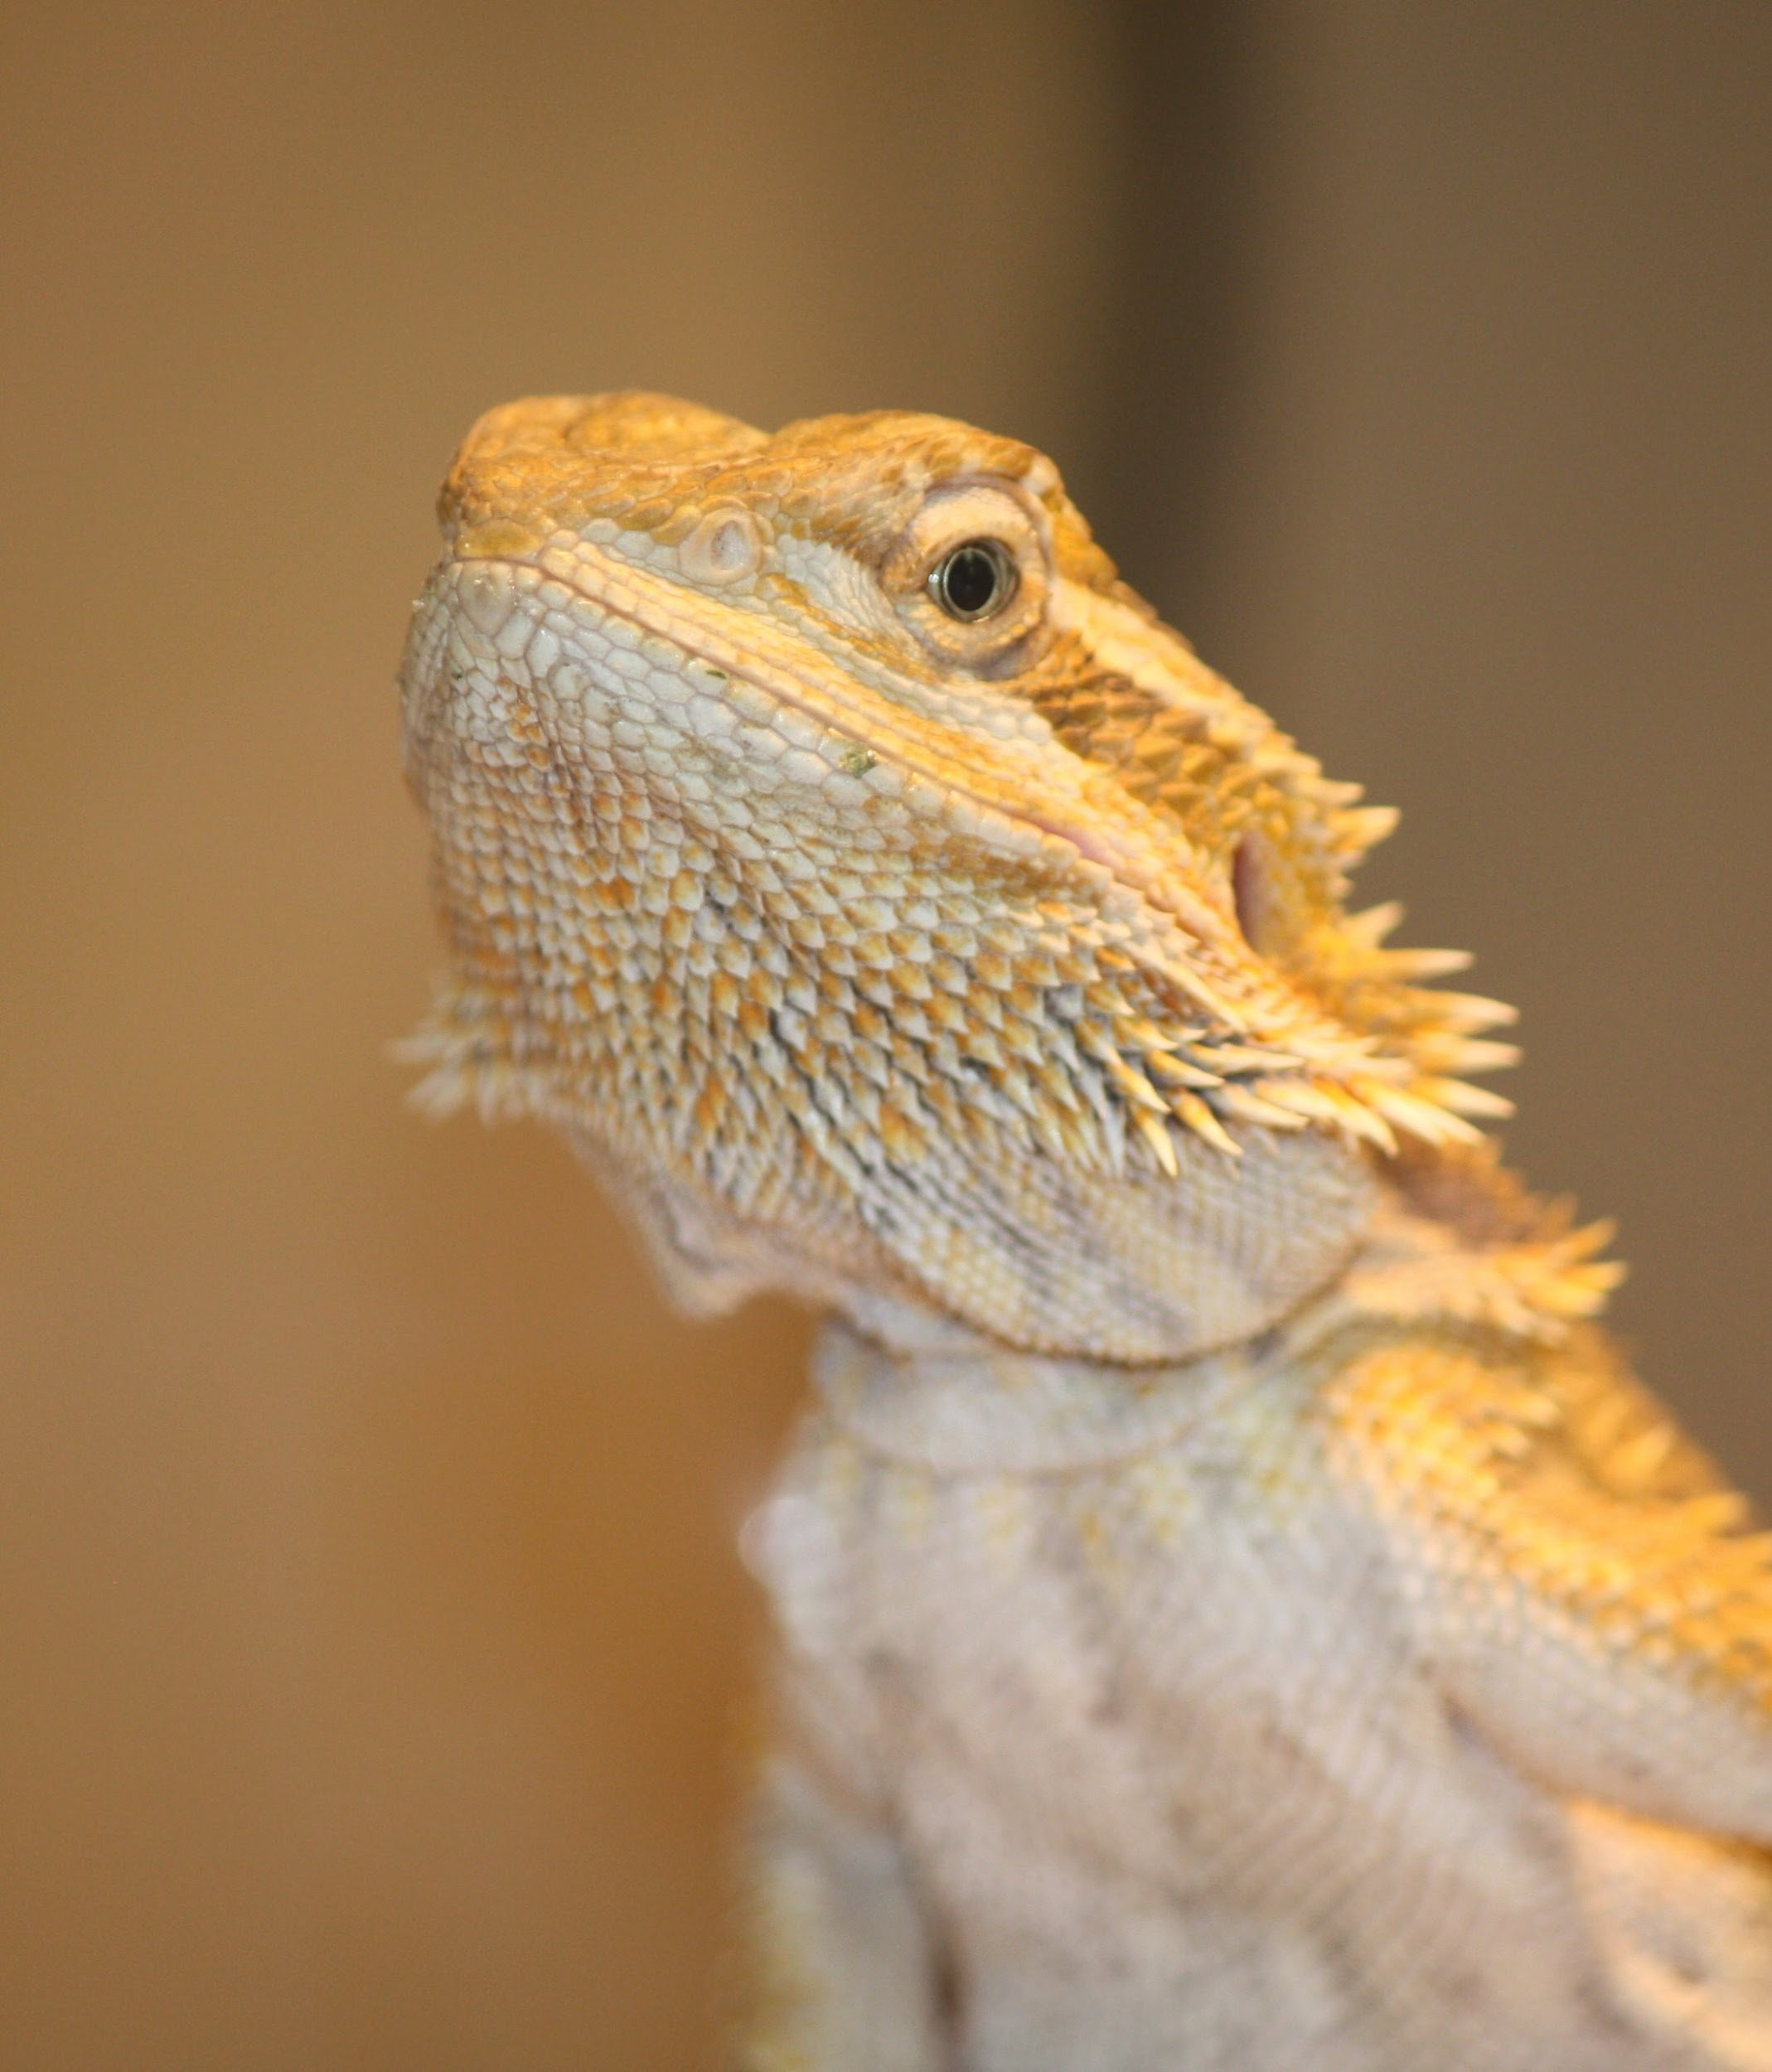
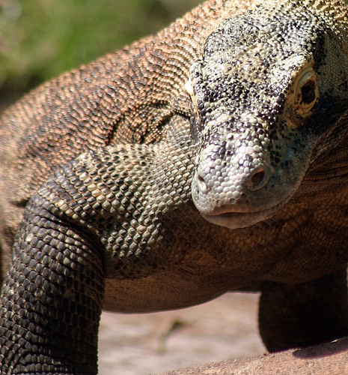
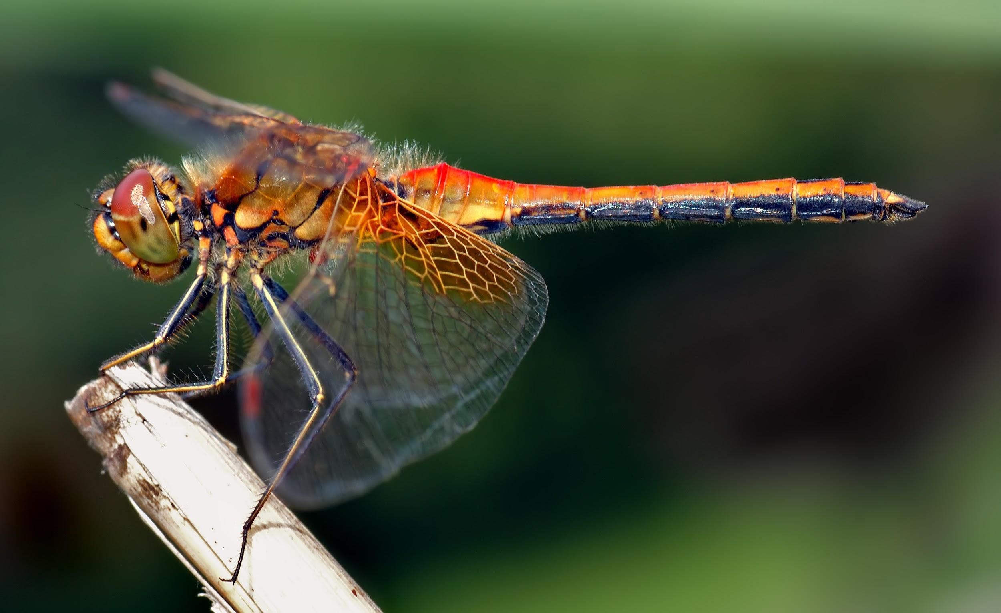
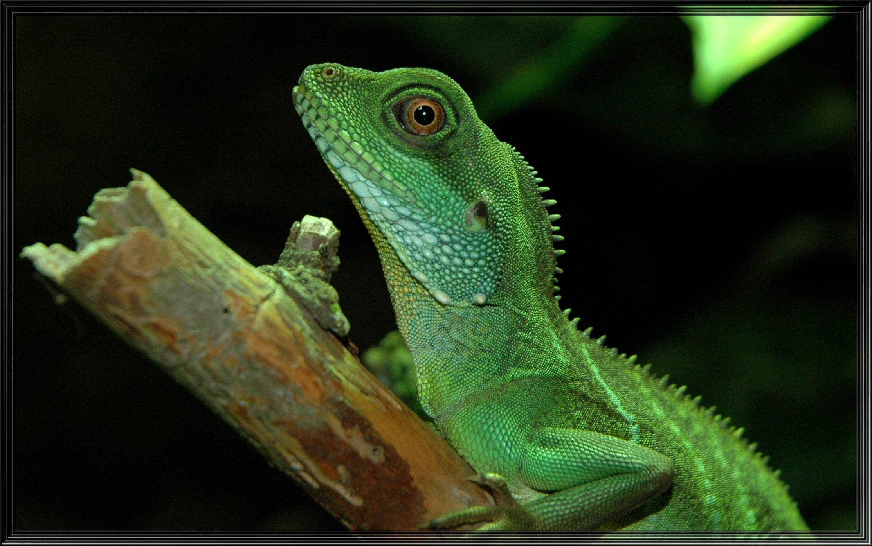
Were there any real dragons?
Yes there are four types of real dragons.There is the Komodo dragon,Bearded dragon,Dragon fly and the Chinese water dragon!

Slide 4
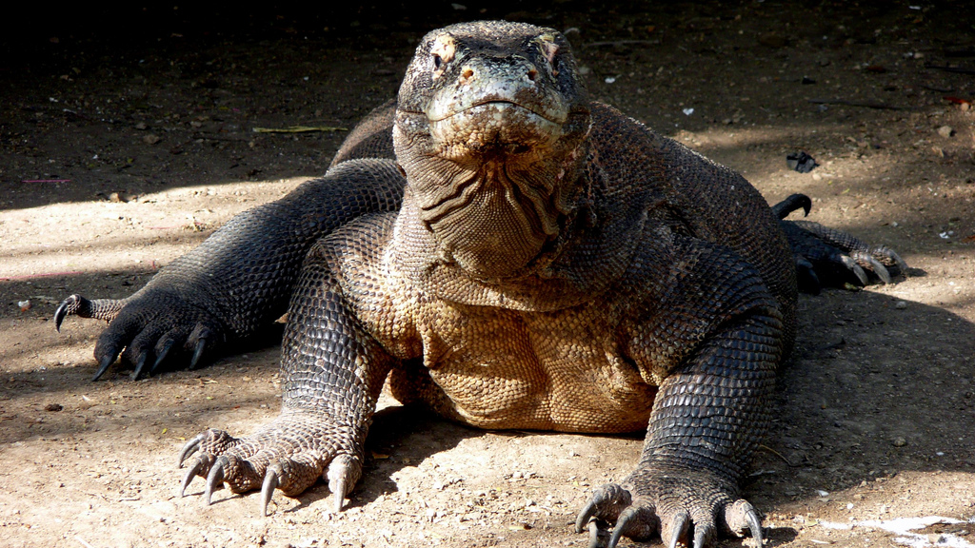
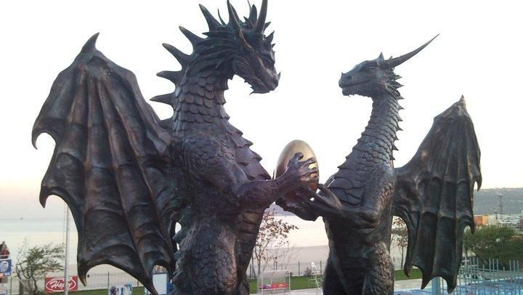
What country do komodo dragons call home?
Komodo dragons live in India.

Slide 5
There are thousands of myths & legends of dragons.There are four types of dragons that exist in this world!Most mythical dragons play the role of a villain.

Slide 6
Which mythical dragon custom evolved from Greek and Middle eastern mythologies ?
A- European dragon
B-Chinese dragon
C-Japanese dragon
D-Egyptian dragon

Slide 7
The Chinese dragon usually resembles a large what?
A-rabbit
B-fox
C-bear
D-snake

Slide 8
Komodo dragons live on the islands of which country?
A.Egypt
B.Indonesia
C.England
D.China

