Slide 1
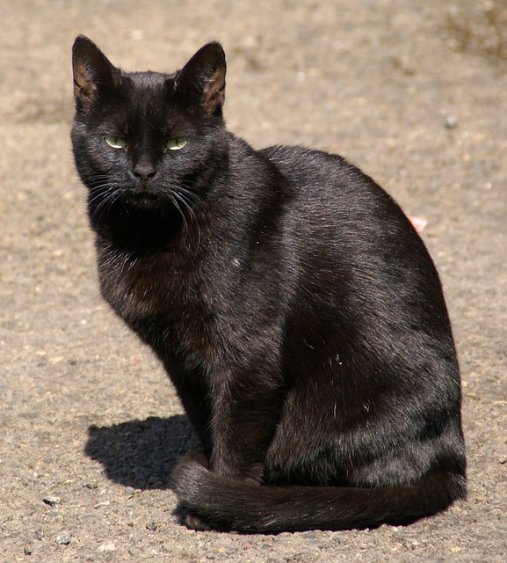
#1504 Do black cats bring bad luck ?
By: Katie Everett

Slide 2
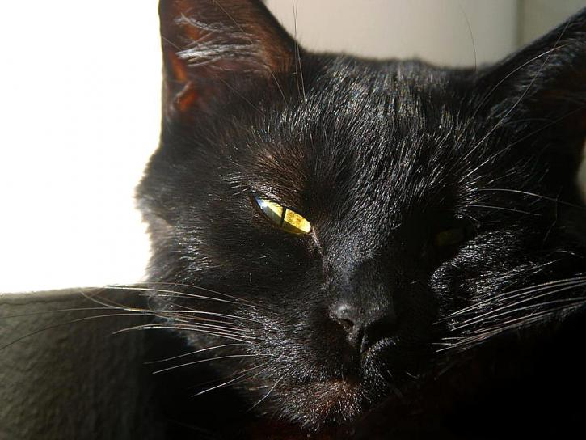
Do black cats bring bad luck?
It is a superstition that black cats bring bad luck.

Slide 3
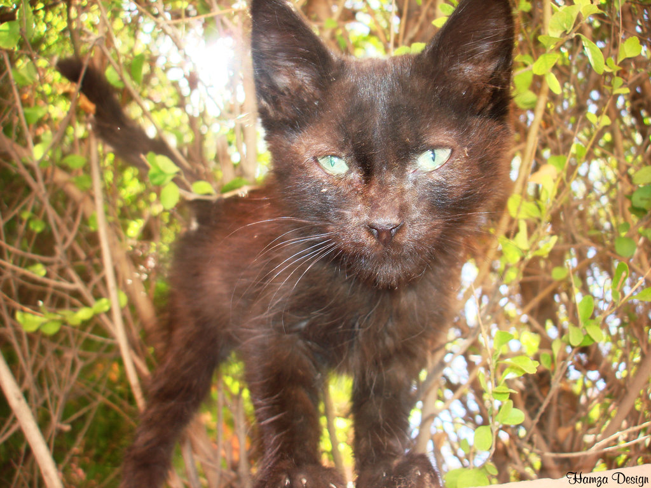
How did the superstitions about black cats get started?
In the mid sixteenth century according to a legend a father and son were traveling on a moonless night. A black cat crossed their path and they threw stones at it until it ran to a lady that was accused of witchcraft. The next day she was bruised and limping.

Slide 4
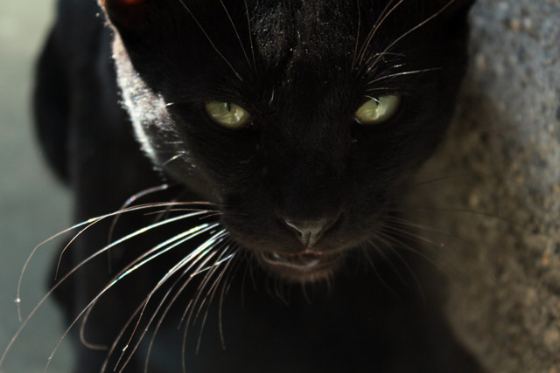
Do any cultures believe black cats bring good luck?
In Scotland, Great Britain,Japan, and Russia many people believe black cats bring good luck.

Slide 5
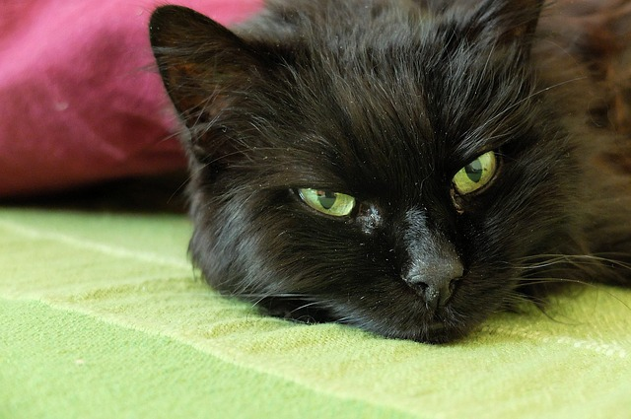
Interesting facts.
Over 5,000 years ago, the ancient Egyptians revered and worshiped cats.A person caught killing a cat could face the death penalty.
In Europe during the mid sixteenth century some older women were accused of witchcraft, many of them owned cats.
You may see black cats for decorations on halloween.

Slide 6
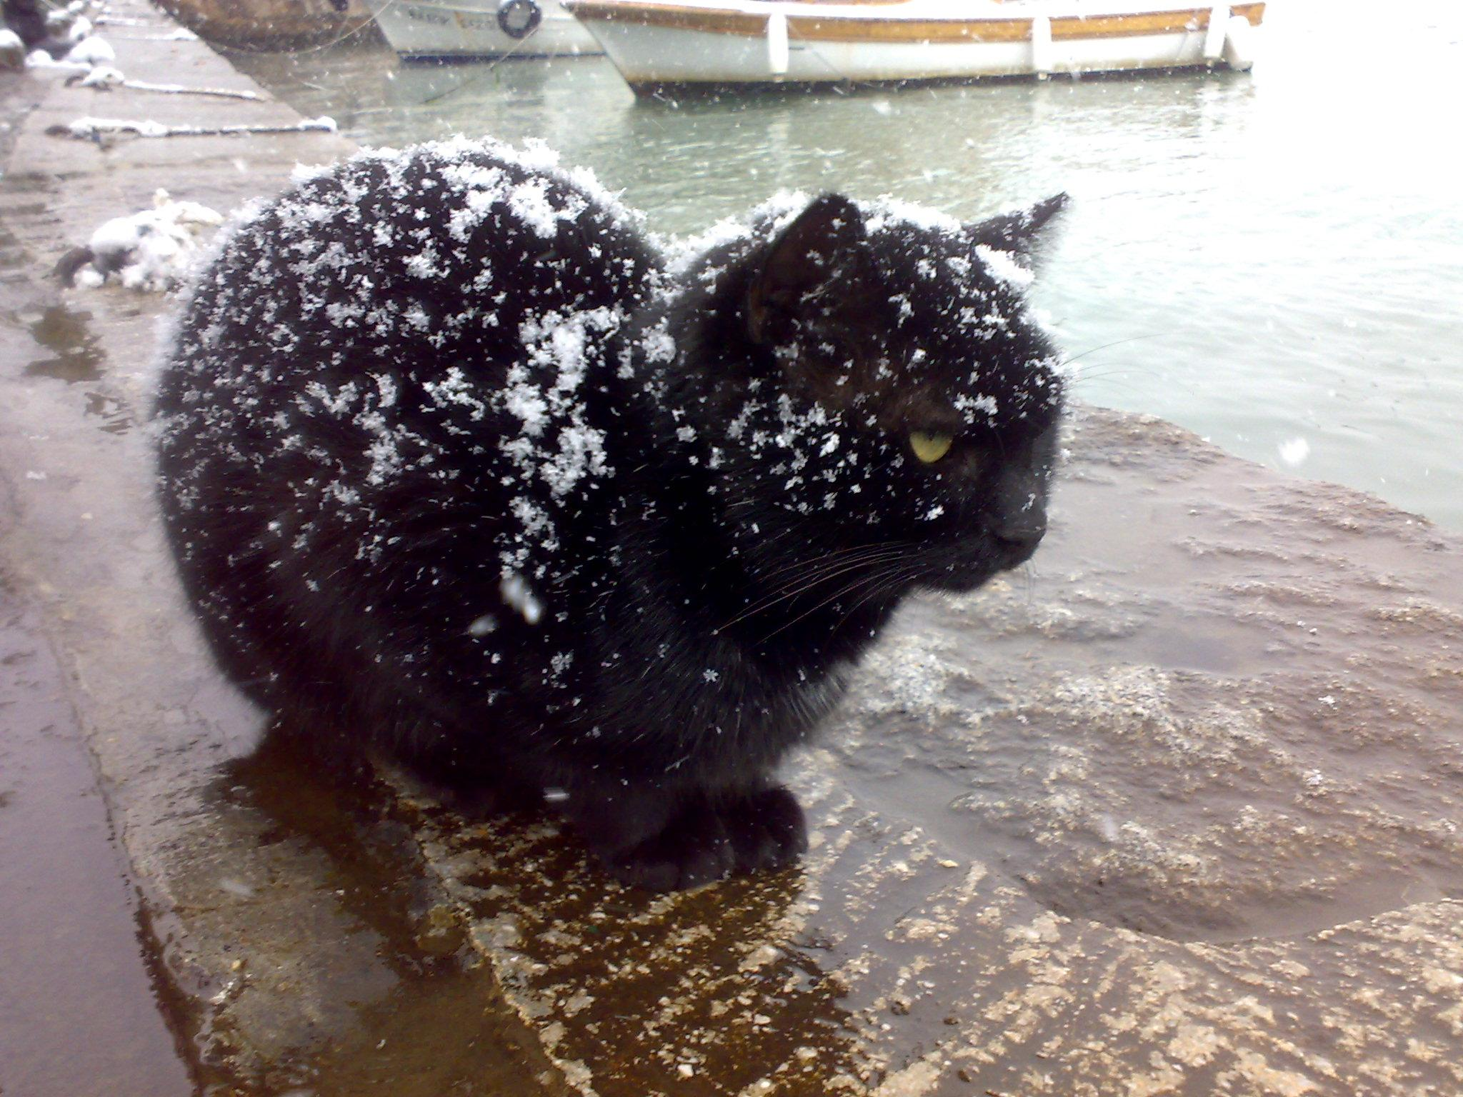
The ancient people of which country revered and worshiped cats?
A. Egypt
B. United States
C. Canada

Slide 7
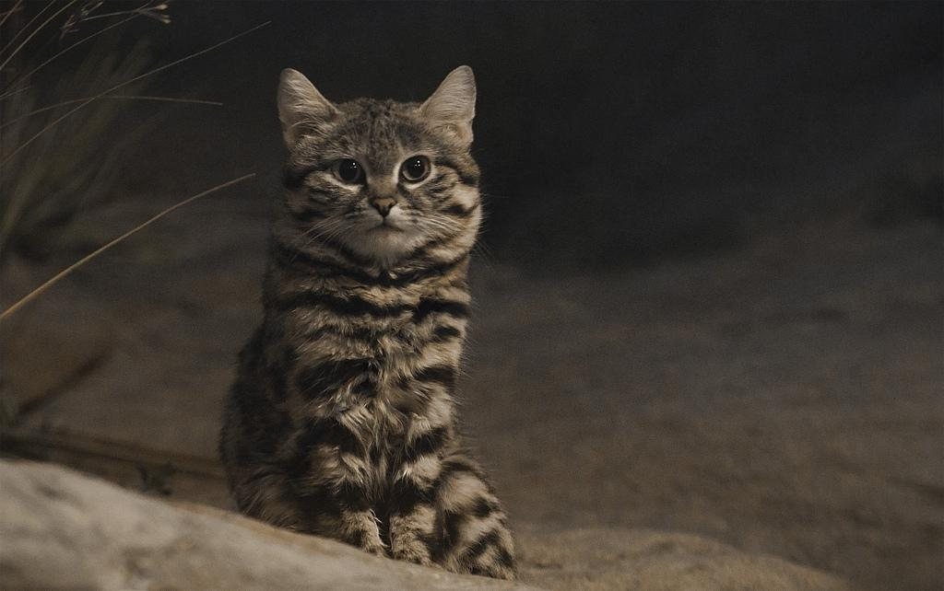
On which continent did fears of witchcraft lead to superstitions about black cats during the middle ages?
A. Europe
B. South America
C. North America
D. Asia

Slide 8
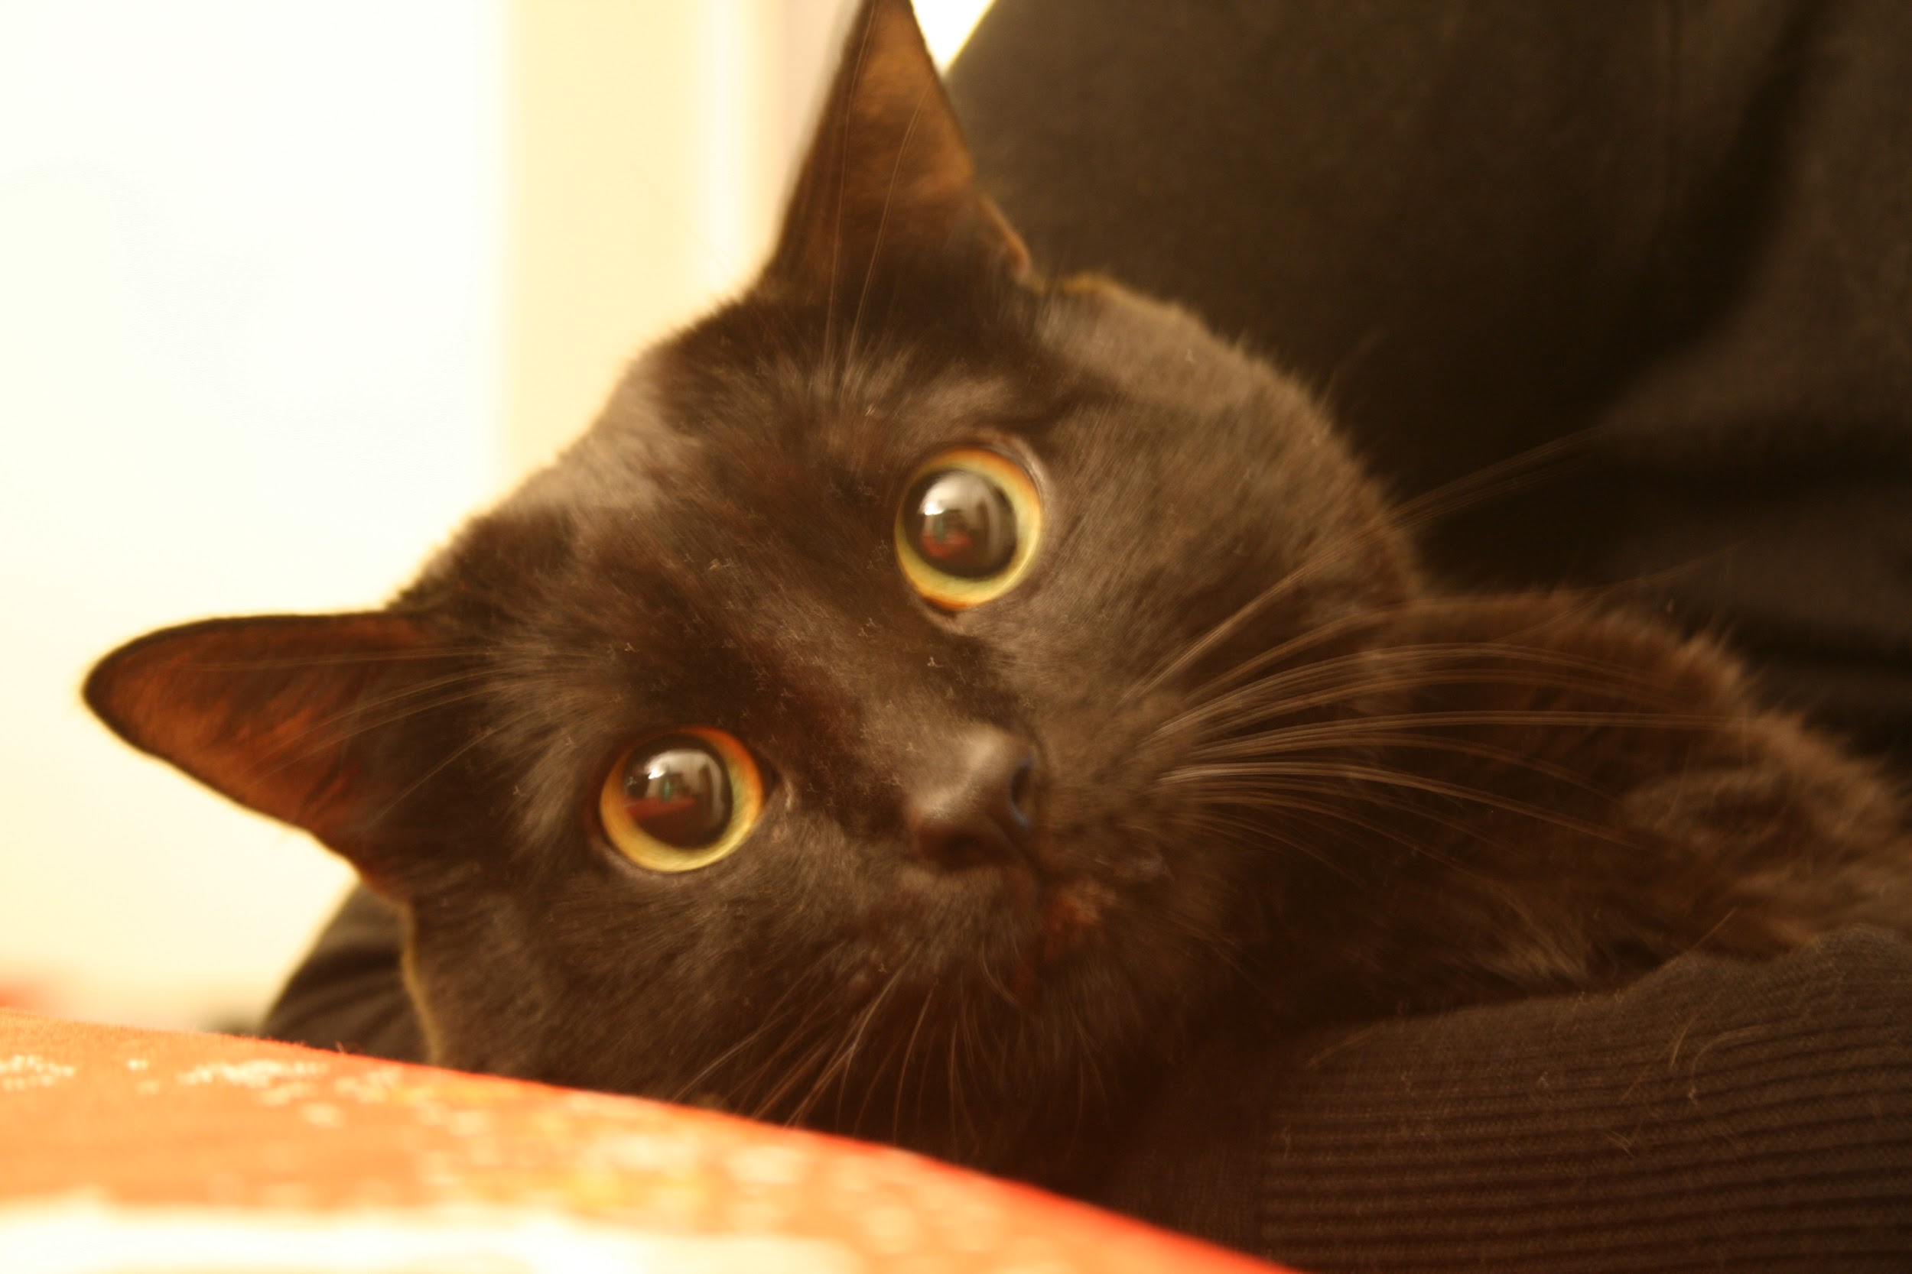
Black cats are often pictured in decoration for which holiday?
A. Halloween
B. Christmas
C. Memorial Day
D. St. Patrick's Day

