Slide 1
#1497 How is nuclear power generated?
By: Chris

Slide 2
How is nuclear power generated?
It is powered by u-235.

Slide 3
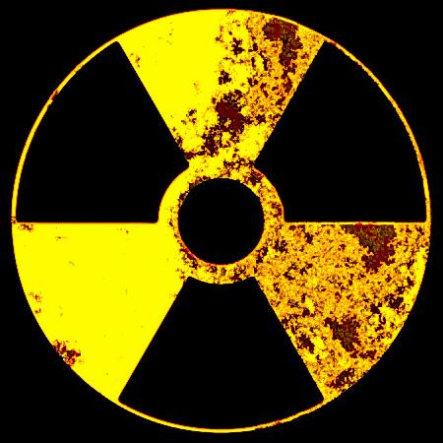
What percentage of electrical power comes from nuclear plants?
In the United States over 100 nuclear plants give us 20% of our electrical power.

Slide 4
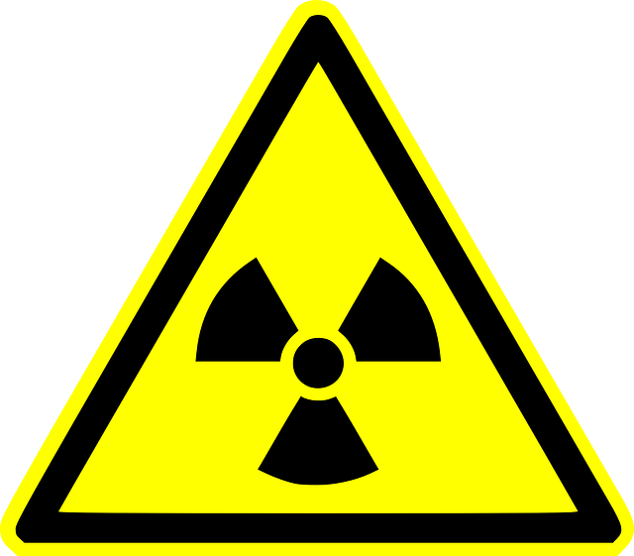
Is nuclear power safe?
No,it can cause disasters including earthquakes and flooding.

Slide 5
Nuclear power can power electronics but it is also dangerous.It can destory cities.Did you know three pounds of highly-enriched u-235 would be equal to 3million gallons of gasoline?

Slide 6
Nuclear power plants generate heat via process called what?
A.nuclear fission
B.hydrotherapy
C.fossil fuel combustion
D.solar energy

Slide 7
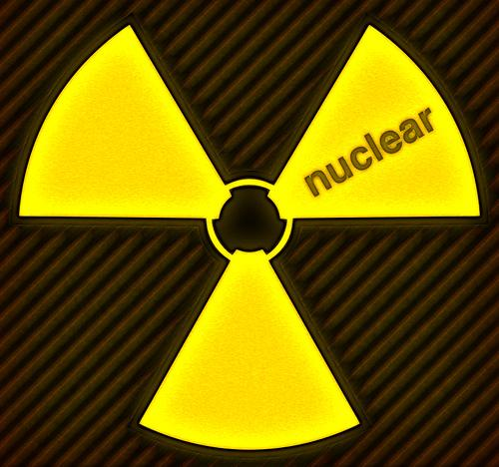
Which radioactive element is used in a nuclear reactor?
A.uranium
B.hydrogen
C.oxygen
D.sodium

Slide 8
Three pounds of highly-enriched u-235 used to power a nuclear submarine would be equal to about how many gallons of gasoline?
A.100
B.200
C.3,000
D.3 million

