Slide 1
Can you eat dandelions? #1508
By Cole

Slide 2
Can you eat dandelions?
yes you can

Slide 3
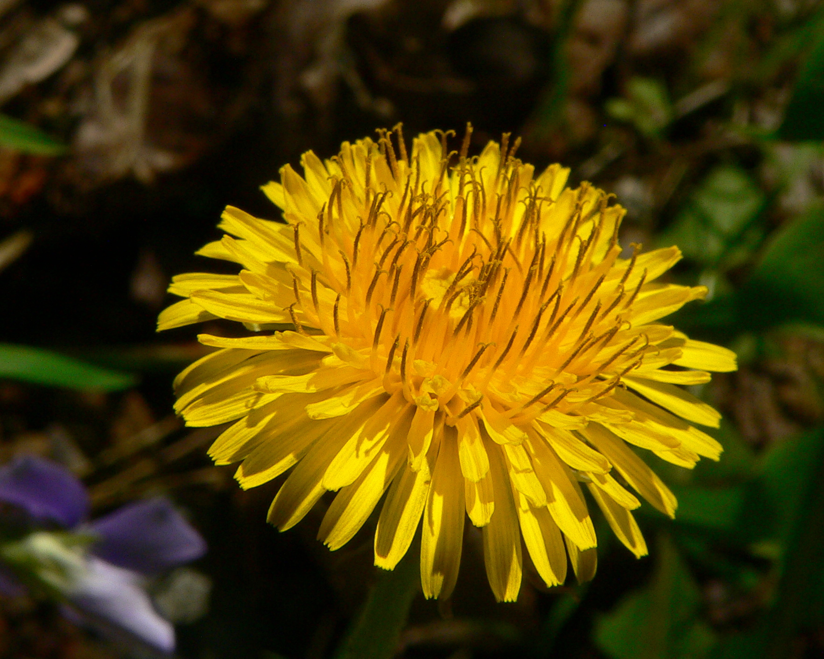
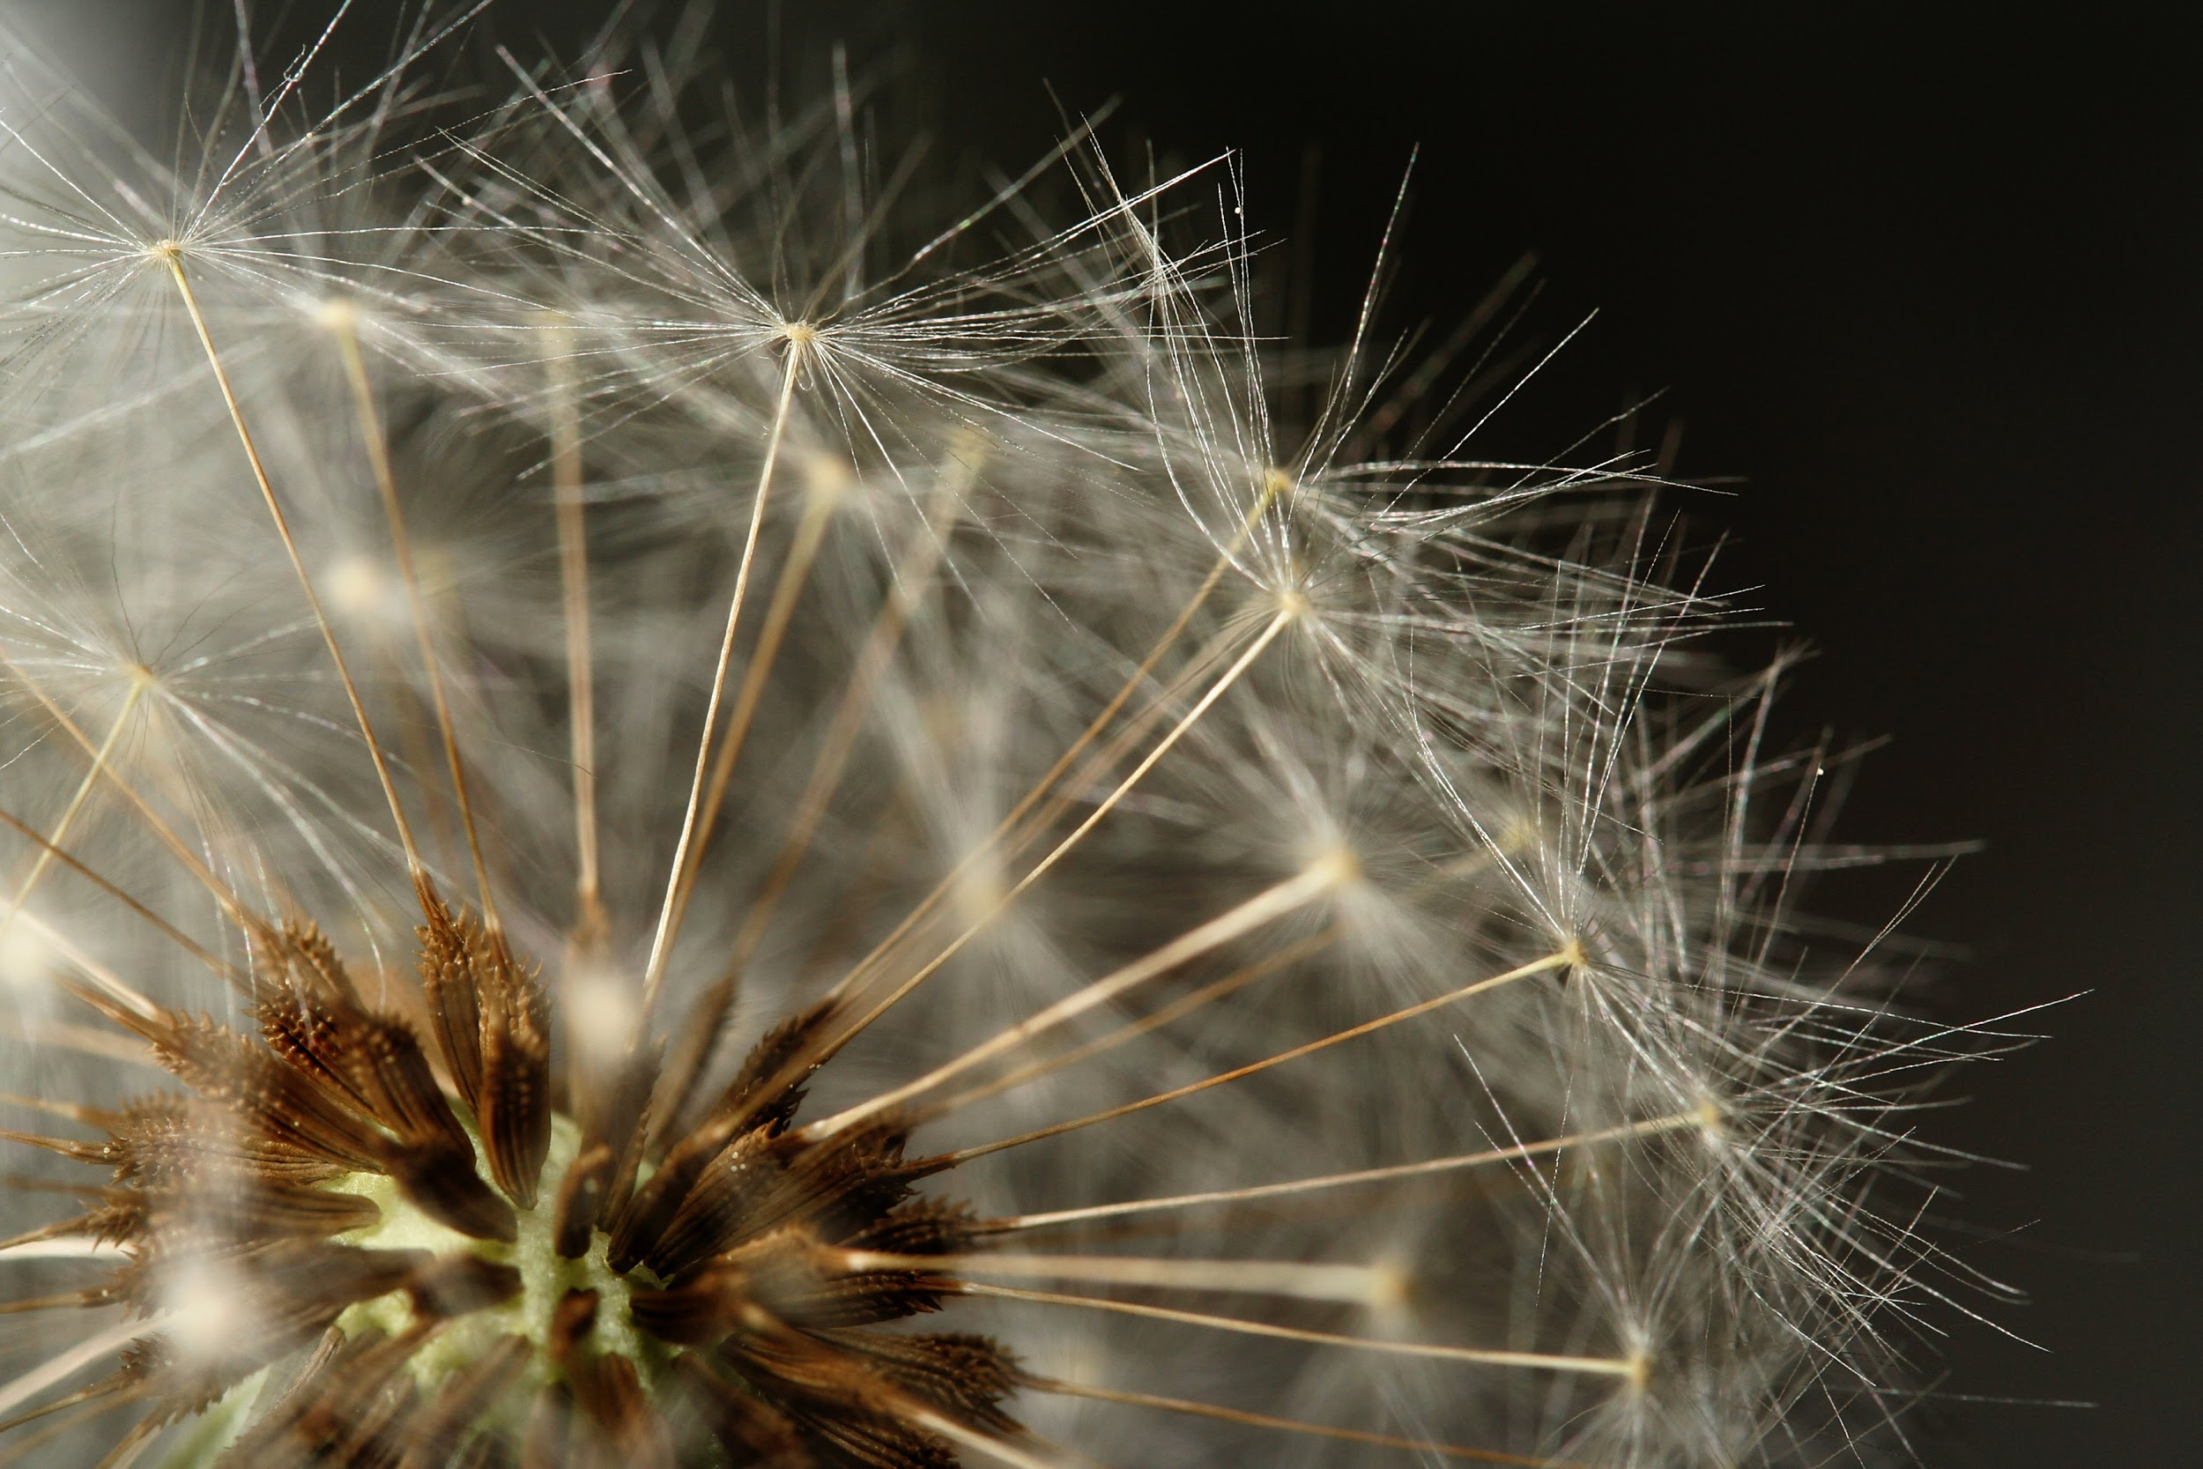
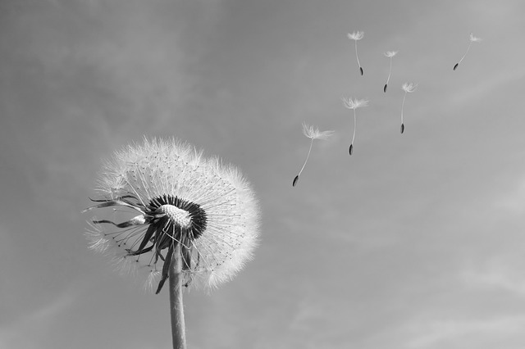
How do dandelions imitate the sun,moon,and stars?
The seed head or the puff ball looks like the moon,and the flowers look like the sun,and when it disperses its seeds they look like the stars

Slide 4
Are dandelions healthy?
They are healthy they can help prevent cancer

Slide 5
Interesting facts.
Dandelions are used in medicines,and every part of a dandelion is useful, they also have vitamin A,vitamin C, Calcium, and iron.They also can be dried ground and roasted to make a drink similar to coffee.

Slide 6
The ‘‘puff ball’’ seed head of a dandelion resembles what celestial body?
Moon
sun
saturn
stars
Notes:
A

Slide 7
Which of the following is not a nutrition found in dandelion greens?
vitamin A
vitamin C
Calcium
polyunsaturated fat
Notes:
B

Slide 8
Dandelion roots can be dried ground,and roasted to make a drink similar to what?
A.soda
b.beer
c.coffee
d.water
Notes:
C

