Slide 1
#1441 How do tornadoes form?????
By Darby

Slide 2
How do tornadoes form?
A tornado forms by a funnel cloud forms if the updraft strengths,it can stretch the funnel cloud causing it to tighten its spin and speed up.If rain and hail from the thunderstorm cause the funnel cloud to lengthen to the point where it touches the ground.

Slide 3
What is a super cell?
A supercell is a severe thunderstorm with updrafts and downdraft.Allowing a storm to maintain itself for several hours.They often produce large hail.Also powerful downpours,very strong winds and sometimes tornadoes.

Slide 4
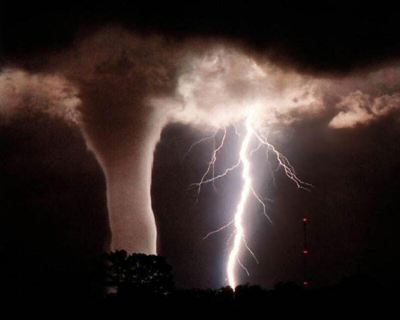
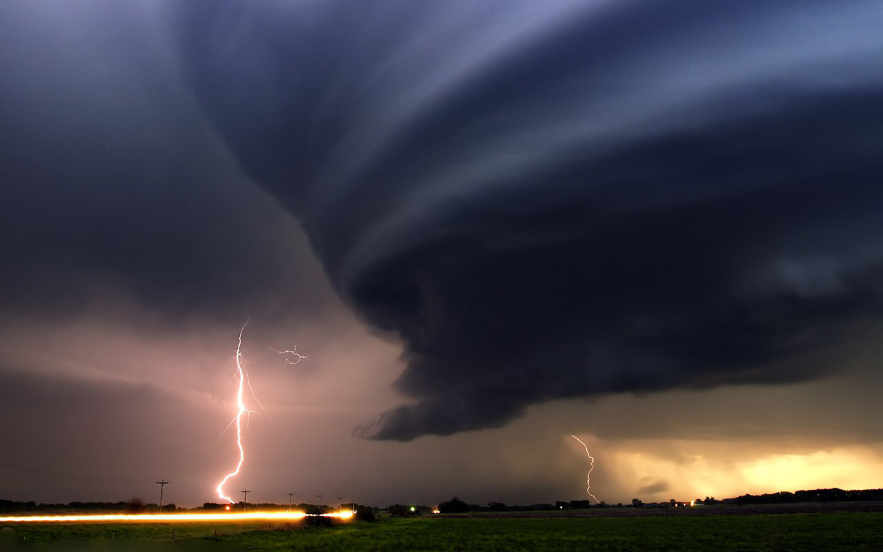
What is wind shear?
Air moving from an area of high pressure.A deformation of an object in which parallel planes remain parallel but are shifted in a direction parallel to themselves.

Slide 5
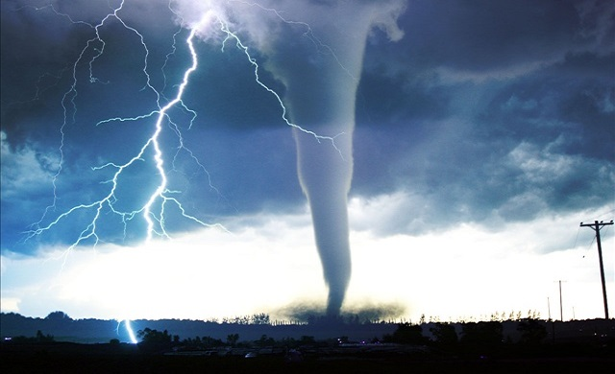
Interesting facts.
Most devastating and destructive forces on earth are tornados.Tornados have hit every single continent but Antarctica.There most common in North America.Tornado alley has as many as 1,000 tornadoes in an average year.Tornadoes most likely happen when there are thunderstorms happening.Scientists are starting to unravel the secrets of tornados.

Slide 6
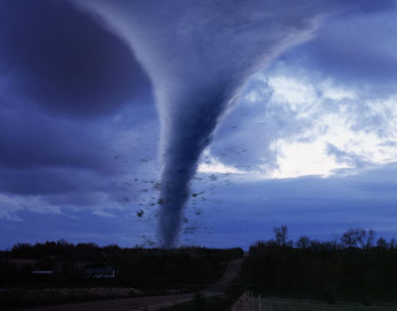
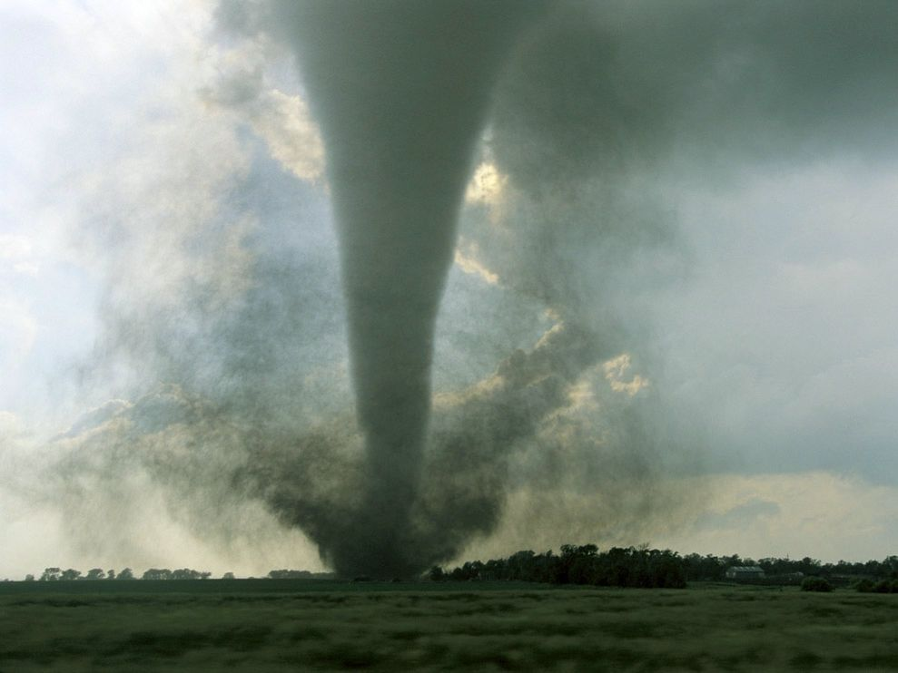
On which continent do most tornadoes form?
A.North America
B.South America
C.Europe
D.Asia

Slide 7
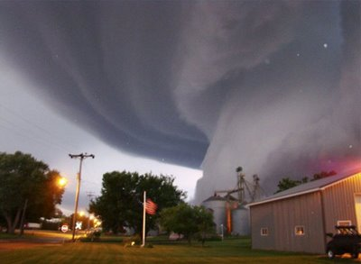
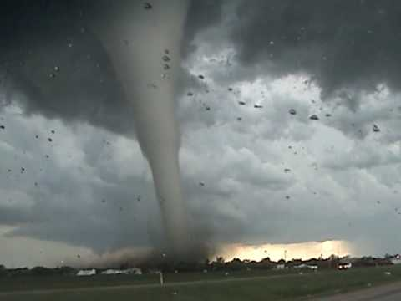
Winds moving at different speeds within a super cell can create phenomenon known as what?
A.Broken wind
B.Tornados
C.Wind shear
D.Water spout

Slide 8
A funnel cloud that touches the ground is called a what?
A.Whirlwind
B.Tornado
C.Windshear
D.Mesocyclone

