Slide 1
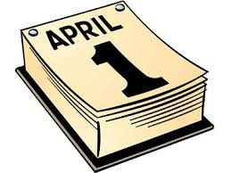
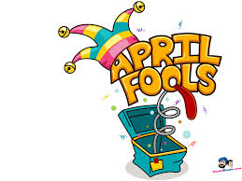
How Did April Fools Begin?
#180
By: Emely Cruz

Slide 2
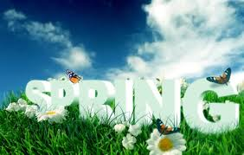
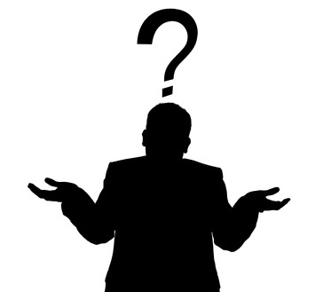
How Did April Fools Begin?
People believe that April Fools’ Day was the result of a desire to celebrate the turning of the seasons around springtime. In fact, many cultures have historically held such celebrations around the beginning of April.For example, the ancient Romans had a festival named Hilaria on March 25. The Hindus celebrate Holi, and the Jews celebrate Purim around this time of year.Eventually, other people began to make fun of these backward “fools” by sending them to look for things that did not exist (called a “fool’s errand”) or tricking them into believing something false.Although we can’t really pinpoint how or when April Fools’ Day got its start, people the world over still celebrate it with glee year in and year out.
mmh…...I wonder why?.....

Slide 3
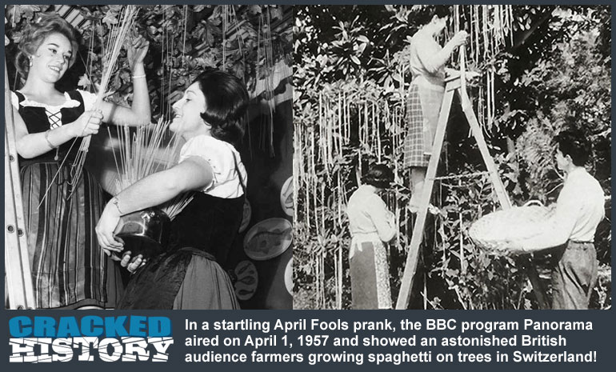
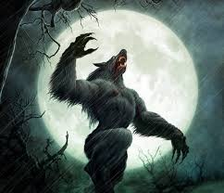
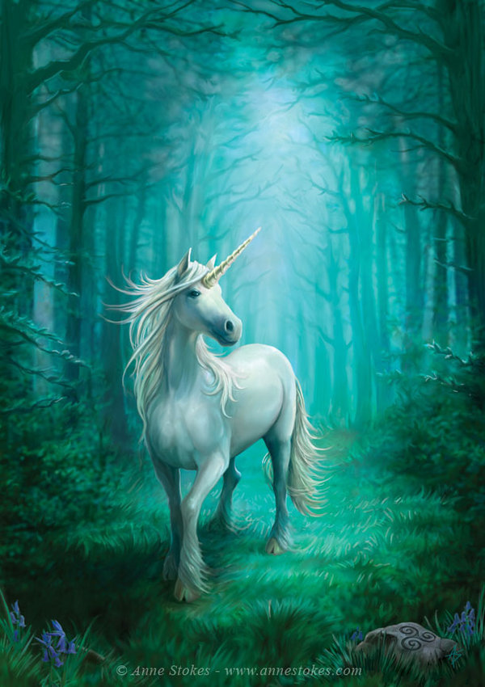
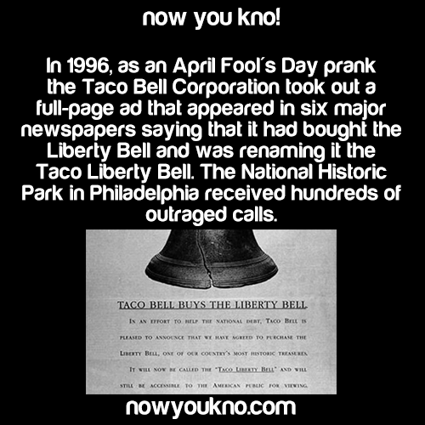
What Is A “Fool’s Errand”?
A “fool’s errand”is when other people began to make fun of these backward“fools” by sending them to look for things that did not exist or tricking them into believing something false.

Slide 4
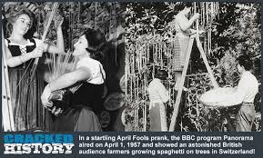
What Are Some Of The BEST April Fool’s Day Hoaxes?
One of the best hoaxes was “Taco” Liberty Bell in 1996, Taco Bell announced that it had bought the Liberty Bell to help ease the national deficit. When the company claimed it would be renaming it the Taco Liberty Bell, thousands of citizens were fooled and called to complain. The company revealed it was a practical joke few hours later, but not before reporters asked White House press secretary Mike McCurry about the sale. Creating a joke of his own, he responded that the Lincoln Memorial had also been sold and would now be known as the Ford Lincoln Mercury Memorial!
Swiss Spaghetti Trees In 1957, the British Broadcasting Company from BBC news program Panorama announced that Swiss farmers were harvesting a record spaghetti crop thanks to the elimination of the spaghetti weevil. News footage showed Swiss peasants pulling spaghetti from trees. Thousands of viewers were fooled. The BBC reported receiving many calls inquiring how to grow spaghetti trees!

Slide 5
Interesting facts.
April fools is sometimes called “All fools day”.
April fools is not a legal holiday.
April fools is celebrated all around the world.
People used to celebrate News year’s day on the first day of April.
(P.S my birthday is the 1st day of April).
http://wonderopolis.org/
FUN

Slide 6
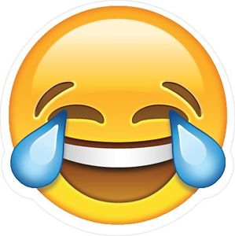
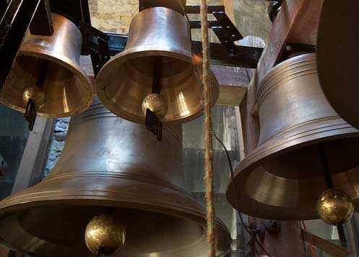
What Do You Call A Fairy That Doesn't Take Baths?
Stinker Bell!

Slide 7
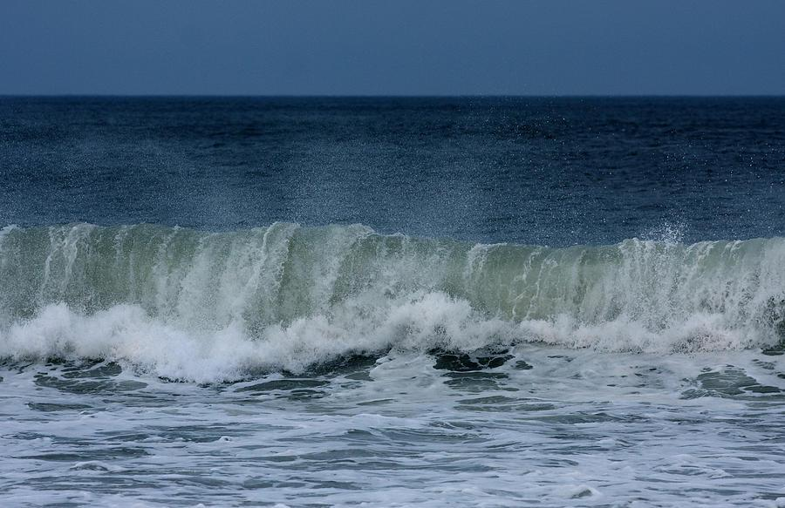
What Did The Beach Say When The Tide Came In?
Long time no
SEA!

Slide 8
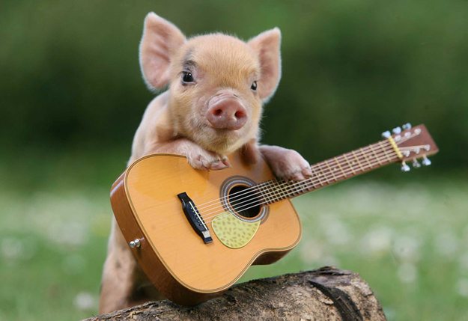
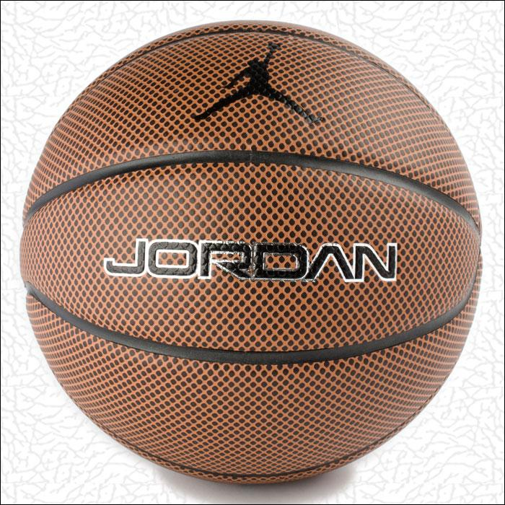
Why Can’t You Play BasketBall With Pigs?
Because they HOG the ball!

