Slide 1
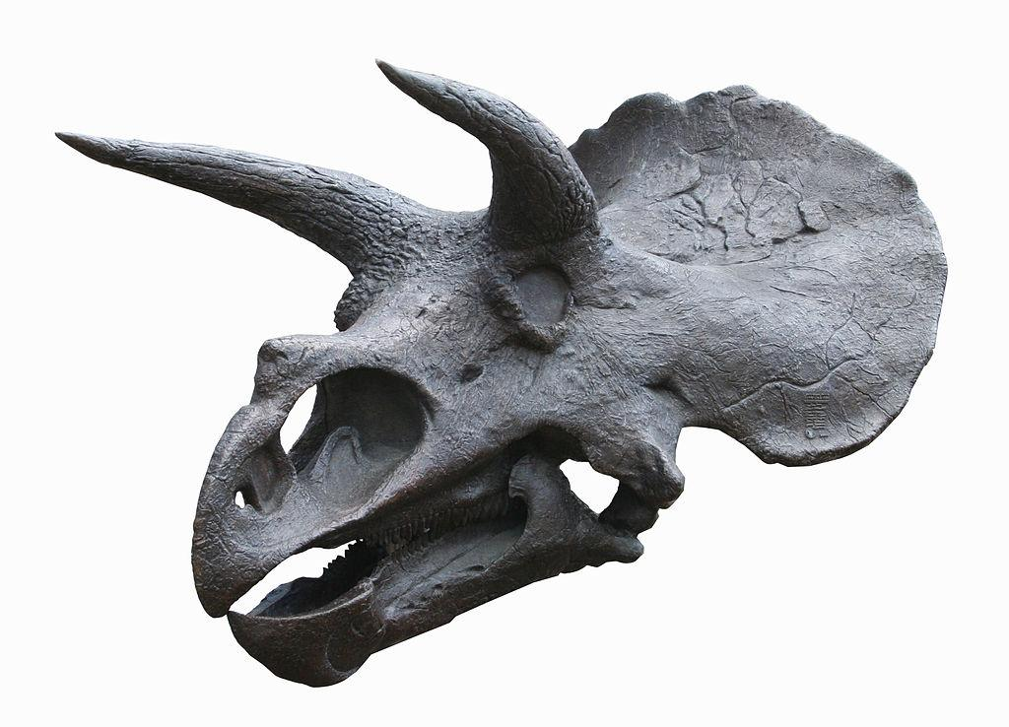
# 1028
What is a paleontologist?
By: Ethan Morris

Slide 2
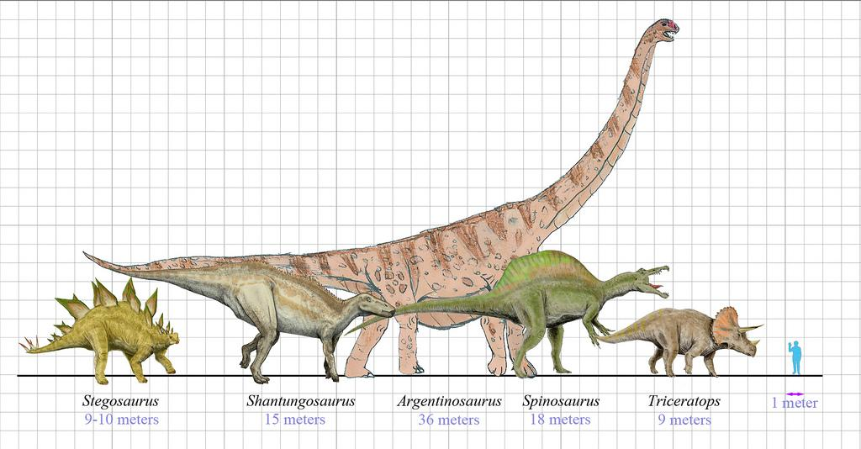
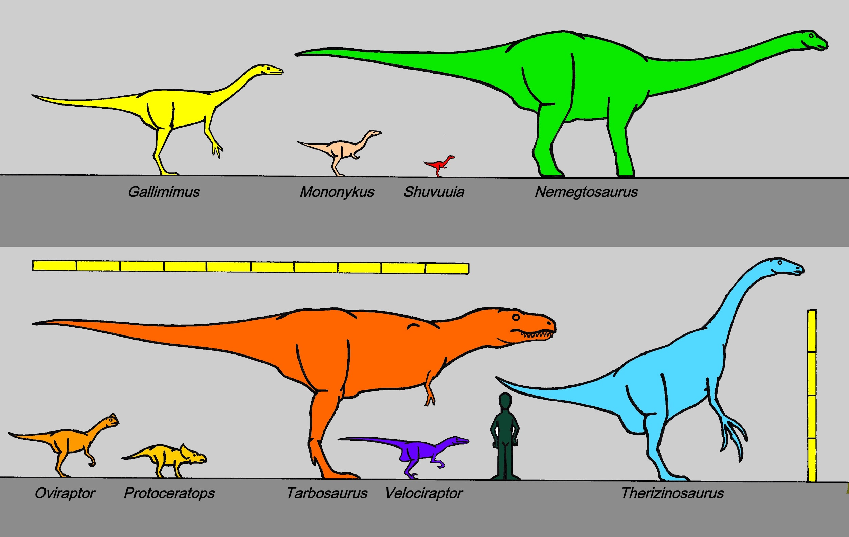
What do you think life was like millions of years ago?
Life millions of years ago was the age of the dinosaurs. The dinosaurs ruled the earth and they were the dominate species.

Slide 3
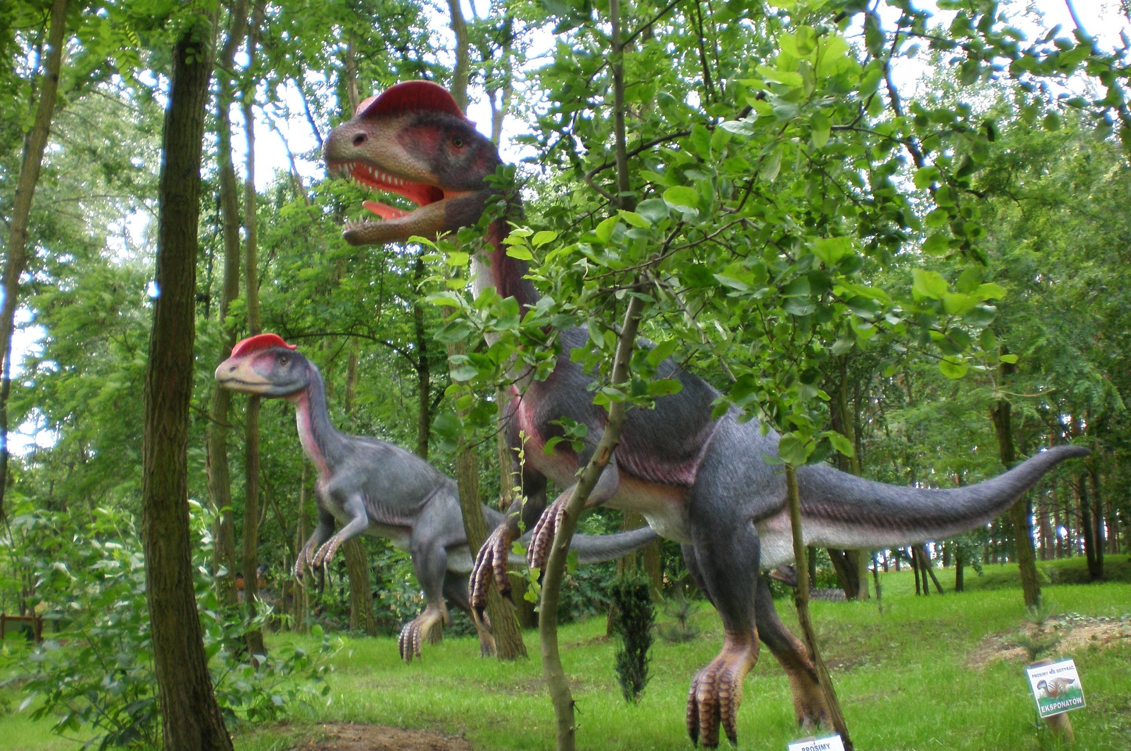
What is the first dinosaur to be discovered?
The first dinosaur to be discovered was the dilophosaurus. This preditory animal can spit venom at its prey.

Slide 4
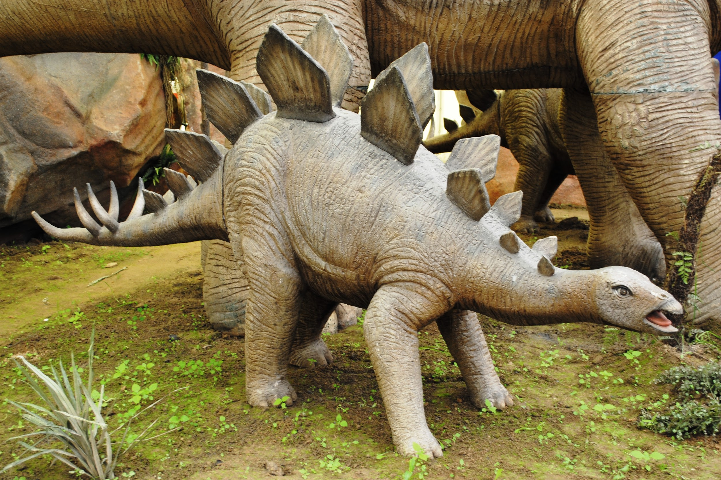
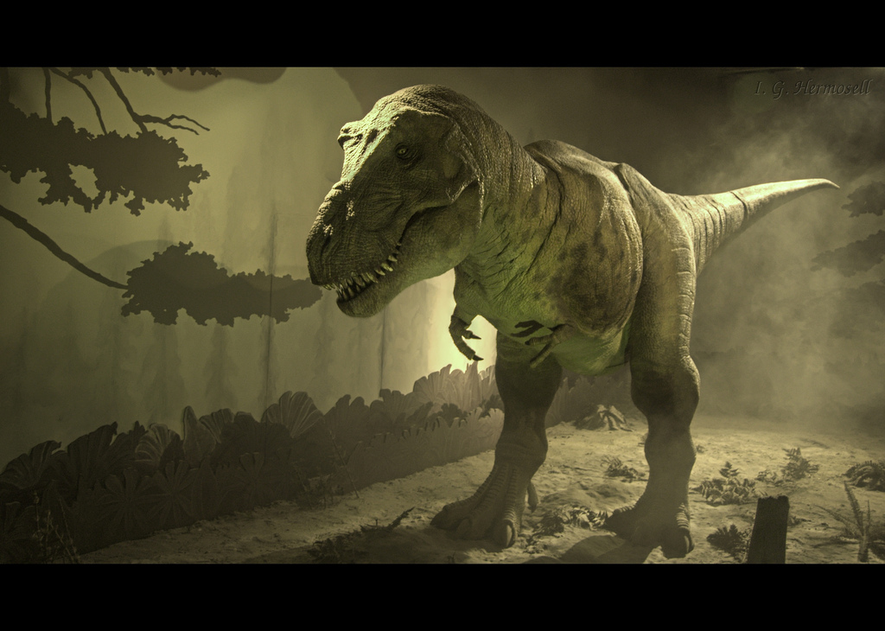
Did a T-Rex ever chase a Stegosaurus?
The answer to my question is no because a T-rex did not live in the same time period as a Stegosaurus!
T-Rex never chased a Stegosaurus because they did not live at the same time period.

Slide 5
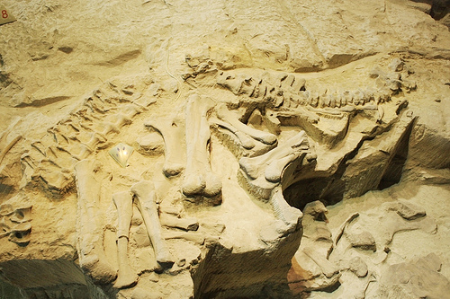
Interesting facts
A Paleontologist is somebody that looks for fossilized bone or tree sap called amber. A paleontologist might do field work and lab experaments.

Slide 6
Who is a scientist who study life on earth millions of years ago?
Paleontologist
Lifeologist
Biologist
Dinosaurology

Slide 7
What do paleontologists look for when they dig in the field?
Letters
Fossils
Oil
Treasure

Slide 8
What might a paleontologist do?
Field work
Research
Lab Experiments
All of the above

