Slide 1
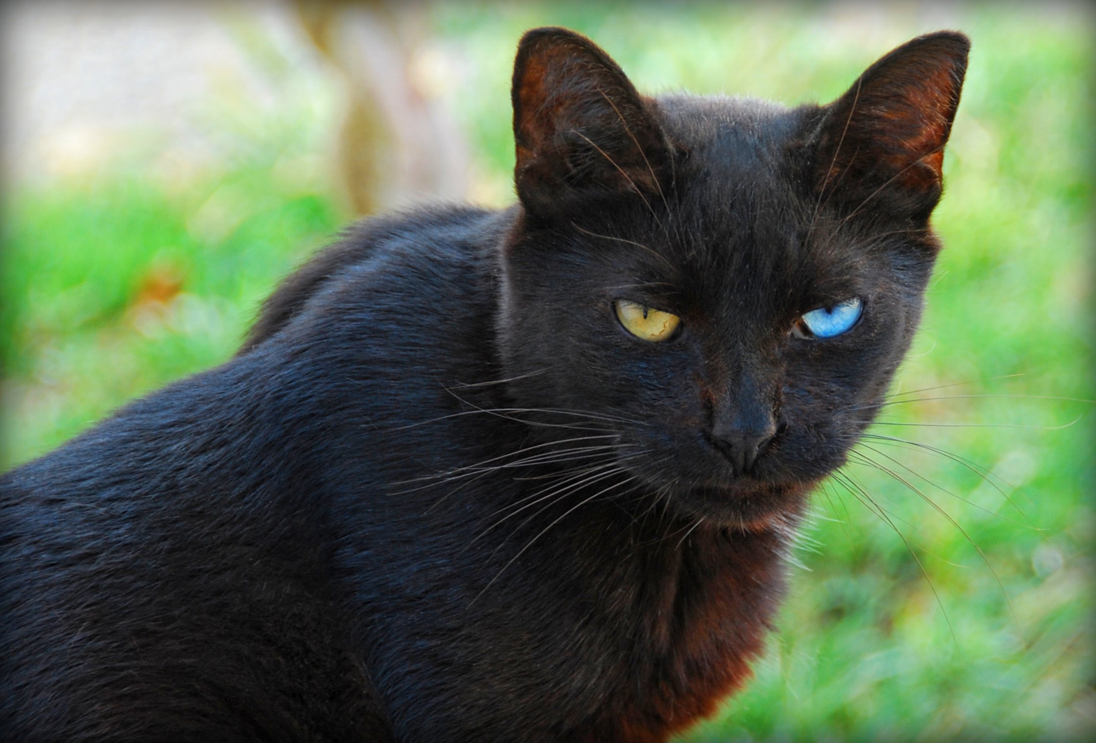
1504# Do black cats bring bad luck?
By: Evan Smith

Slide 2
Do black cat bring bad luck?
No because I have went under a ladder broke 4 mirrories and nothing has happened to me. And I have a black cat at my street walks by me every day.What i'm trying to say is bad luck is fake.

Slide 3
How did superstitions about black cats get started?
When people started using witch craft.It started during the middle age
at Europe.Plus people where thinking
black cats turn into witches.

Slide 4
Do any culture think black cats bring good luck?
Egypt worshiped black cats for 5,000 years.

Slide 5
Interesting facts.
Black cats aren’t bad luck,they just normal cats.

Slide 6
The ancient people of which country revered and worshipped cat over 5,000 years ago?
A.Egypt
B.United States
C.Canada
D.Finland Test Time

Slide 7
Of which continent did fear of witchcraft lead to superstition about “black cat’’ during the middle age?
A.North America
B.South America
C.Asia Test Time
D.Europe

Slide 8
Black cat are often pictured for which holiday
A.Christmas
B.Memorial Day
C.Halloween Test Time
D.St.Patrick Day

