Slide 1
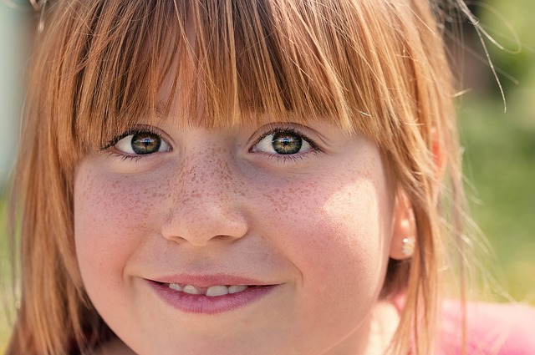
WHERE DO FRECKLES COME FROM?
#261
By:Jordan Toler

Slide 2
What causes freckles?
Freckles Are caused by sunlight.The suns ultraviolet rays radiation causes melanocytes to make more melanin which can cause freckles to appear or become darker.So people have more melinan in them than others which causes freckles.

Slide 3
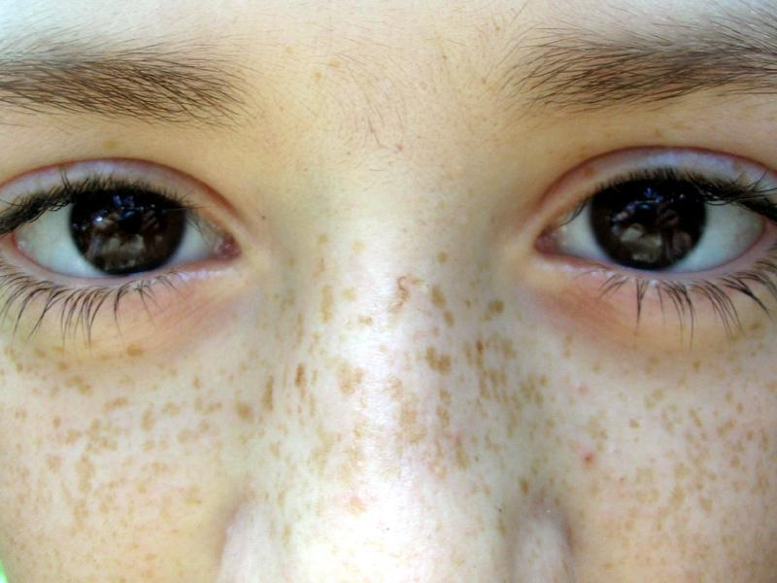
What is Melanin?
Melanin is a chemical made by skin cells called melanocytes .

Slide 4
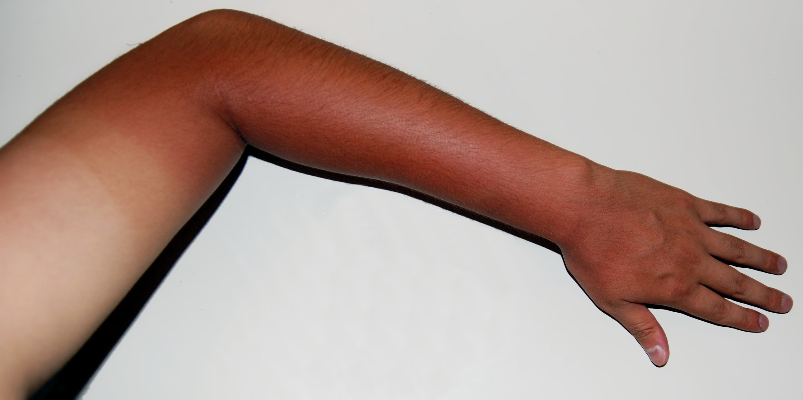
Why do some people tan easily than others?
The melanin in your skin is what makes you look tan.The more melanin you have in your skin the easier it is to get tan.

Slide 5
FUN FACT
Freckles are caused by the sun.

Slide 6
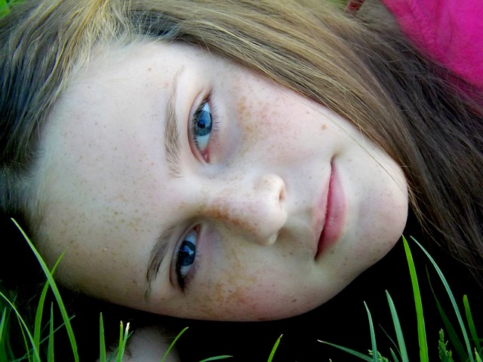
Freckles are just skin cells that contain a pigment called what?
melanin
sunshine
caffeine
swine

Slide 7
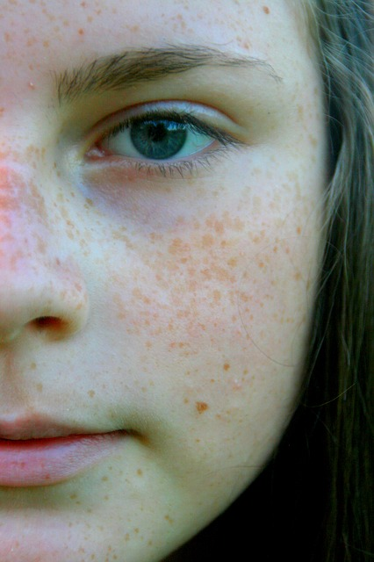
Melanin is a chemical made by skin cells called what?
A.epithelials
B.melanocytes
C.elbows
D.ultraviolets

Slide 8
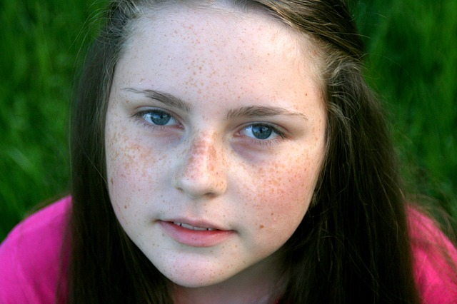
Melanin helps to protect the skin from what?
A.water
B.carbon monoxide
C.ultraviolet rays
D.scrapes

