Slide 1
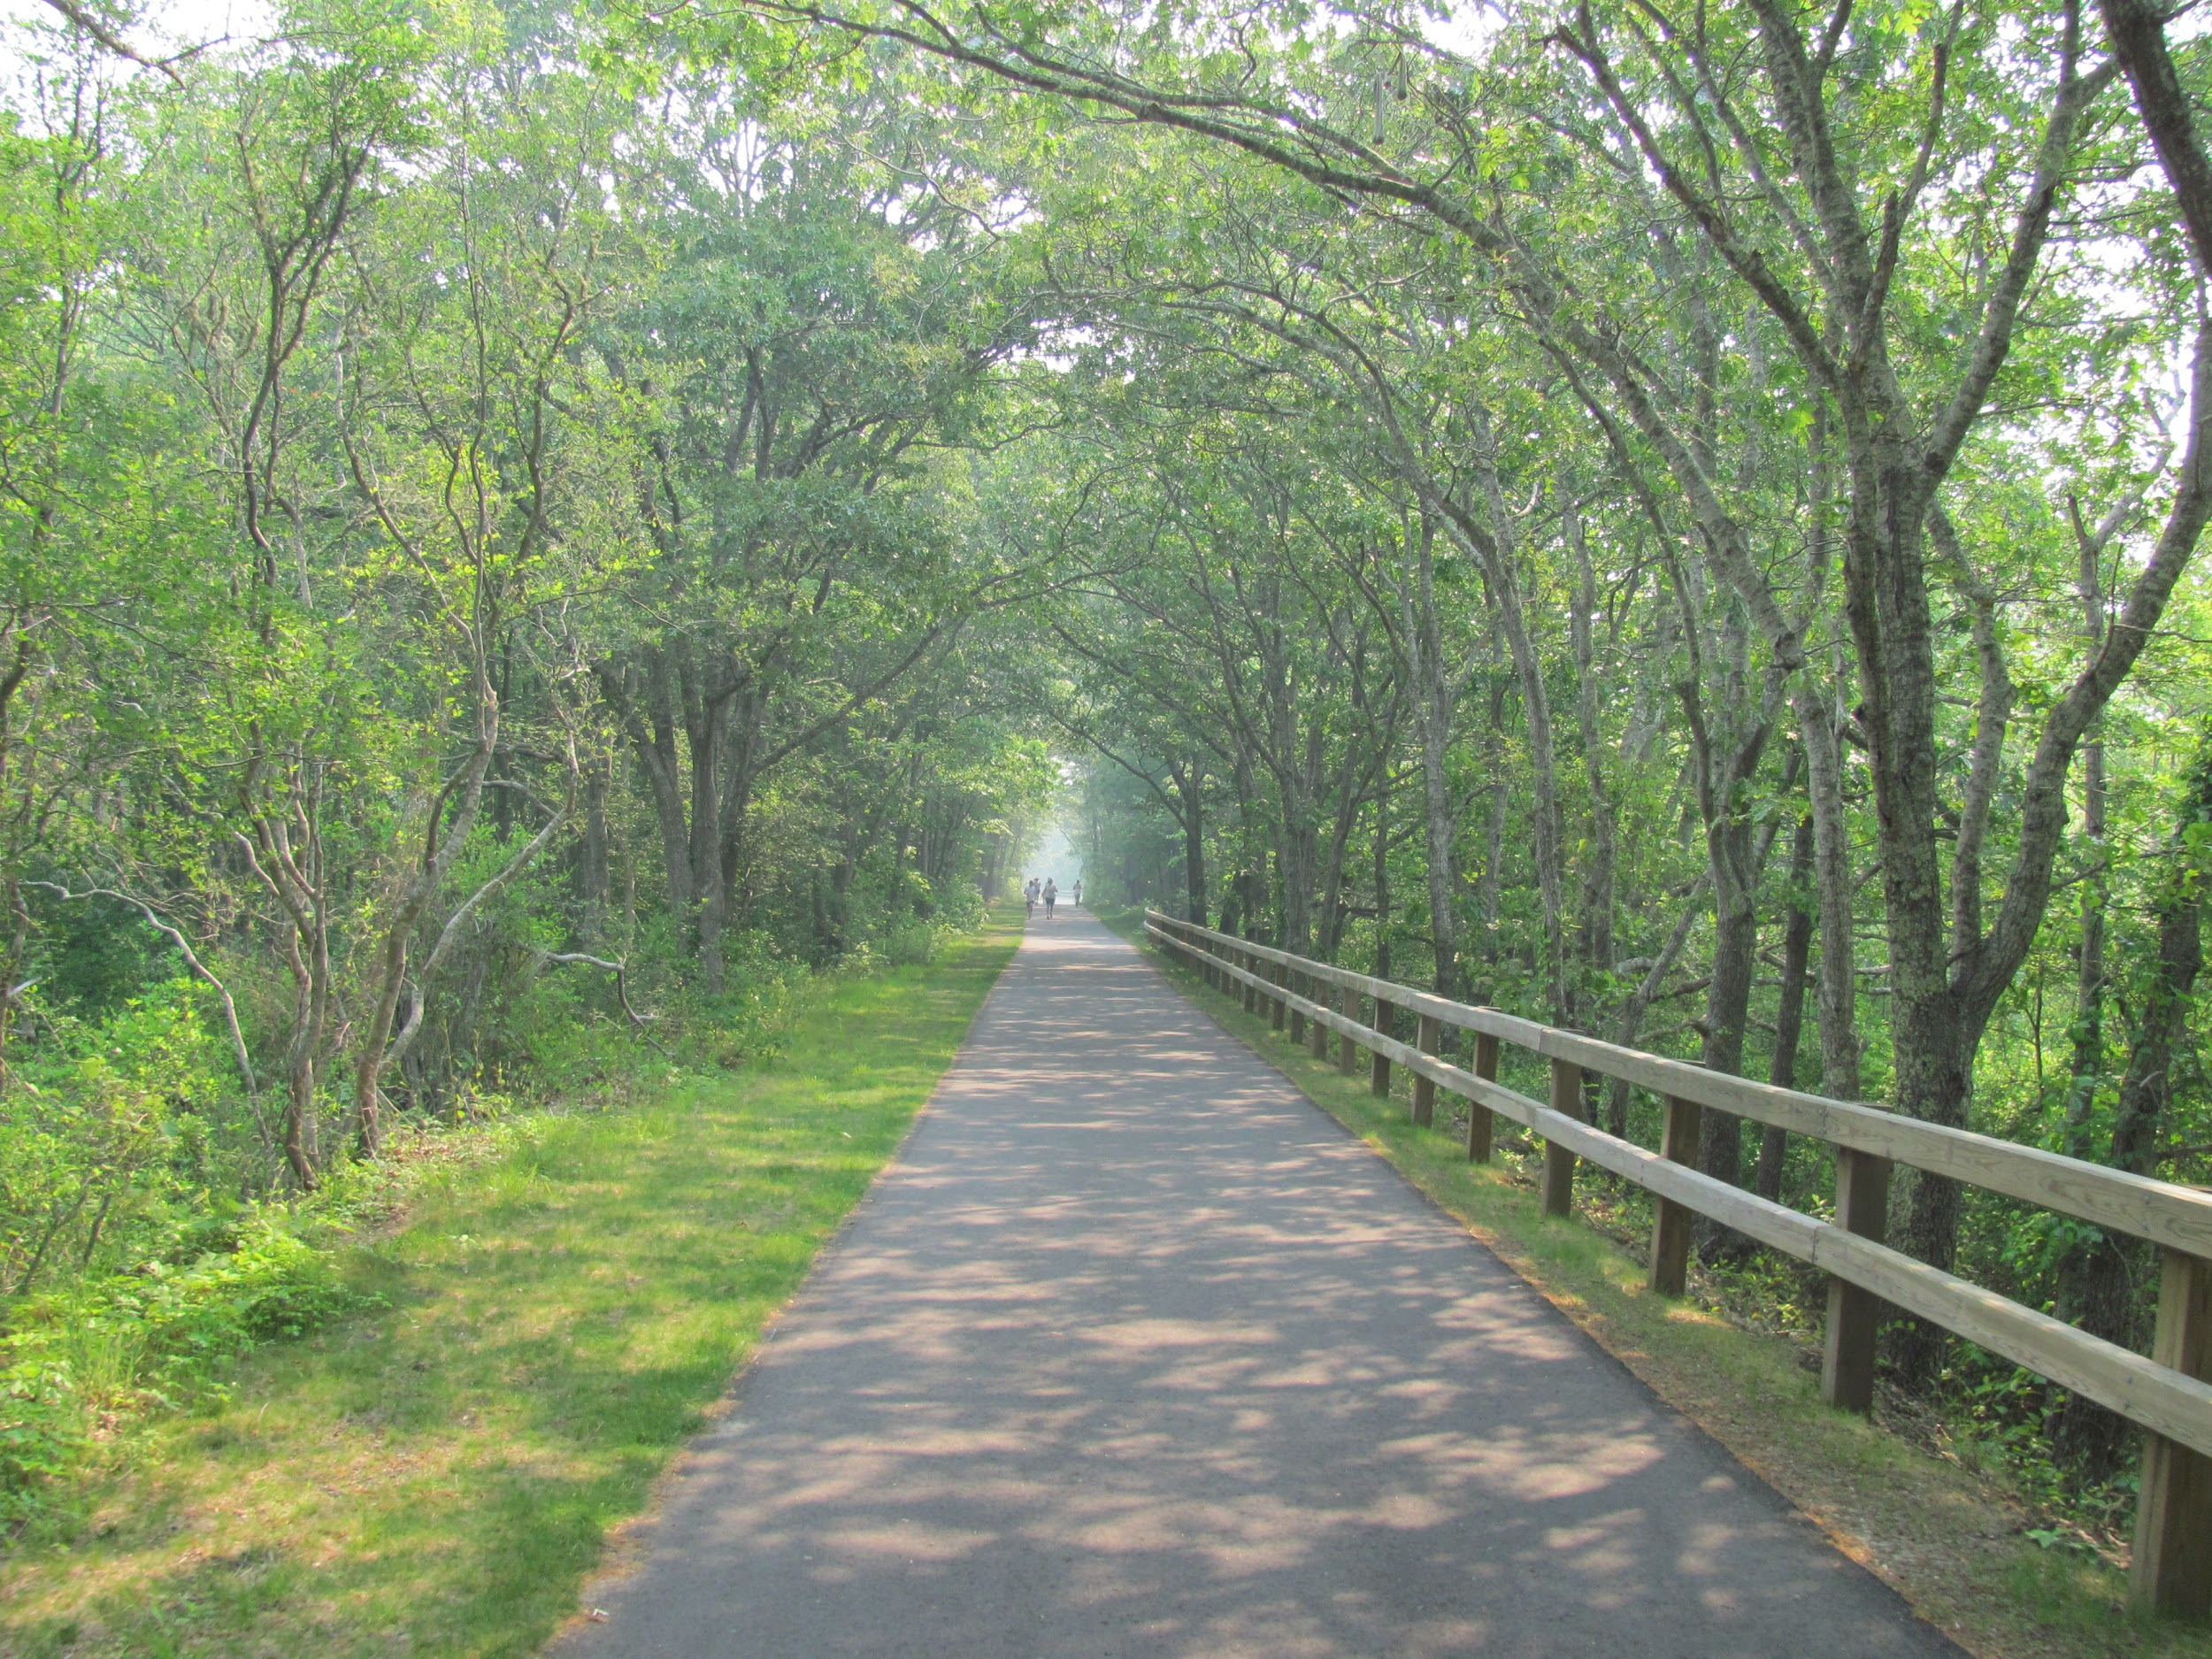
#1469
What happens to old train tracks.
By:Kaleigh Smith

Slide 2
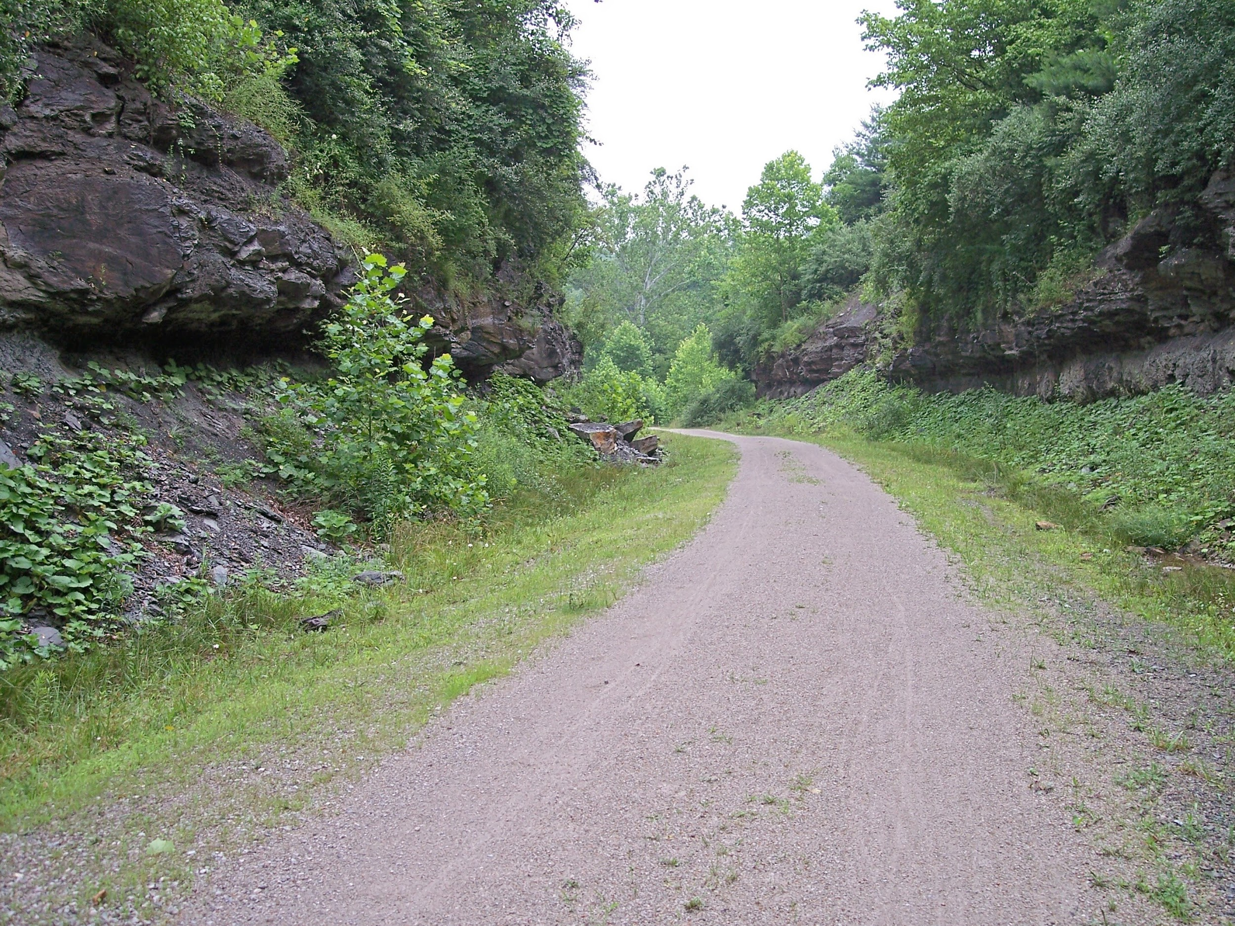
What happens to old train tracks ?
Old train tracks get turned into rail trail.s.

Slide 3
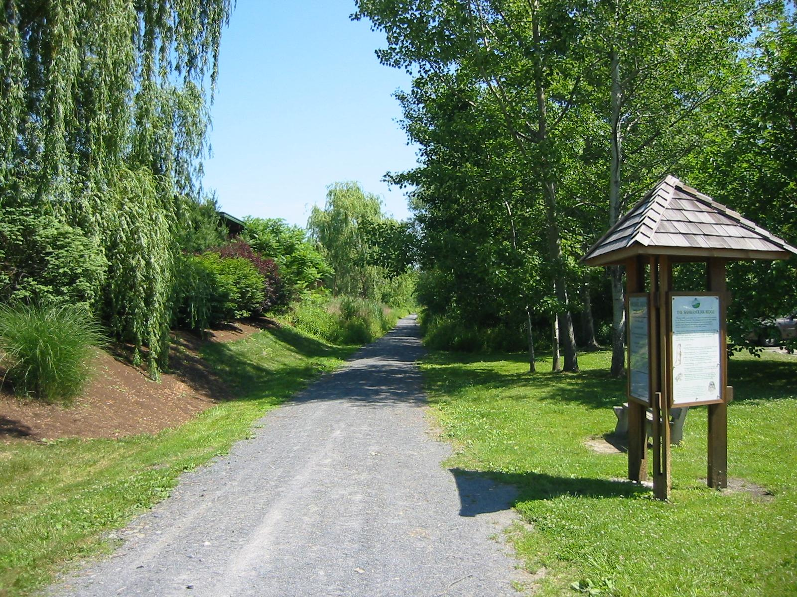
What is a rail trail?
A rail trail is a trail mostly is in the woods so when your walking you see the beautiful things of nature .

Slide 4
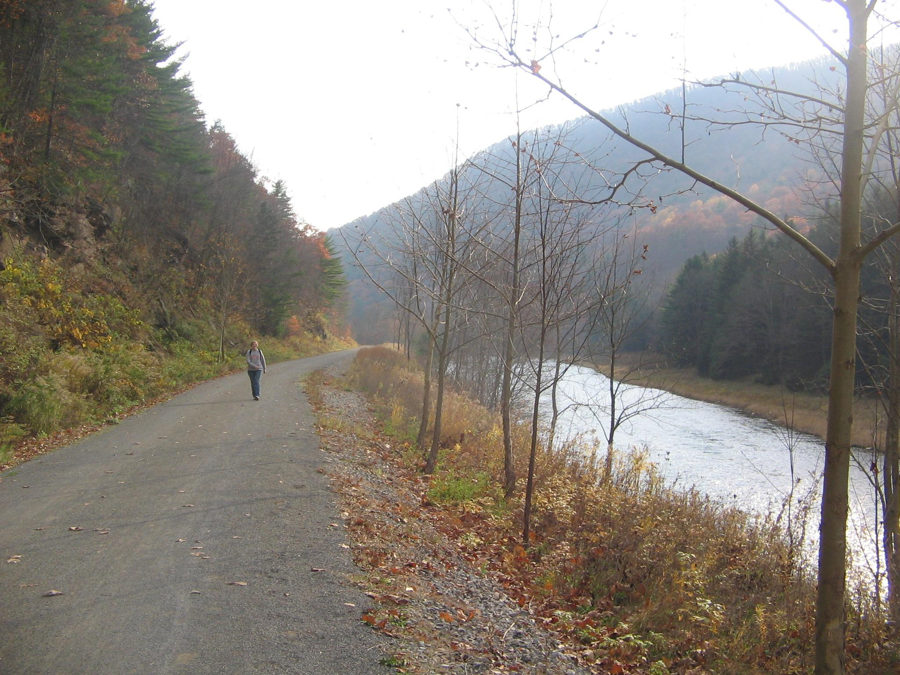
How many miles of rail trails are there in the U.S.A?
There are 30,000 miles of rail trails and the rails- to -trails conservancy are working on 8,000 more miles.

Slide 5
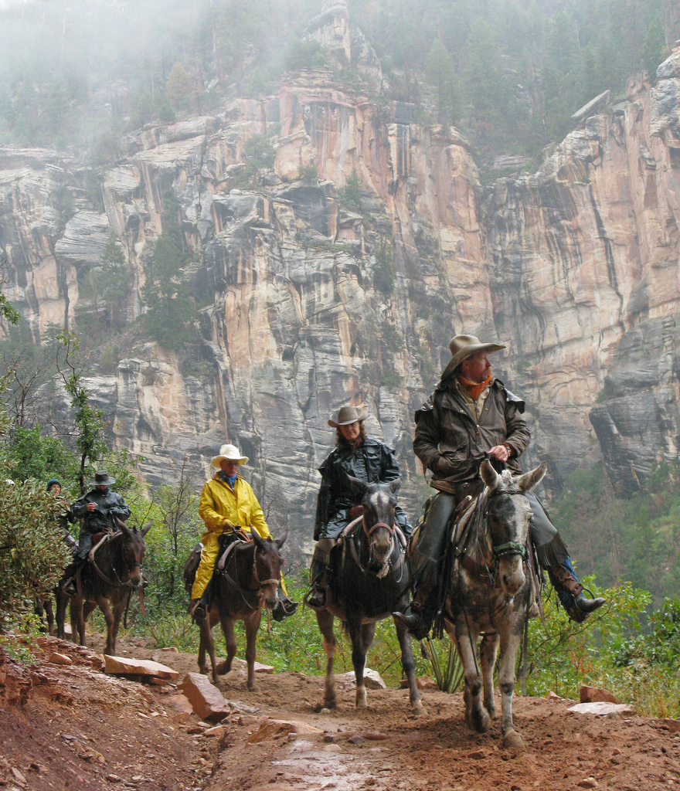
Fun Fact
Rail trails are made for walking ,cycling and sometimes even horse riding.The physical parts of an old rail road is recycled and turned in to a raail trail.

Slide 6
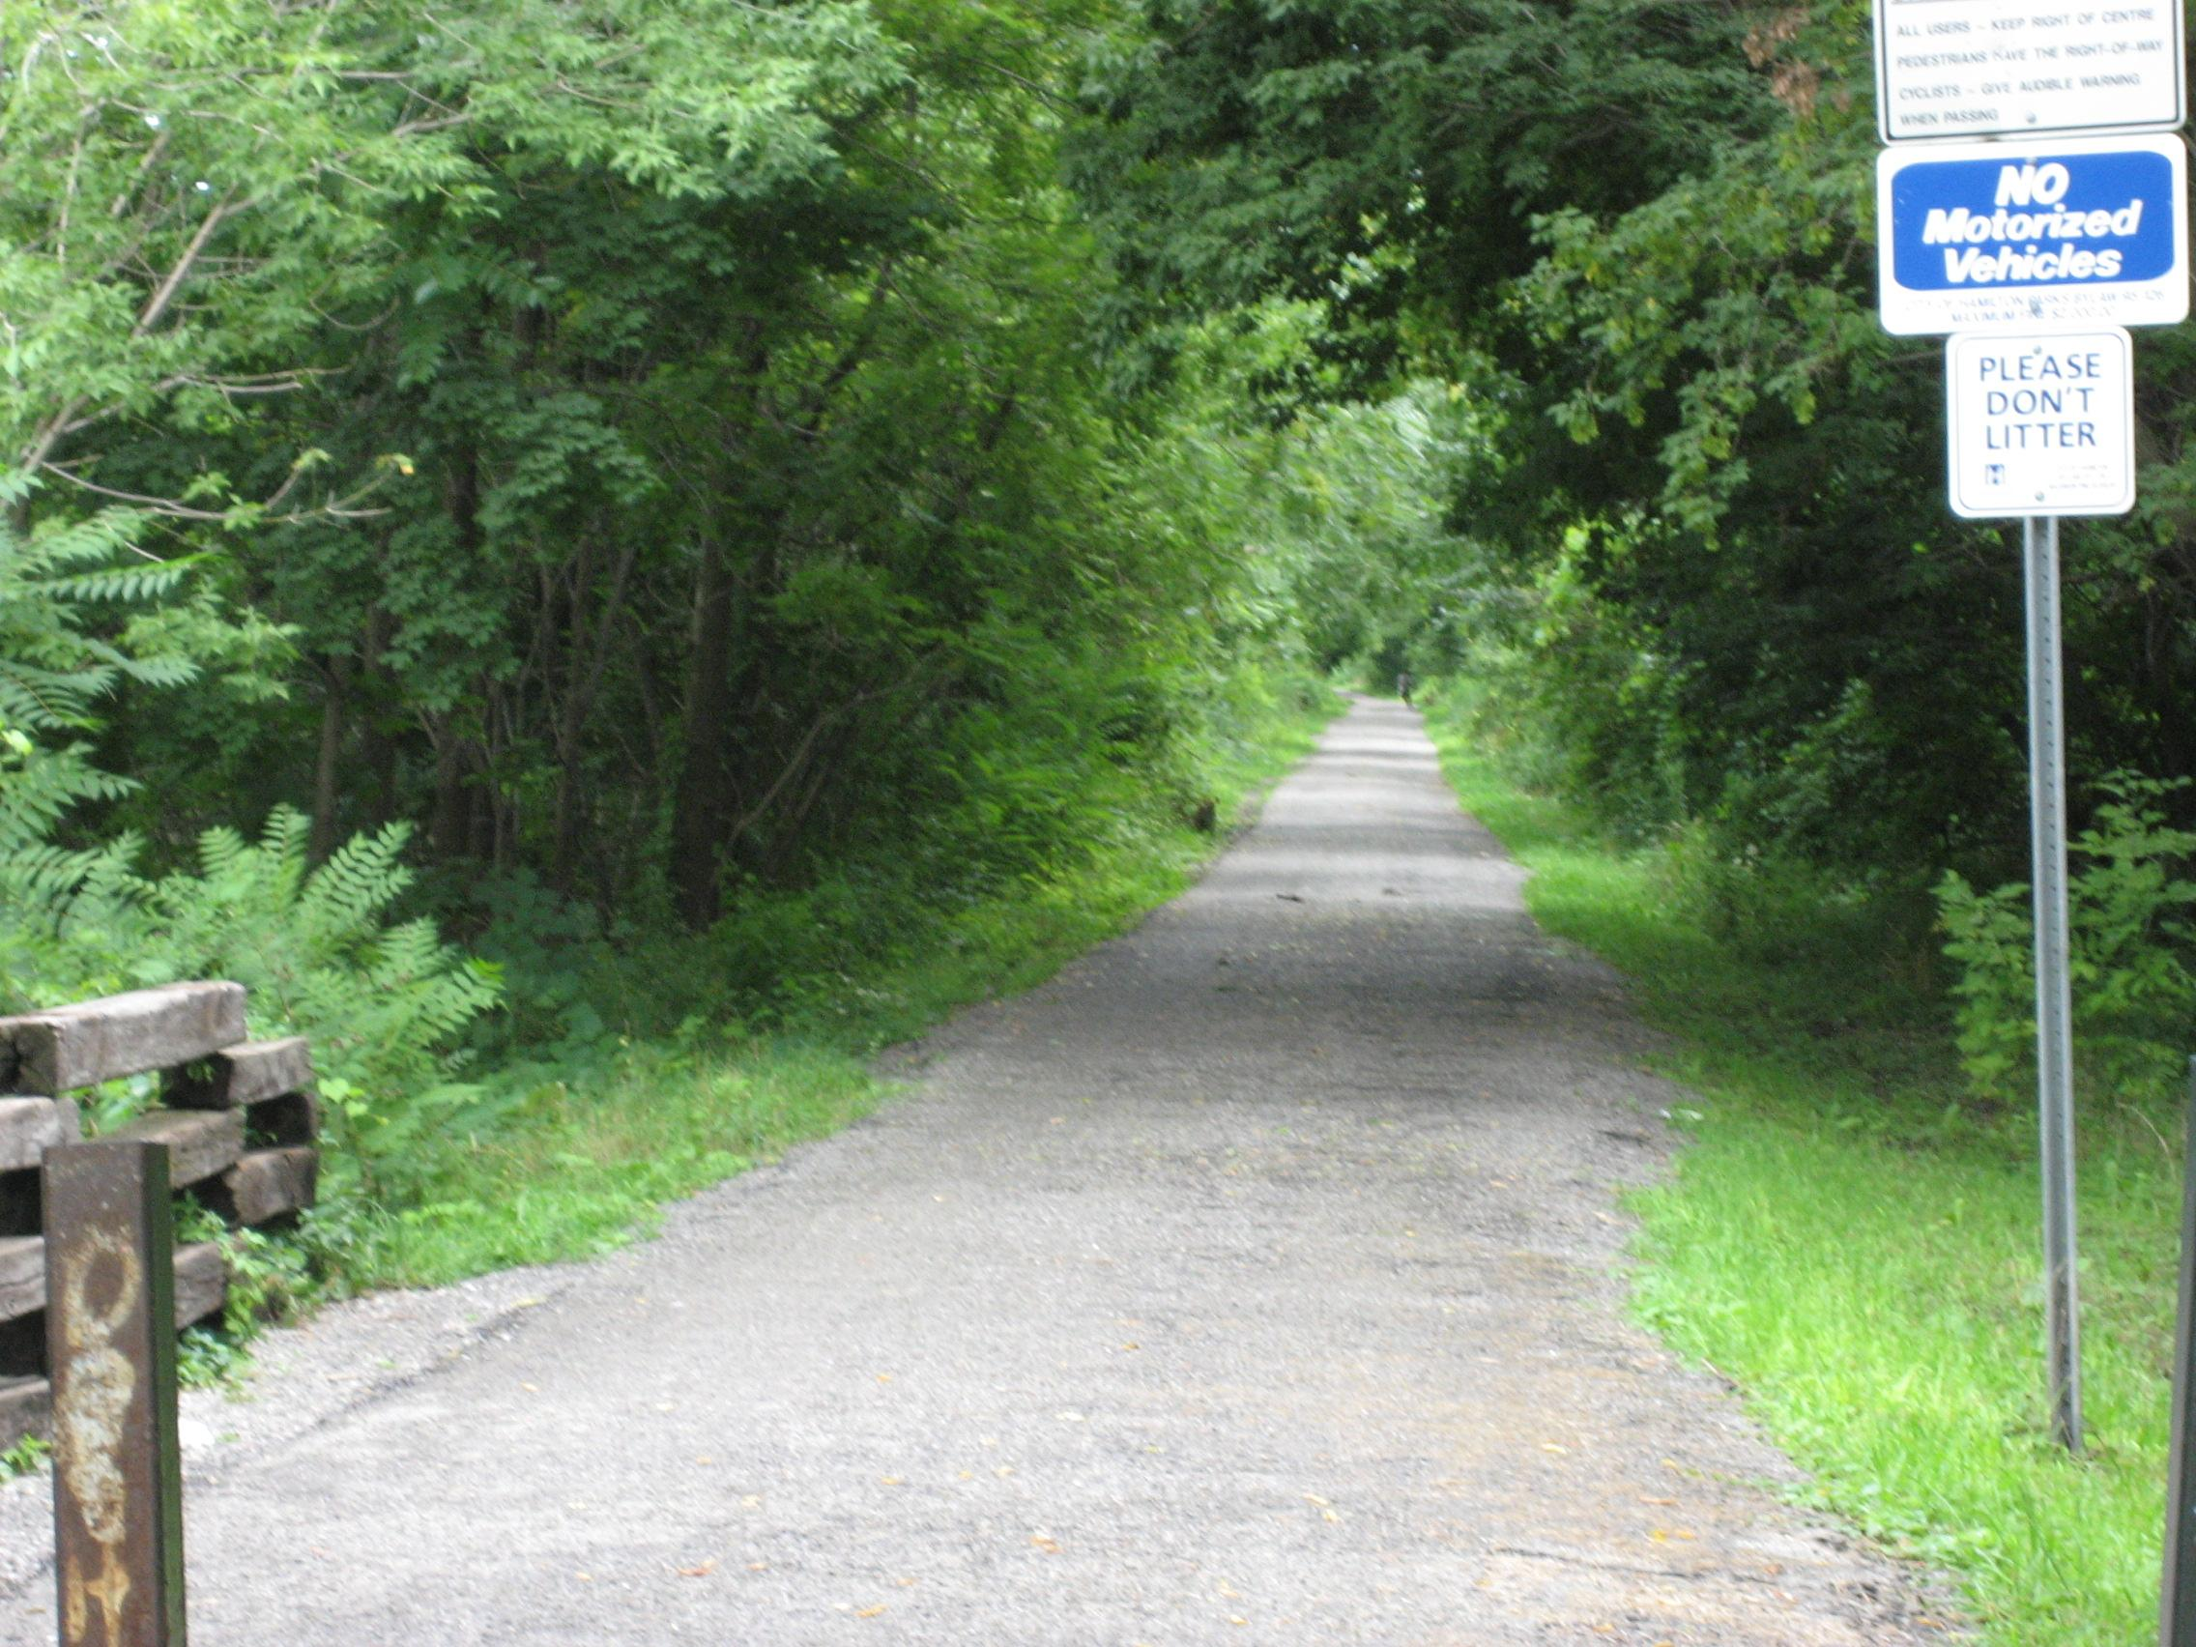
The physical parts of old railroad tracks are usually what?
trashed
recycled
stolen
burned

Slide 7
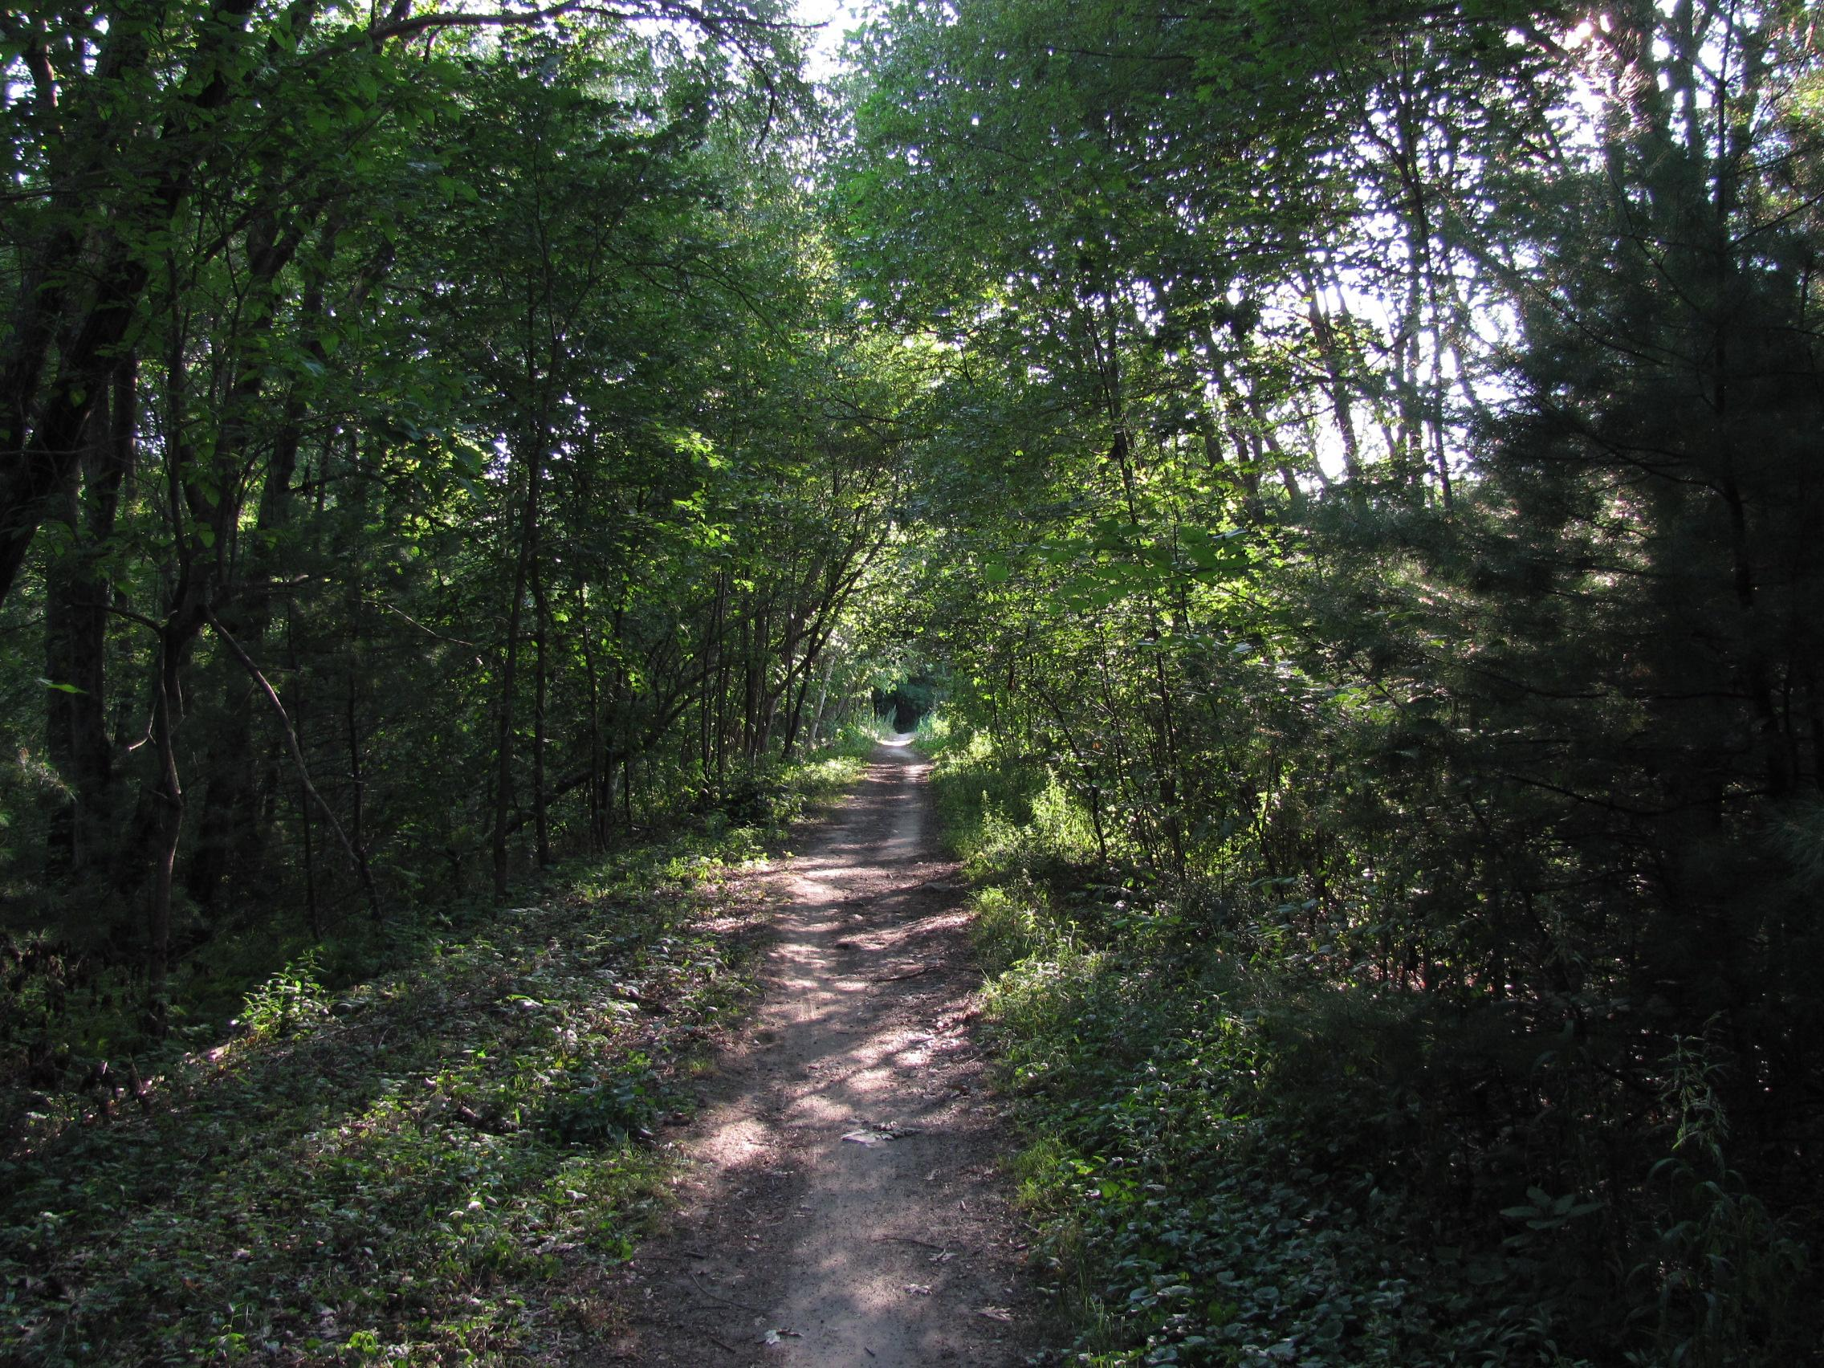
Abandoned railways that are converted to recreational trails are known as what ?
A. subways
B.highways
C.interstates
D.rail trails

Slide 8
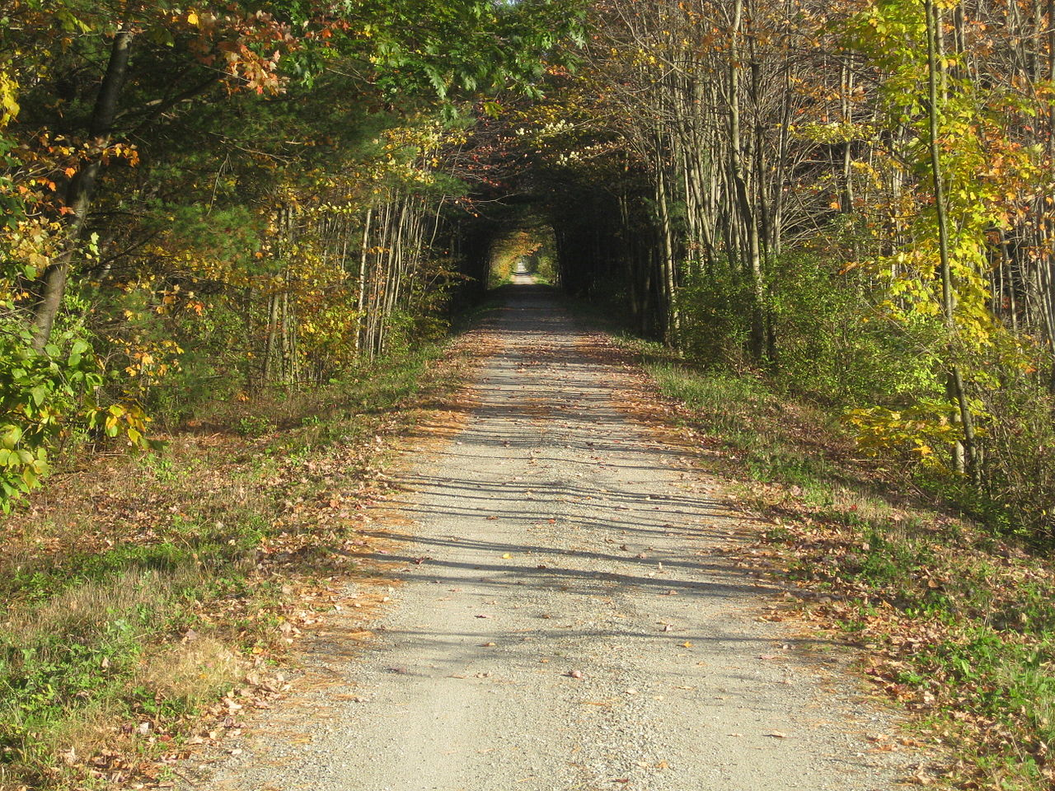
What nonprofit organization helps communities convert abandoned railways into rail trails ?
A.rails-to-Trails conservancy
B.boy scouts
C.girl scouts
D.appalachian Trail Society

