Slide 1
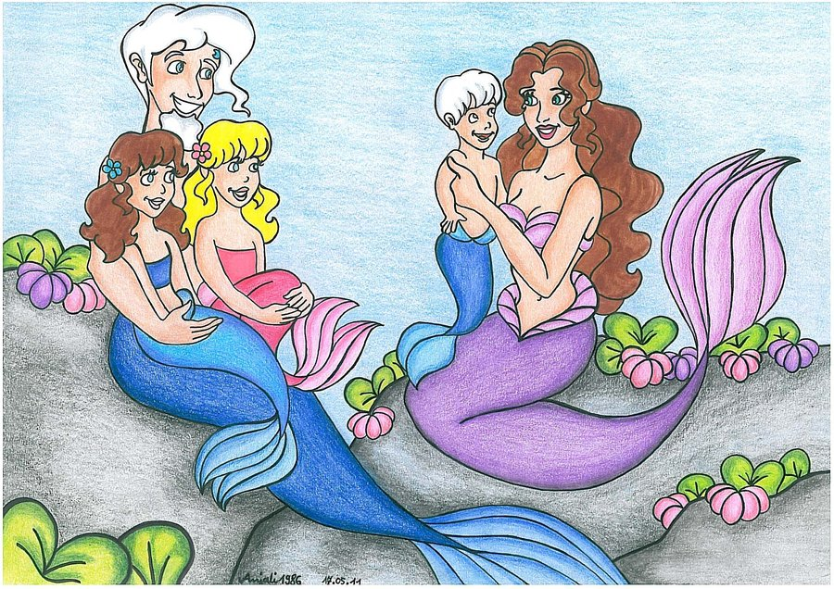
#1210 Are mermaids real?
By:Katie

Slide 2
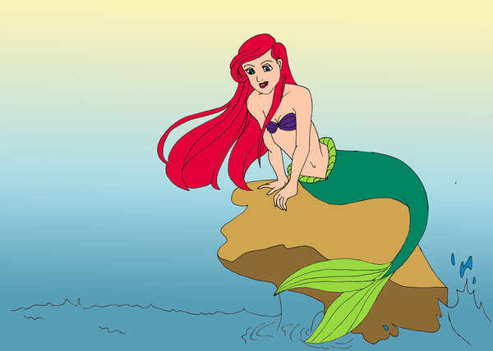
Are mermaids real?
Mermaids are not real but some people still believe in them.
.

Slide 3
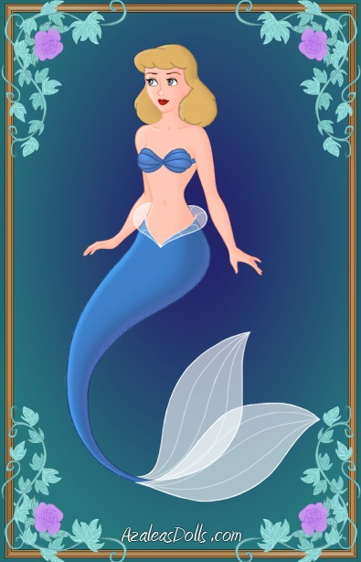
What are mermaids?
A mermaid is a mythology creature that is half-fish and half-human.

Slide 4
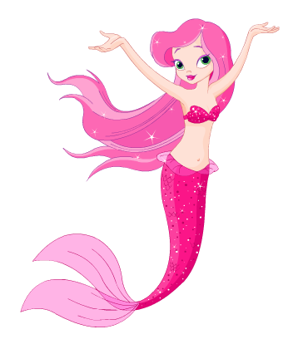
How long have mermaids myths and legends been around?
Mermaids myths have been around for thousands of years.

Slide 5
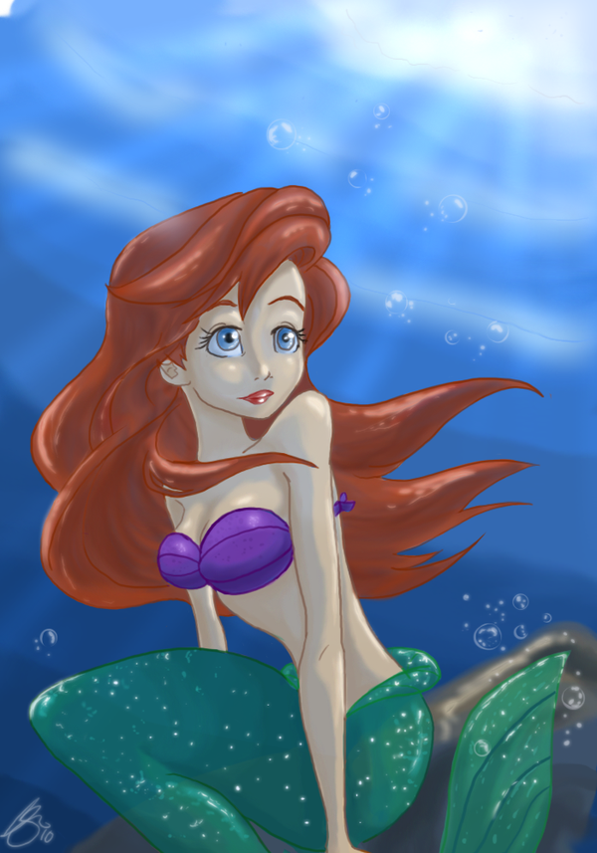
Interesting fact
The sirens of greek mythology were known to lure sailors into dangerous waters with their beauty and singing.Mermaids sightings might actually be nothing more than misunderstood encounters with manatees and dugongs.Mermaids are known as half-woman and half-fish.

Slide 6
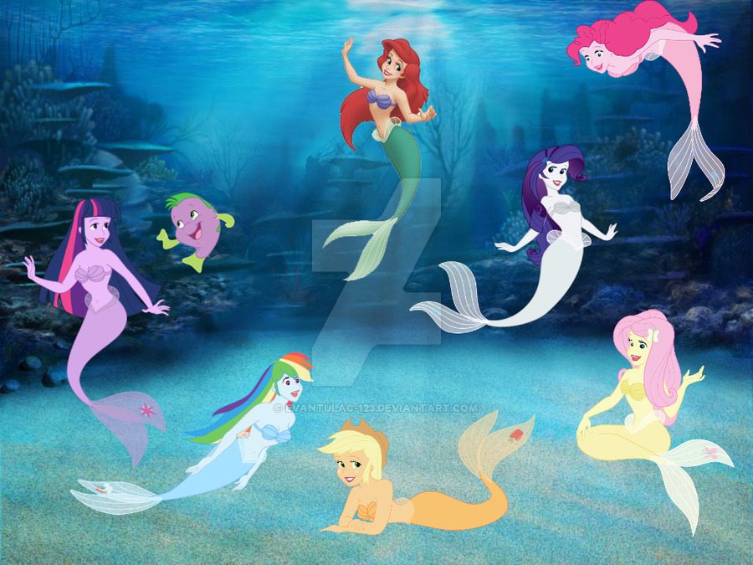
A mermaid is half woman and half what other creature?
A.fish
B.bird
C.reptile
D.snake

Slide 7
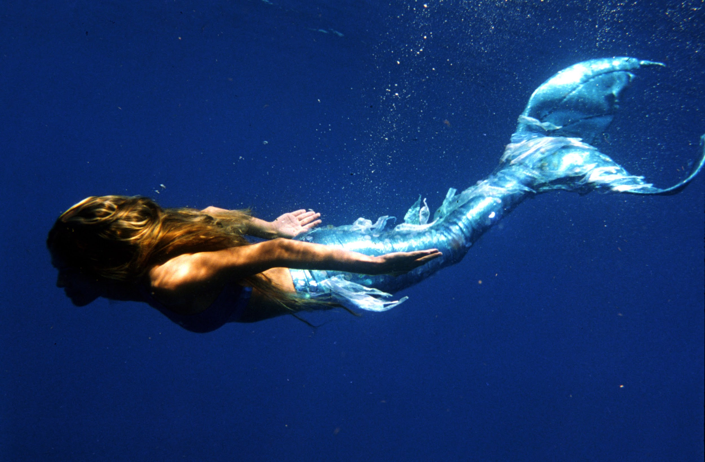
Supposed mermaid might merely be misunderstood encounters with dugongs or what other creatures?
A.dolphins
B.whales
C.sharks
D.manatees

Slide 8
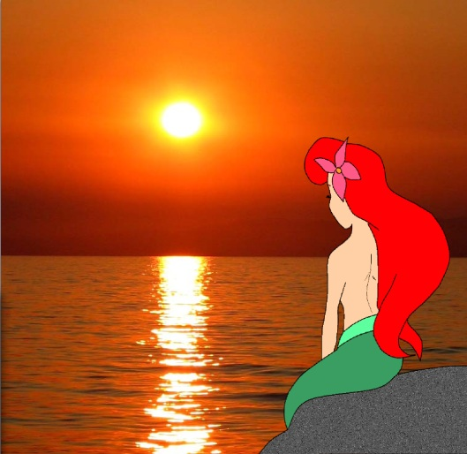
Mermaids often been associated with what dangerous mythological Greek creature?
A.Trojan Horse
B.Sirns
C.Dugongs
D.Anemones

