Slide 1
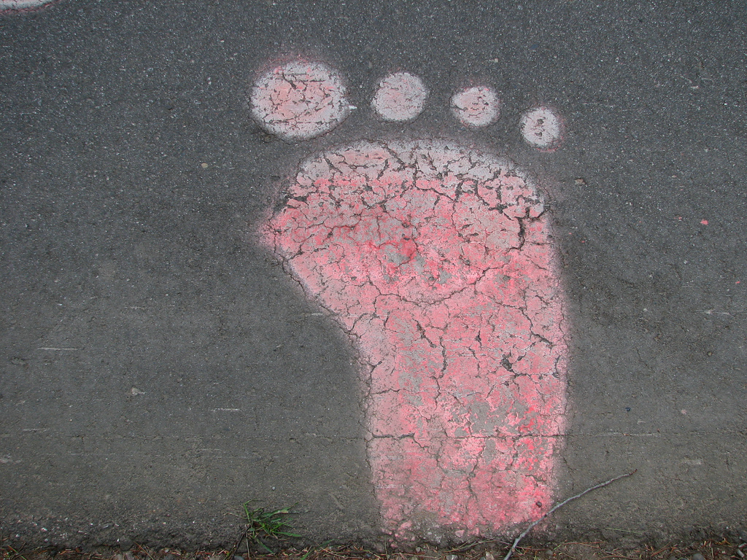
IS THERE ANY PROOF THAT BIGFOOT IS REAL?
By: Mackenzie Riggs

Slide 2
What are some other common nicknames for bigfoot?
They call Bigfoot sasquatch and a huge,hairy mixture of ape that walks on two legs like a man.

Slide 3
How do some experts explain alleged bigfoot sightings?
Bigfoot enthusiasts point to “mounds” of evidence, including eyewitness accounts, photographs, videos and even DNA evidence of the reality of bigfoot.To date however, none of these pieces of alleged evidence has proven to be trustworthy.

Slide 4
IS THERE ANY PROOF BIGFOOT IS REAL?
Scientist also note that, for bigfoot to exist in many places there would have to be a significant amount of them alive in order to maintain a viable breeding population.They claim that in today’s world such a large number of creatures simply could go undiscovered.

Slide 5
A. Pacific northwest
B.Kentucky
C.West virginia
D. Key west
All of the following are areas where bigfoot has allegedly been seen except
for which one?

Slide 6
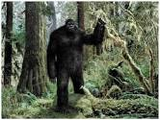
A complete lack of what leads most scientists to doubt the existence of bigfoot?
A.Common sense
B.Physical evidence
C.Courage
D.Eyewitness accounts

Slide 7
Which of the following is NOT a nickname for a mythical ape-like beast?
A.Bigfoot
B. Sasquatch
C. Yeti
D. Nessie

Slide 8
Interesting facts.
The reason the legend keeps going is because so many people want it to be true.They want it to be true because people are fascinated by the idea that there might be a huge hairy ape in the woods.That has lived for hundreds of years.Most people would think he is in a suit.

Slide 9
Interesting facts
Recently Rick Dyer a bigfoot hunter claimed that he has killed bigfoot. Then he had a conclusive DNA test run on the body.He took his find on tour and charged people to see bigfoot.

Slide 10
http://wonderopolis.org/wonder/is-there-any-proof-that-bigfoot-is-real

Slide 11
The
End

