Slide 1
What Causes Lightning #1193?
Macy Swain

Slide 2
What Causes Lightning ?
Lightning is caused by water in a storm cloud that freezes, and the pieces roll around bumping into each other.After all the bumping and rolling the pieces create an electrical charge that separates into two groups. The groups are called negative charge and positive charge .Positive charge is a proton that has the same amount of positive charge as an electron. Electron means negative charge. Negative charge is called electrons which form at the bottom of the cloud. Earth’s surface is made of positive charge.Positive charge is attracted to anything that sticks up.The positive charge in the cloud is attracted to tall things and strikes because it is too powerful to pass over.

Slide 3
How many times does lightning strike earth each day?
Lightning strikes earth more than 3 million times each day.That is more than 40 flashes each second.

Slide 4
Who he world record for being hit by lightning the most times?
Roy Sullivan of Virginia has been struck by lightning the most times.He has been struck 7 times.

Slide 5
Interesting facts about lightning?
Lightning strikes are not more than an inch wide.
A lightning strike is hotter than the sun surface.
Lightning strikes 62,000miles per second.
Lightning can strike twice in the same place.

Slide 6
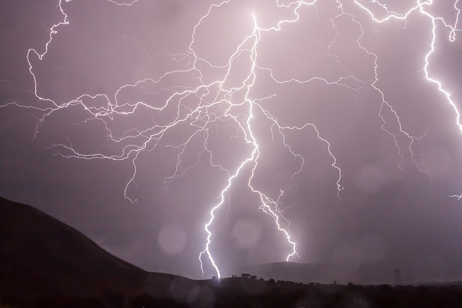
The earth’s surface has what kind of charge?
positive
negative
neutral
irrelevant

Slide 7
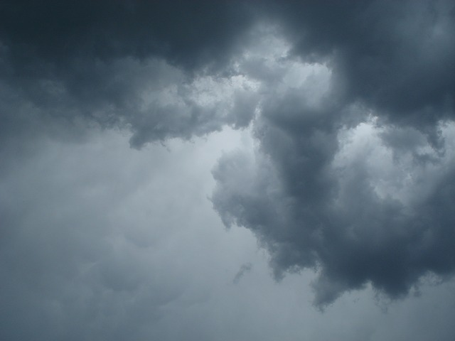
The negative charges that settle at the bottom of clouds are called what?
protons
neutrons
neutrinos
electrons

Slide 8
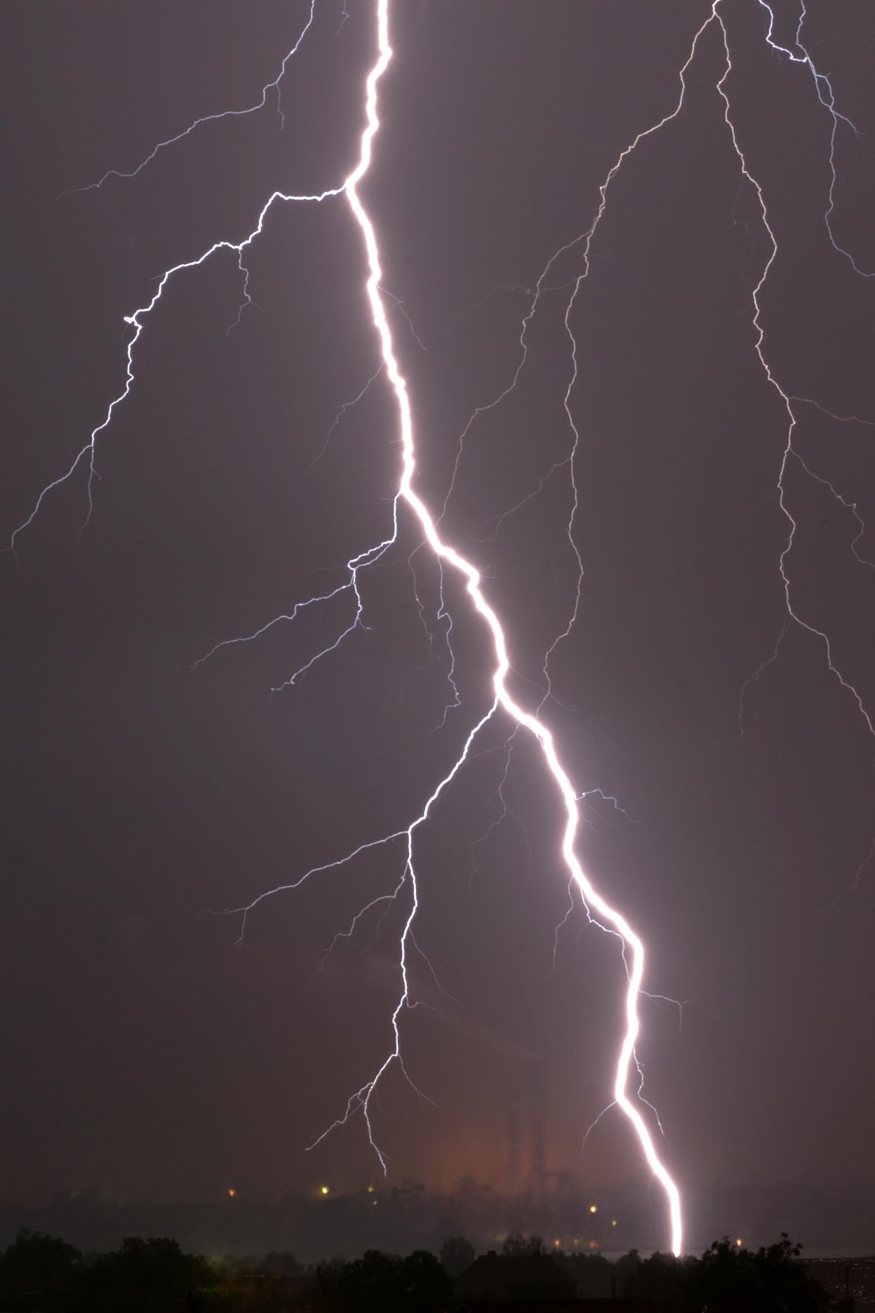
Roy Sullivan has been struck by lightning how many times in his life?
five
six
seven
eight

