Slide 1

#1508 Can you eat dandelions?
By: Madison Dickens

Slide 2
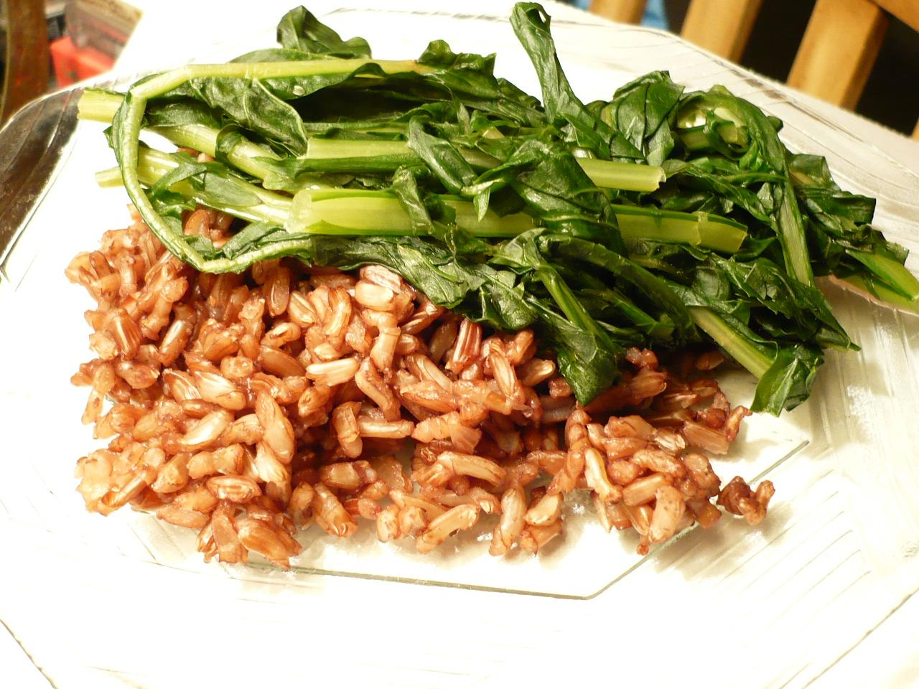
Can you eat dandelions?
You can eat dandelions ! Instead of killing them just eat them.

Slide 3
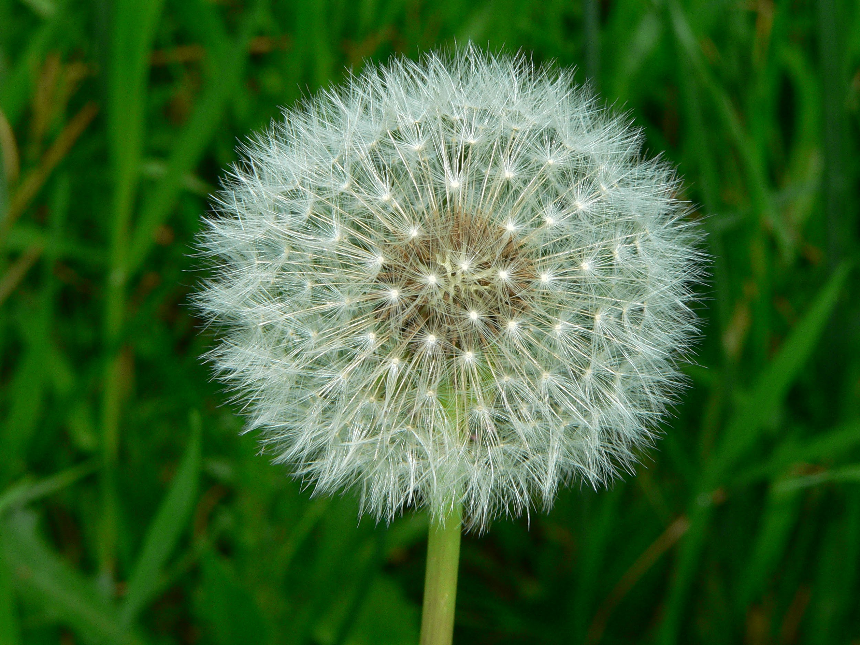
How do dandelions copy the moon, the sun, and the stars?
They copy the sun when they bloom.It copys the sun when it puffs out.It copys the stars by flying in the sky when you blow it.

Slide 4
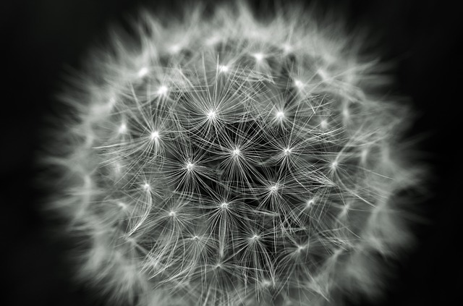
Are dandelions healthy ?
They are healthy! The flowers of a dandelion are low on calories.

Slide 5
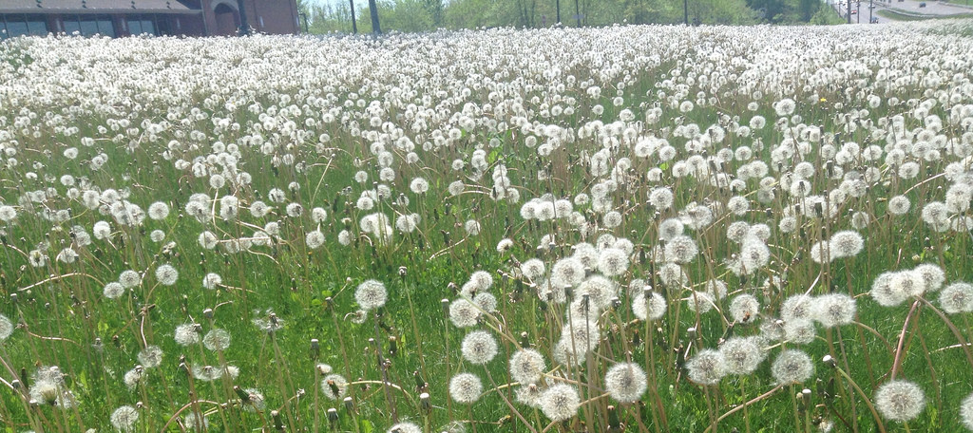
Interesting facts
Can eat dandelion greens raw
Can crush them and make syrup or jelly and wine
Can use them to dye clothing
Nutrients in dandelions are vitamin A,B,C,and calcium,potassium,and iron.
Can be ground,dried and roasted to be a similar drink to coffee

Slide 6
The “puff ball” seed head of a dandelions resemble what body?
Moon
sun
Saturn
stars

Slide 7
Which of the following is not a nutrient fact found in dandelion greens?
vitaminA
vitamin C
calcium
polyunsaturated fat

Slide 8
Dandelion roots can be dried,ground,and roasted to a drink similar to what?
soda
beer
coffee
water

