Slide 1
#1499 When was the Great War?
By :Buddy Brandon Swain

Slide 2
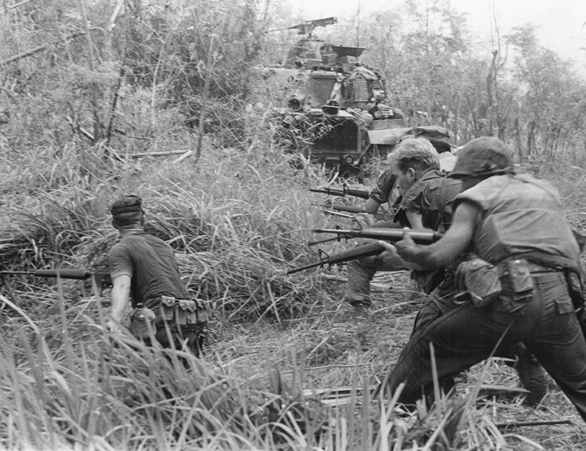
When was the Great War
The Great War started on June 28,1914 and ended on November 11,1918.

Slide 3
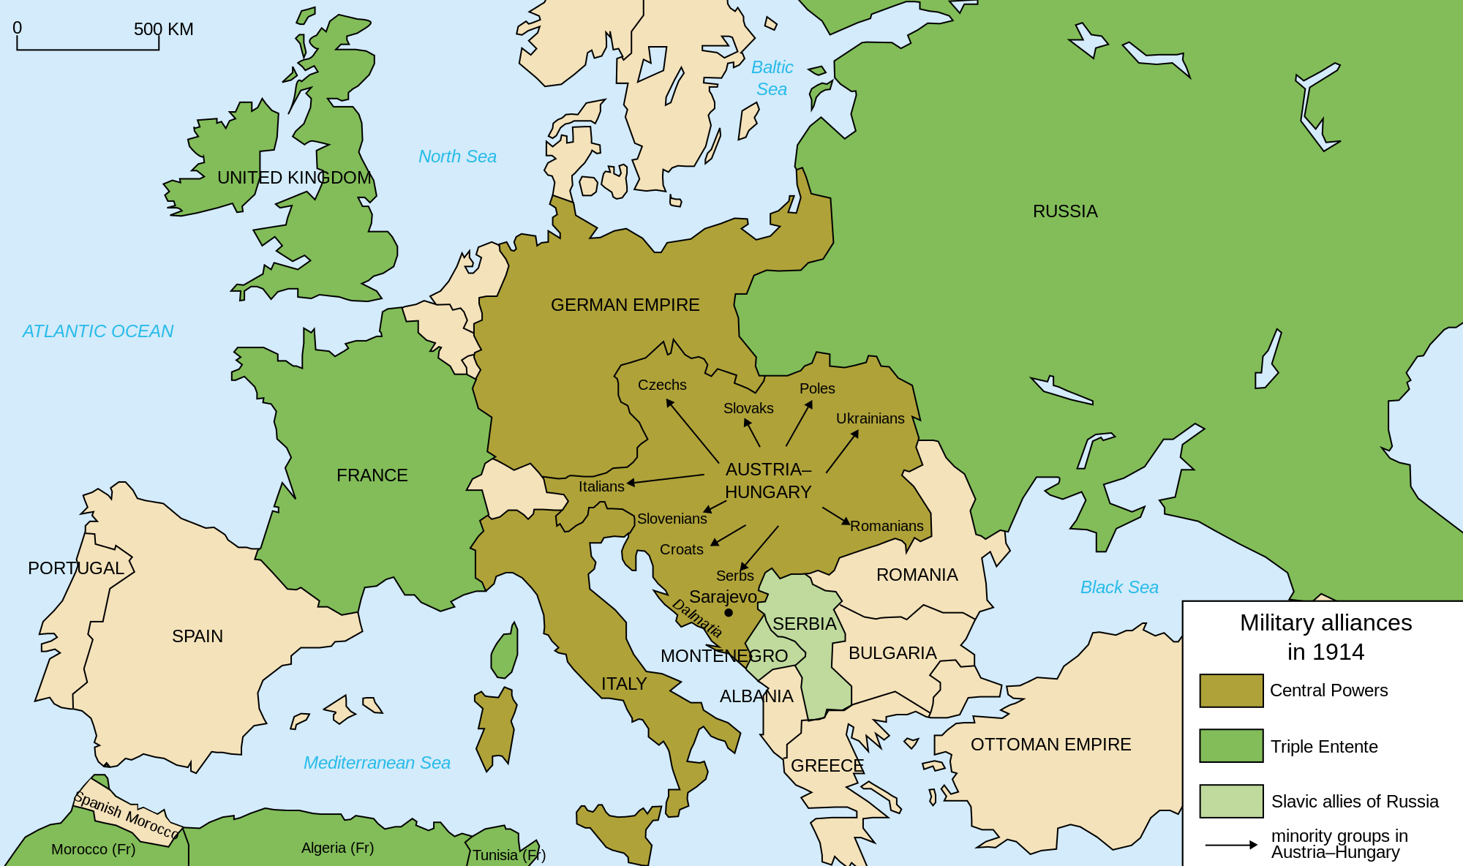
Which countries fought in World War 1?
There were 6 countries that fought in the Great War. Europe was split into two sides. Germany,Austria-Hungary,Italy that
was the Axis Power Russia,France,and Great Britain that was the Allied Forces.The United States joined the war with the Allied Forces.

Slide 4
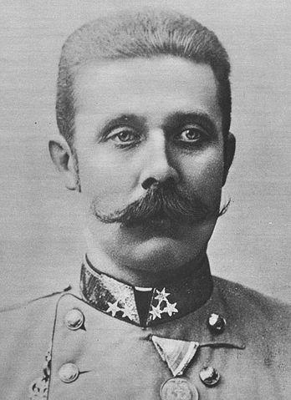
What event triggered World War 1?
The event that triggered World War 1 was when Archduke Franz Ferdinand was killed by Serbian terrorist organization called the Black Hand.Germany, Austria-Hungary declared war on Serbia and Russia came to defense Serbia so a lot of treaties and alliances happen.

Slide 5
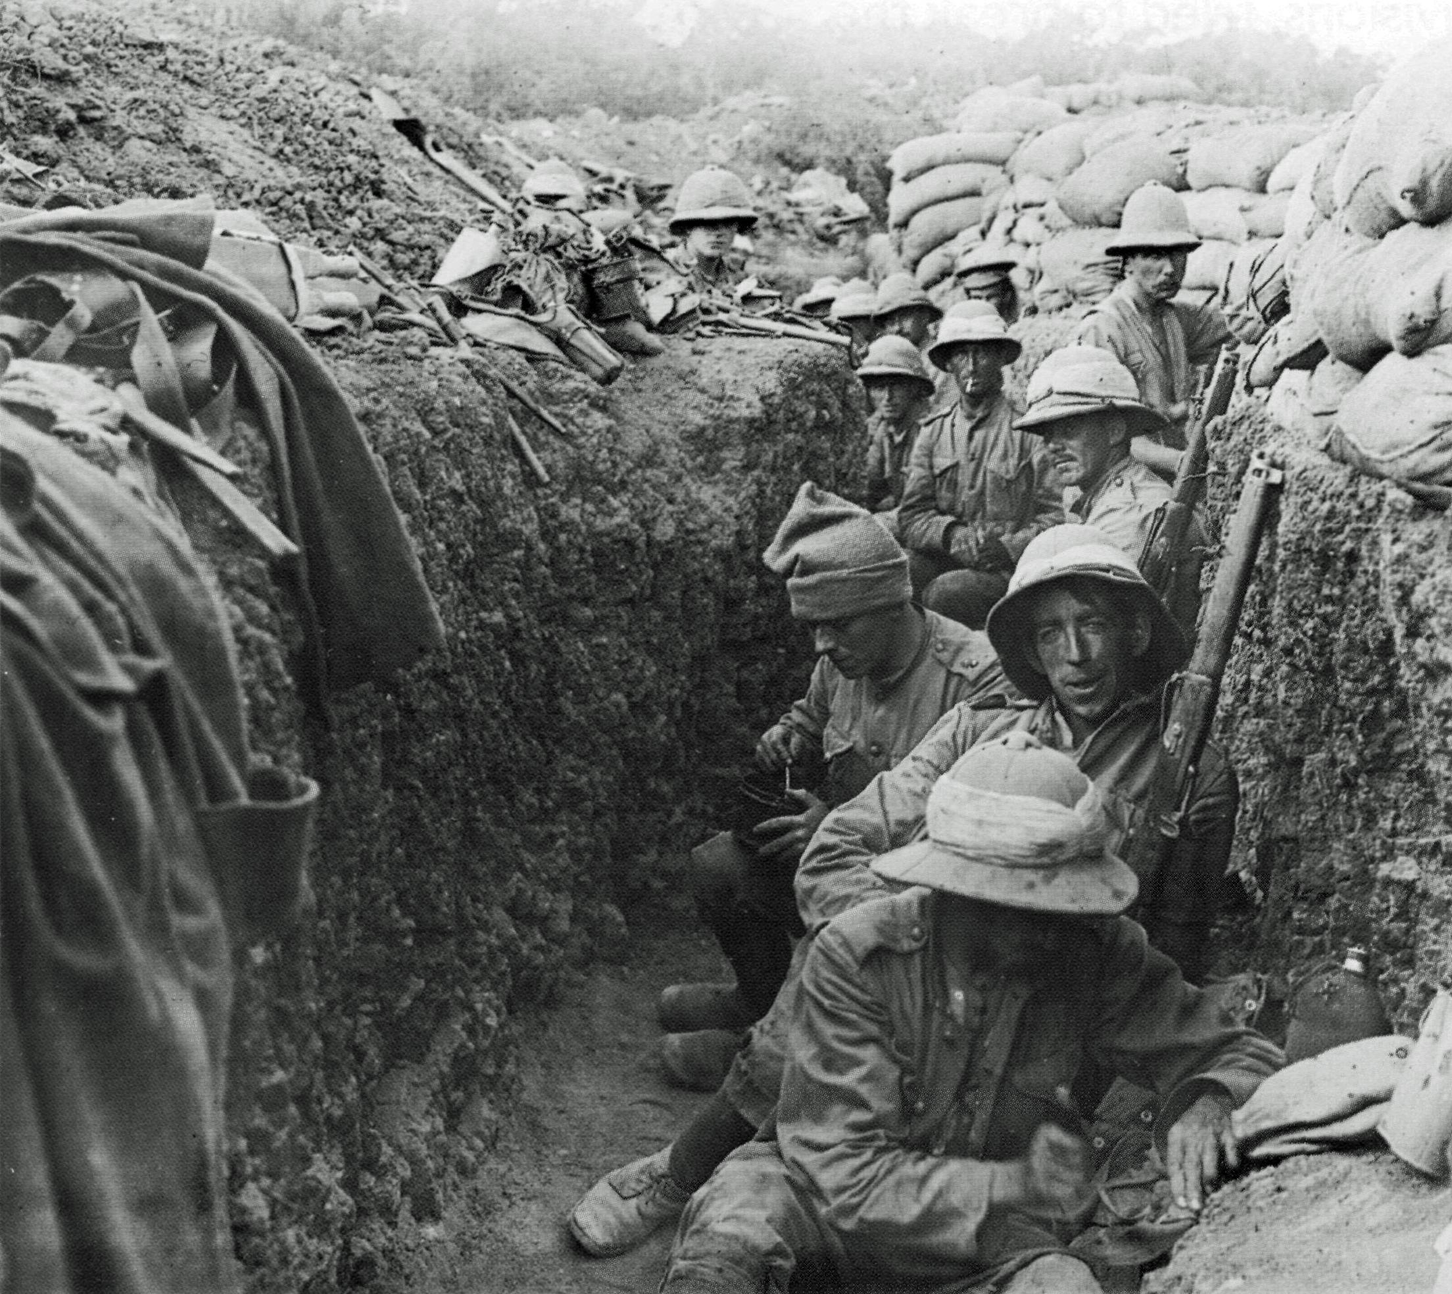
Facts about the Great War
Soldiers fought in trench and sometimes they got killed with Trench Fever and Trench Foot.
15 million people died during the Great War and 20 million people got wounded during the Great War.

Slide 6
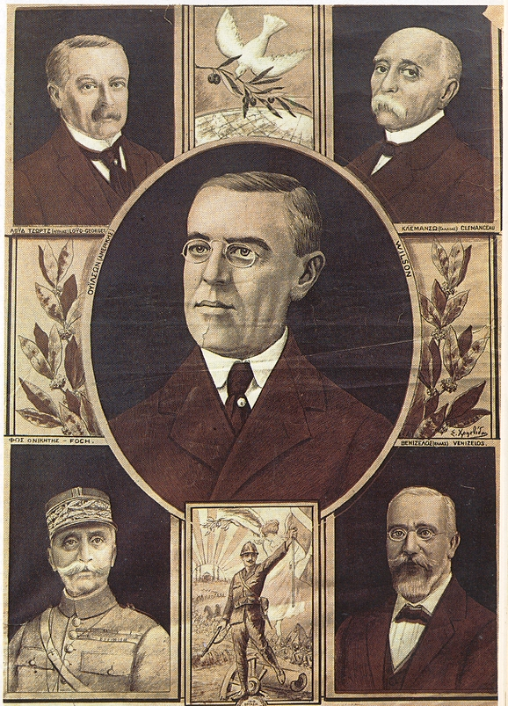
Quiz Question 1
The event that triggered the Great War was the assassination of whom?The answer is Archduke Franz Ferdinand.
Archduke Franz Ferdinand
Adolf Hitler
Winston Churchill
Theodore Roosevelt

Slide 7
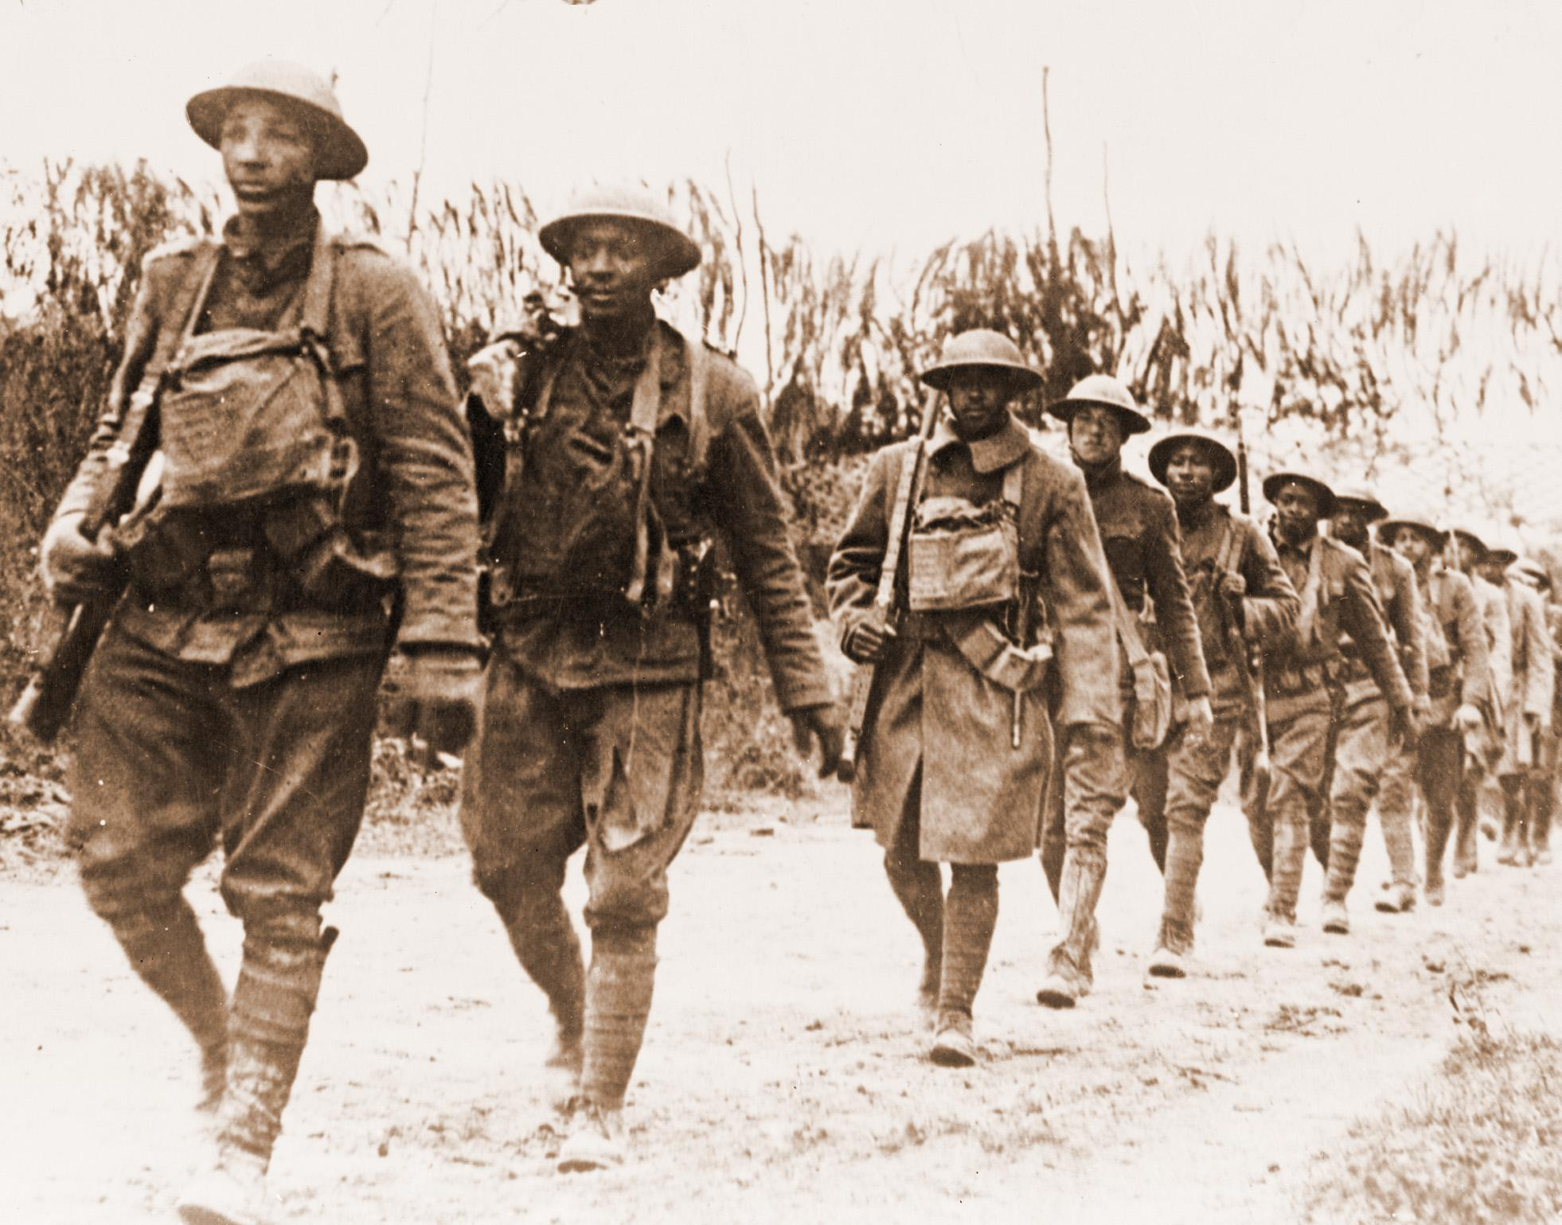
Quiz Question 2
Germany,Austria-Hungary,and France were collectivly known as what.
Allied Forces
Justice League
League of Nation
Central Power

Slide 8
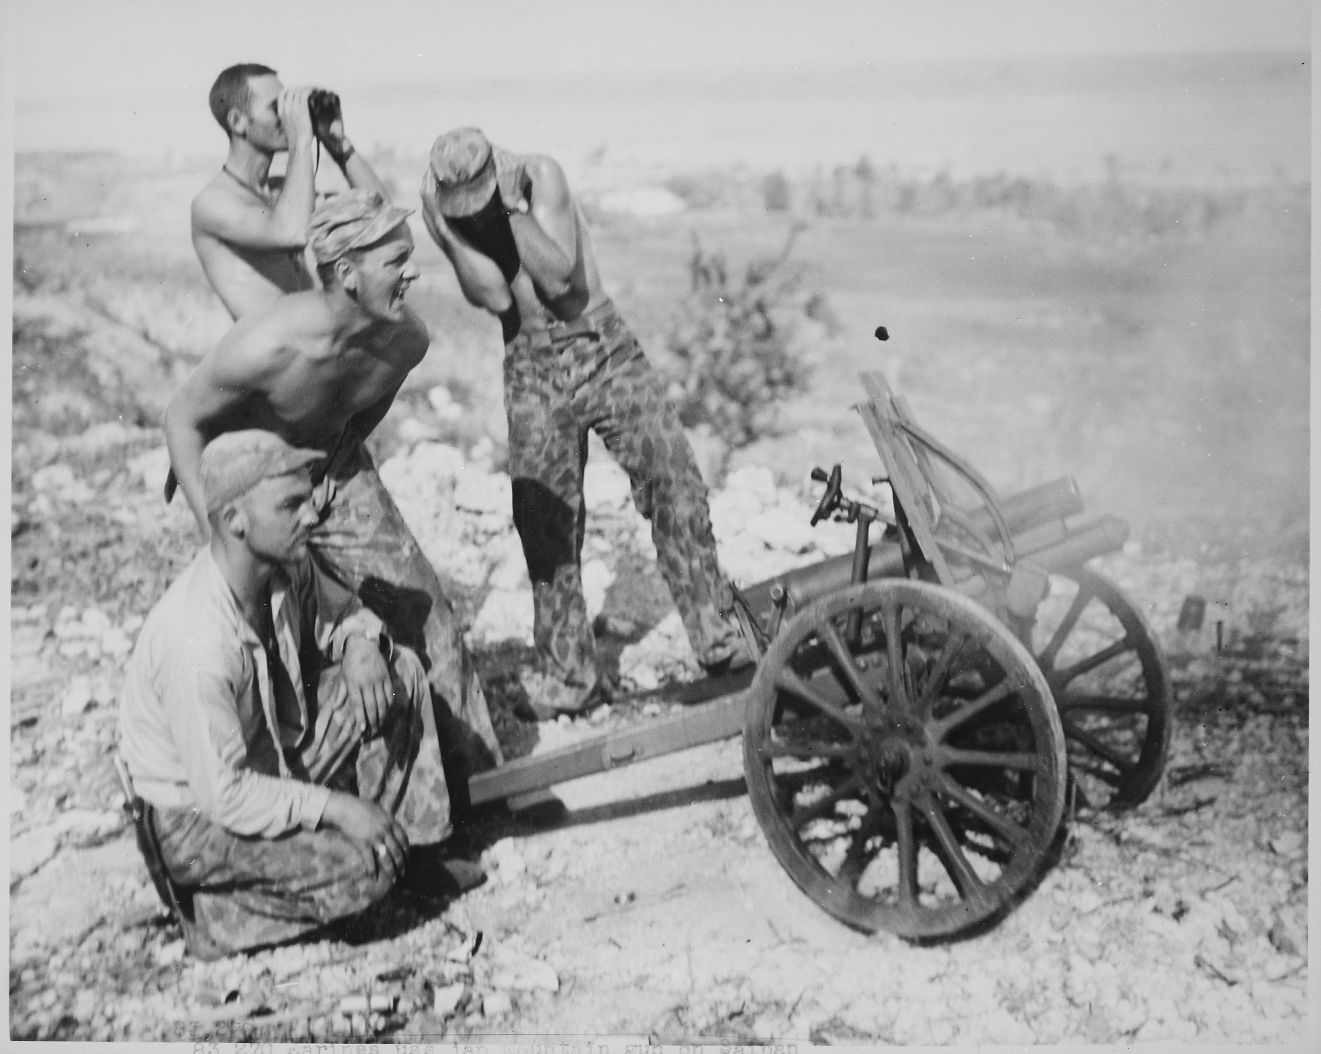
The fighting during World War 1 officially ended on what day?The answer is November 11,1918.
October 3,1919
January 1,1919
November 11,1918
December 25,1918

