Slide 1
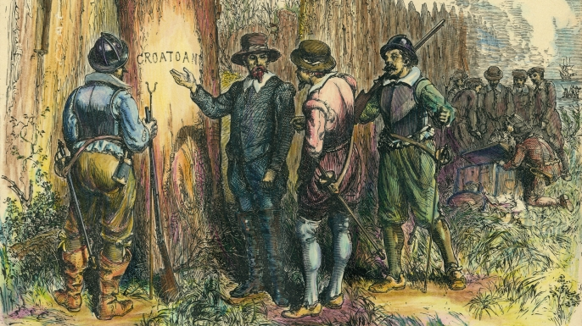
#1324
What happened to the lost colony?
By: Nathaniel Parker Fillingame

Slide 2
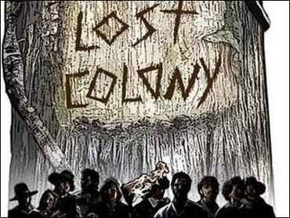
What happened to the colony?
No one knows what happened to the colony of Roanoke.

Slide 3
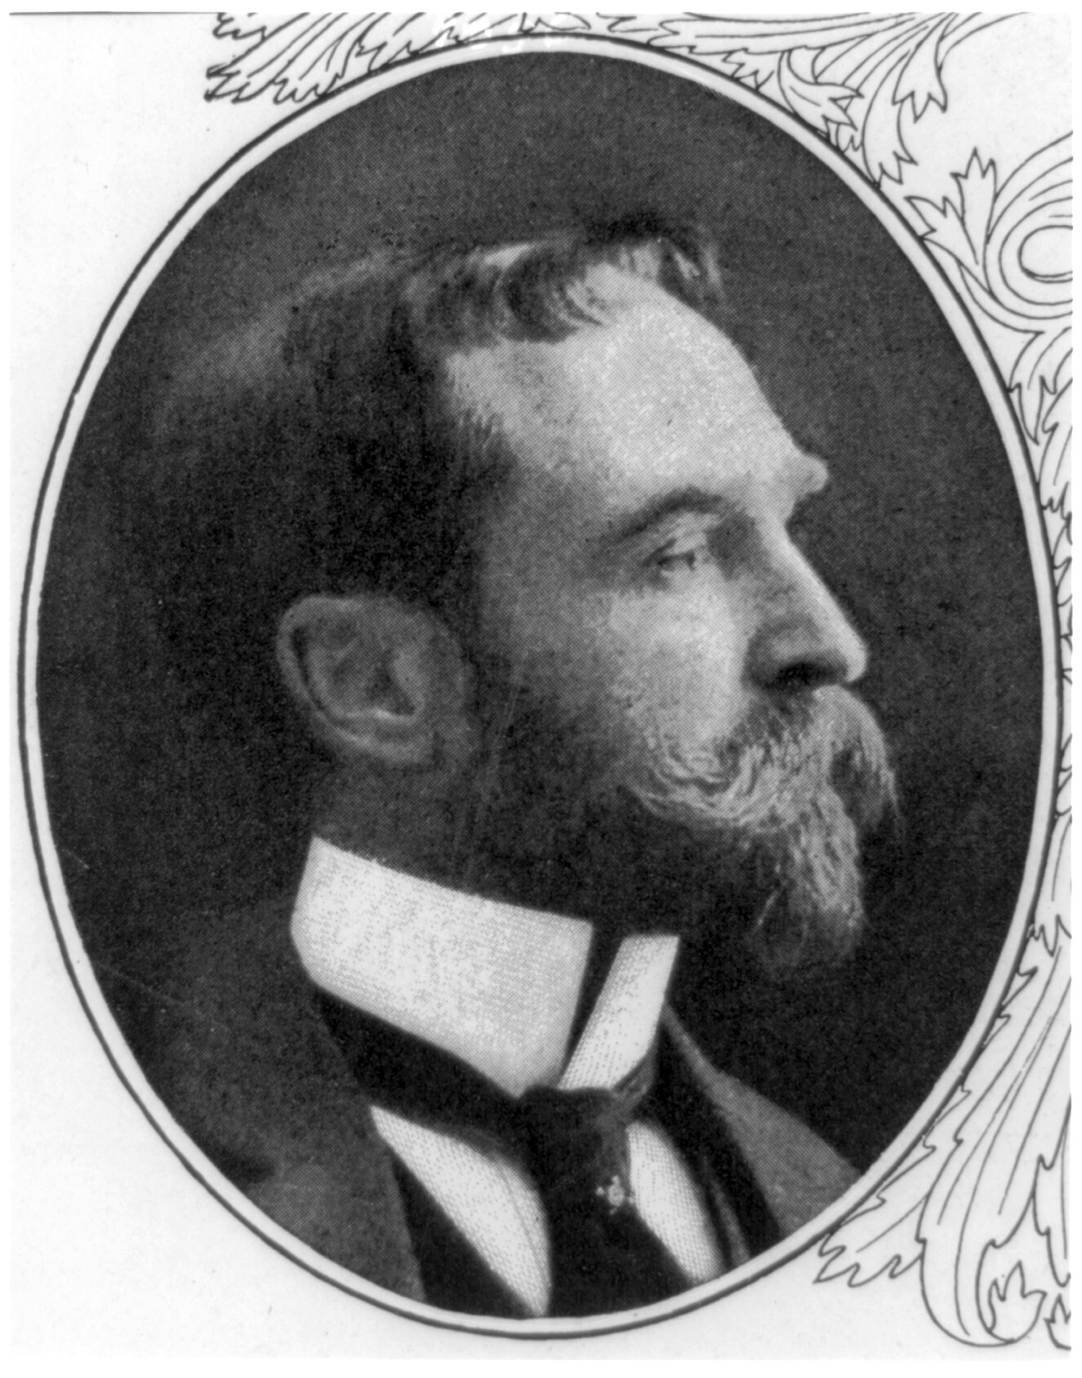
Who first settled in Roanoke?
John White first settled in Roanoke.

Slide 4
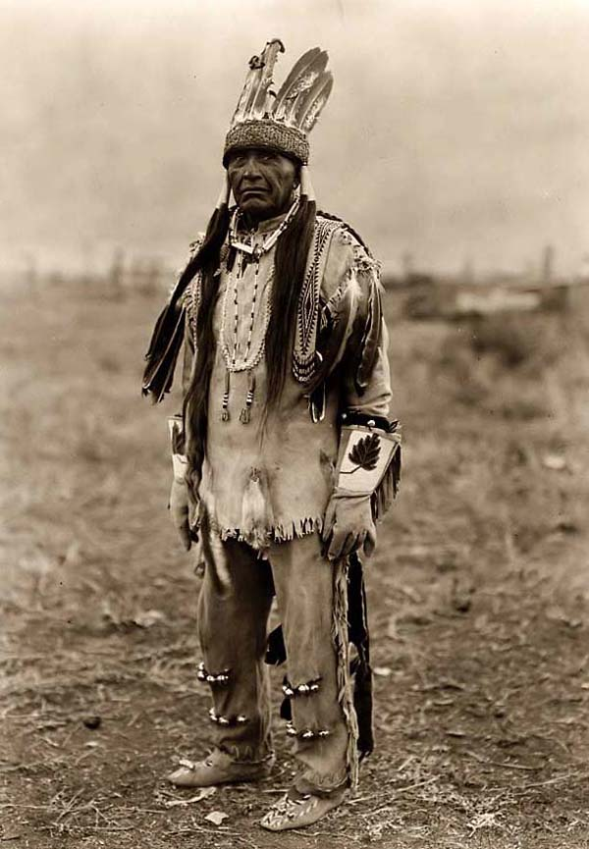
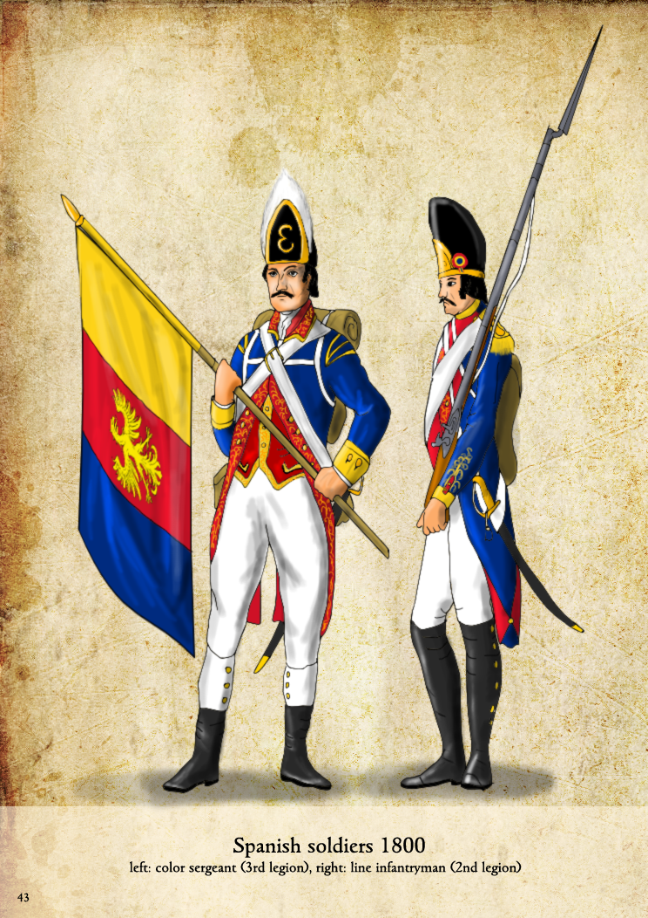
What are the theories of how they disappeared?
1.They were attacked by the Spanish from the south.
2.They joined the native tribes.
3.They got lost at sea.

Slide 5
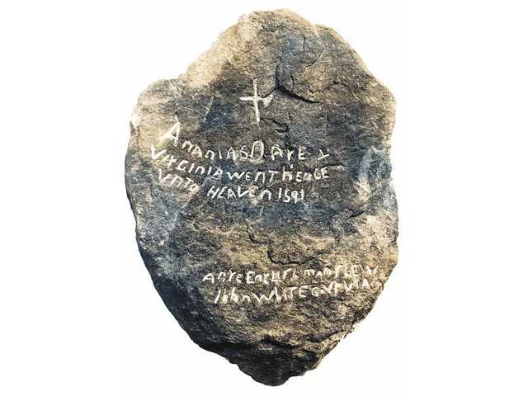
Interesting facts about the Lost colony of Roanoke.
( Note: I did not get this info from wonderopolis ) They found stones at the site that they called dare stones after the first born child at Roanoke Virginia Dare.

Slide 6
What year did the colony of Roanoke settle?
A.1585
B.1590
C.1587
D.1607

Slide 7
Croatoan was the name of a nearby what??
A. island
B. Native American tribe
C. river
D. trading post

Slide 8
What was the name of the first born child at Roanoke?
A. Carolina Moon
B. Croatoan White
C. Joan Powhatan
D. Virginia Dare

Slide 9
Thank you!!!!

