Slide 1
#257 Why is the Statue of Liberty green?
By: Nicholas

Slide 2
Why is the Statue of Liberty green?
Oxidation.When water and air reacted to the copper plates causing the copper plates to turn green.

Slide 3
What is a patina?
Copper Carbonate.Which protects the Statue of Liberty,s overlayer.

Slide 4
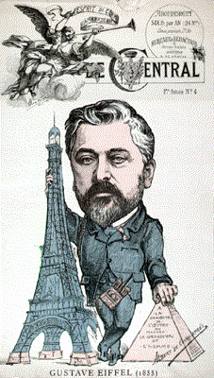
Who designed the support structure for the Statue of Liberty?
Gustave Eiffel.

Slide 5
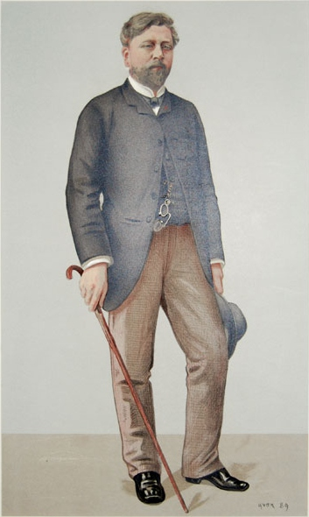
Interesting facts.
The statue of liberty alone stands 151 feet tall.
Gustave Eiffel designed the design of the Eiffel Tower.

Slide 6
Why is the Statue of Liberty green?
rusting
oxidation
patinazation
oxidation

Slide 7
The Statue of Liberty is a worldwide symbol of:
struggle
freedom
pain
hardship

Slide 8
Which country developed a close friendship with the United States during the Revolutionary War?
A.Great Britain
B.Germany
C.France
D.Spain

