Slide 1
#598 What Was The Kraken?
By: Rachel Dawson

Slide 2
What Was The Kraken?
Kraken is a German word for Octopus. The Kraken is a large creature with many arms. These arms could reach as high as the top of a ship’s main mast!!

Slide 3
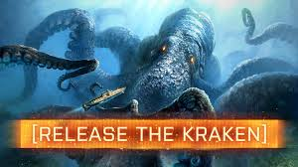
What creature might The Kraken have been based upon?
The Kraken legends may have been based in part on a real creature. . . The Giant Squid!! Giant Squids have long tentacles and grow up to 40-50 feet in length. They usually live deep in the sea, but they’ve been known to surface and attack ship’s from time to time.

Slide 4
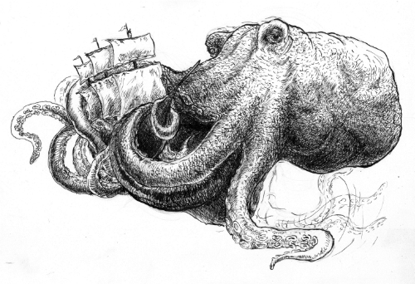
Who Wrote The Famous Sonnet About The Kraken?
The Kraken gained fame in 1830 when Alfred Tennyson published his sonnet called The Kraken. In it, he described a huge sea creature that lived in the depths of the ocean.

Slide 5
Interesting facts.
Alfred Tennyson wrote the famous sonnet about the Kraken.
“Below the thunders of the upper deep; Far far beneath in the abysmal sea, His ancient, dreamless, uninvaded sleep The Kraken sleepeth: faintest sunlights flee About his shadowy sides; above him swell Huge sponges of millennial growth and height; And far away into the sickly light, From many a wondrous grot and secret cell Unnumber'd and enormous polypi Winnow with giant arms the slumbering green. There hath he lain for ages, and will lie Battening upon huge sea worms in his sleep, Until the latter fire shall heat the deep; Then once by man and angels to be seen, In roaring he shall rise and on the surface die.”

Slide 6
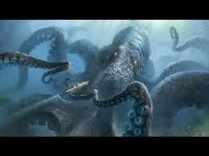
A sea monster that attacks ships and sailors, often portrayed as an octopus or squid.
SONNET
KRAKEN
SURFACE
MASSIVE

Slide 7
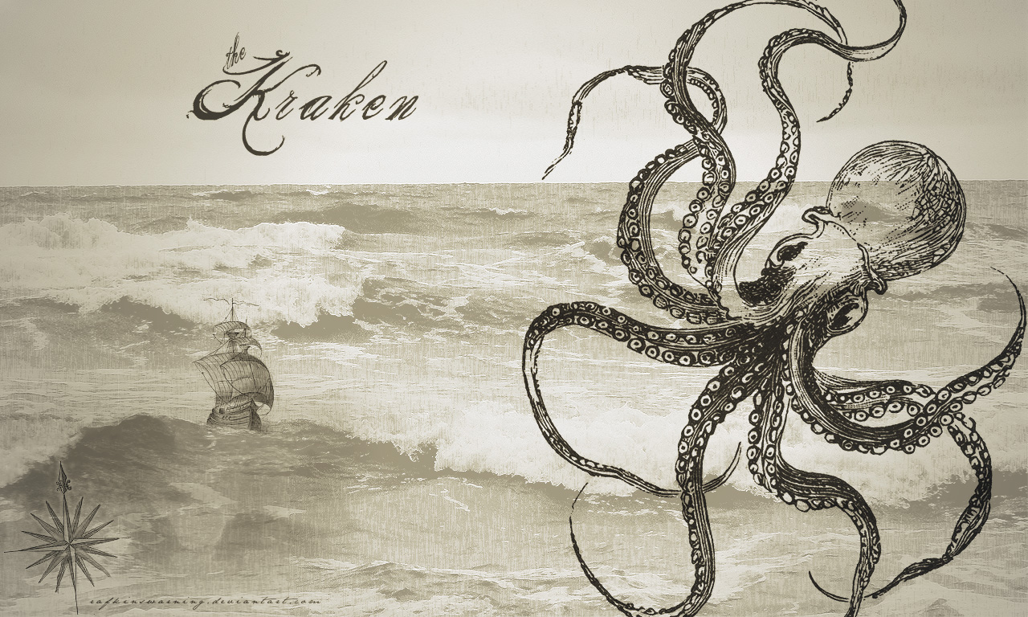
A living organism characterized by voluntary movement.
CREATURE
TENTACLES
SONNET
MASSIVE

Slide 8
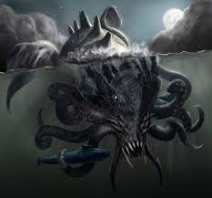
A verse form consisting of 14 lines with a fixed rhyme scheme.
SONNET
LITERARY
KRAKEN
GIGANTIC

