Slide 1
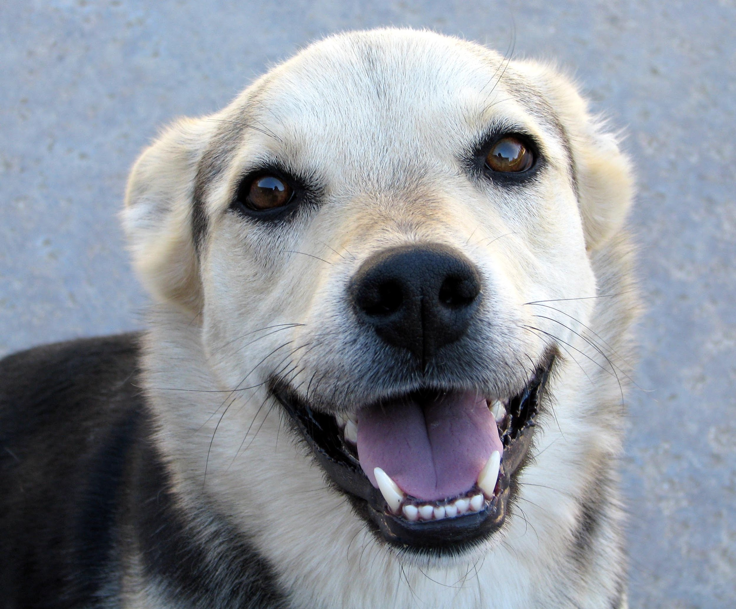
# 1,243 Why Do Dogs Bark During Thunderstorms
By: Summer Raines

Slide 2

Why do dogs bark during thunderstorms?
Many experts believe they may simply be expressing fear. As humans, we can relate to that emotion, since many people are also very scared of storms.

Slide 3

Are all dogs scared of thunderstorms?
Of course, not all dogs are scared of thunderstorms. Like some people who love storms,some dogs just aren't bothered by all the thunder and lightning.

Slide 4
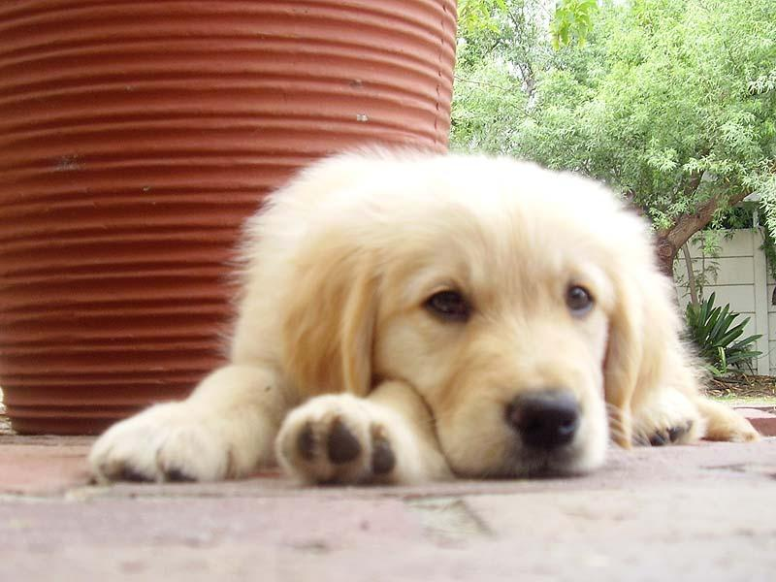
Can dogs predict when storms are coming.
Although it would be very cool if dogs could predict the weather,their ability to know about storms before who can be explained simply by science. Most big changes in the weather, such as an approaching storm, are preceded by a drop in the barometric pressure and shifts in the static electricity fields that surround us.

Slide 5

Interesting facts.
Dogs are much more sensitive than humans to such changes. While you're still enjoying your favorite television show, your dog can sense these changes in air pressure and electricity and begin to warn you about what he senses is on the way.

Slide 6
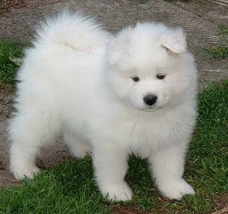
A dog barking during a thunderstorm may very likely be communicating what emotion?
A. joy
B. boredom
C. fear
D. pride

Slide 7

A dog may get an early warning about an approaching storm if it smells what associated with lightning?
A.ozone
B.thunder
C.methane
D.dihydrogen oxide

Slide 8
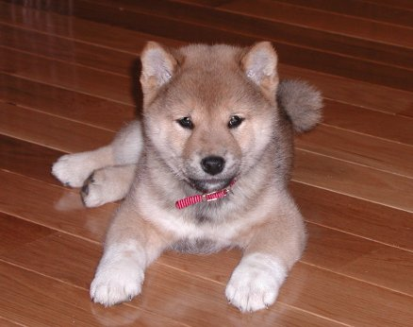
Which of the following is NOT a way that a dog might know a storm is approaching?
A.drop in barometric pressure
B. shift in static electricity fields
C.hearing thunder
D.watching television weather forecast

