Slide 1
#89 How did the months of the year get their names?
By:Tasha Till

Slide 2
How did the months of the year get their names.
The months of the year got their names from the ancient Romans that gave us something very important, the months names.

Slide 3
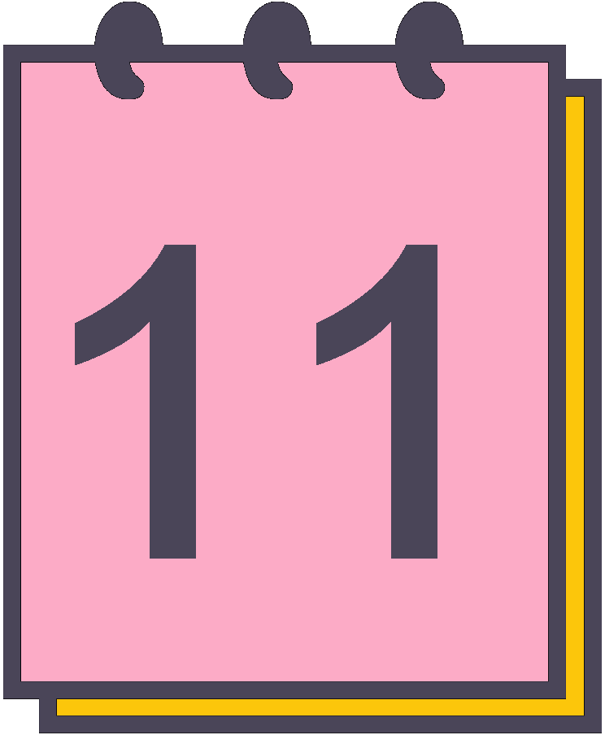
Have the years always started in January and ended in December?
No, the years have not always started in January and ended in December.

Slide 4
what is the Gregorian calendar?
The Gregorian calendar is a adjusted calendar that most western nations began celebrating the start of the year on January.

Slide 5
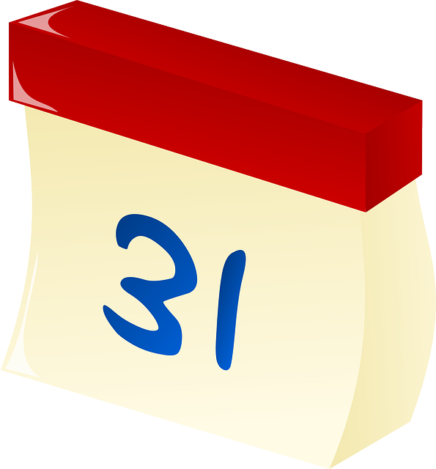
Interesting facts.
Around 690 B.C Numa Pompilius turned a period of celebration at the end of the year into a month of its own,named after the festival februa.

Slide 6
Which month gets their name from the latin word for seven?
A.September
B.November
C.April
D.June

Slide 7
Which month is named after the God of beginnings and endings?
A.December
B.March
C.August
D. January

Slide 8
Which month was originally named Quintilis?
A.January
B.October
C.July
D.April

