Slide 1
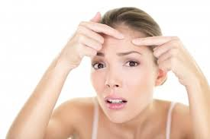
#1281 Why do we get pimples?
by:TaylorRogers

Slide 2
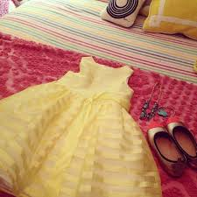
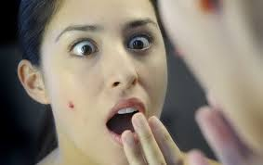
OH NO!!!!!!!!!!!!!
It’s your first school dance on Friday!!! You wake up Friday morning so excited!!!!!! you get your dress and shoes out your ready to go.You walk into the bathroom to get ready for the big day. You look in the mirror and see a pimple right in the middle in your face!!!! You say to yourself “why did you have to show up at worst possible time.” These are some reasons why this might of happened.
it’s to far
YAY!!!!
pretty!
NOO!!!!!!!!!

Slide 3
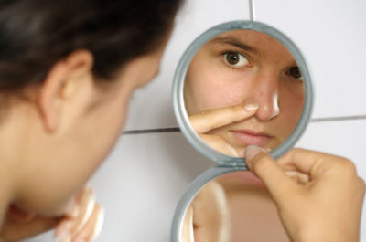
Why do we get pimples?
Especially during puberty. oil glands in the skin can become overactive. producing too much of an oil called sebum. Sebum, dead skin cells, and bacteria clog pores in your skin causing them to inflame. This what we call a pimple.

Slide 4
What is acne?
When you get a pimple you may see these areas as different types of blemishes such as whiteheads , blackheads , papules , pustules , nodules , or cysts.
Notes:
they wont

Slide 5
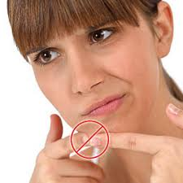
Should we pop pimples?
One word of caution that your dermatologist will give you is this: avoid touching your face and don’t pop pimples! Popping pimples can push infected material deeper into the skin resulting in to breakouts, swelling, and redness.So no don’t pop your pimples.

Slide 6
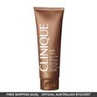
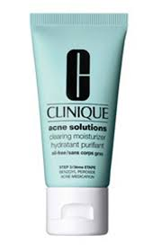
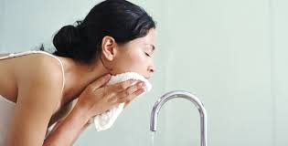
Interesting facts
don’t wash your face to often or aggressively because over washing and scrubbing can irritate the skin
you should use lotions and makeup that are non acnegenic that means it does not clog pores.

Slide 7
Acne is the result of overproduction of oil is called?
canola
sebum
olive
pustule
Notes:
b

Slide 8
A nonacnegenic lotion would NOT ?
clog pores
clean skin
remove oils
clean the face
Notes:
a

Slide 9
What is not a blemish called acne?
white heads
black heads
red heads
papules

Slide 10
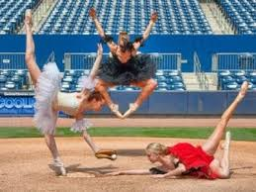
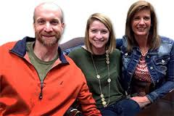
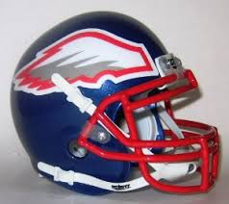
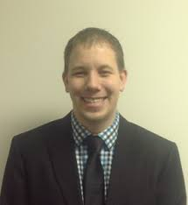
About the Author
Hi I’m Taylor Rogers ,I’m 11 and in the 5th grade.My birthday is October 12,2004.I dance at Dance Theatre of New Bern.The owners are Amber Gover and her husband but I forgot his name.Their daughter is my teacher.I also enjoy softball.I play shortstop and third.my big brother is the captain of the West Craven Eagles.I’m very pround of him.I go to church at West Vanceboro Church of God.My uncle is the seinor pastor at our church. And his wife just had a baby!!!!!!! his name is Ezekiel “Zeke” Josiah Manning. he is so cute!!!! He is a month old now! He is getting so BIG!!!

