Slide 1
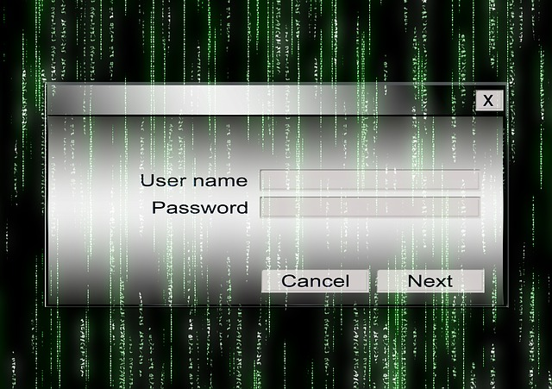
#1503 What is a password?
By: Chase Norville

Slide 2
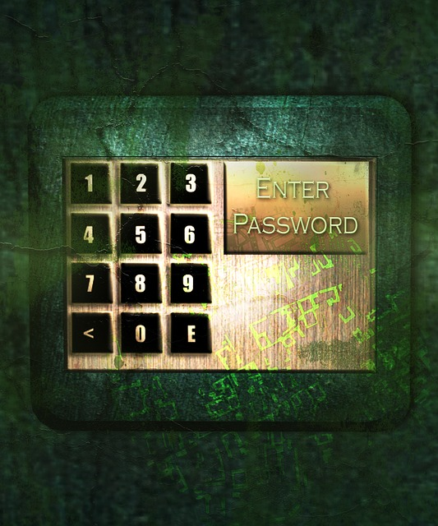
What is a password?
A password is a piece of information that you would need to get into your lair.

Slide 3

How can you create a strong password?
You can create a strong password by making it at least eight characters long.

Slide 4
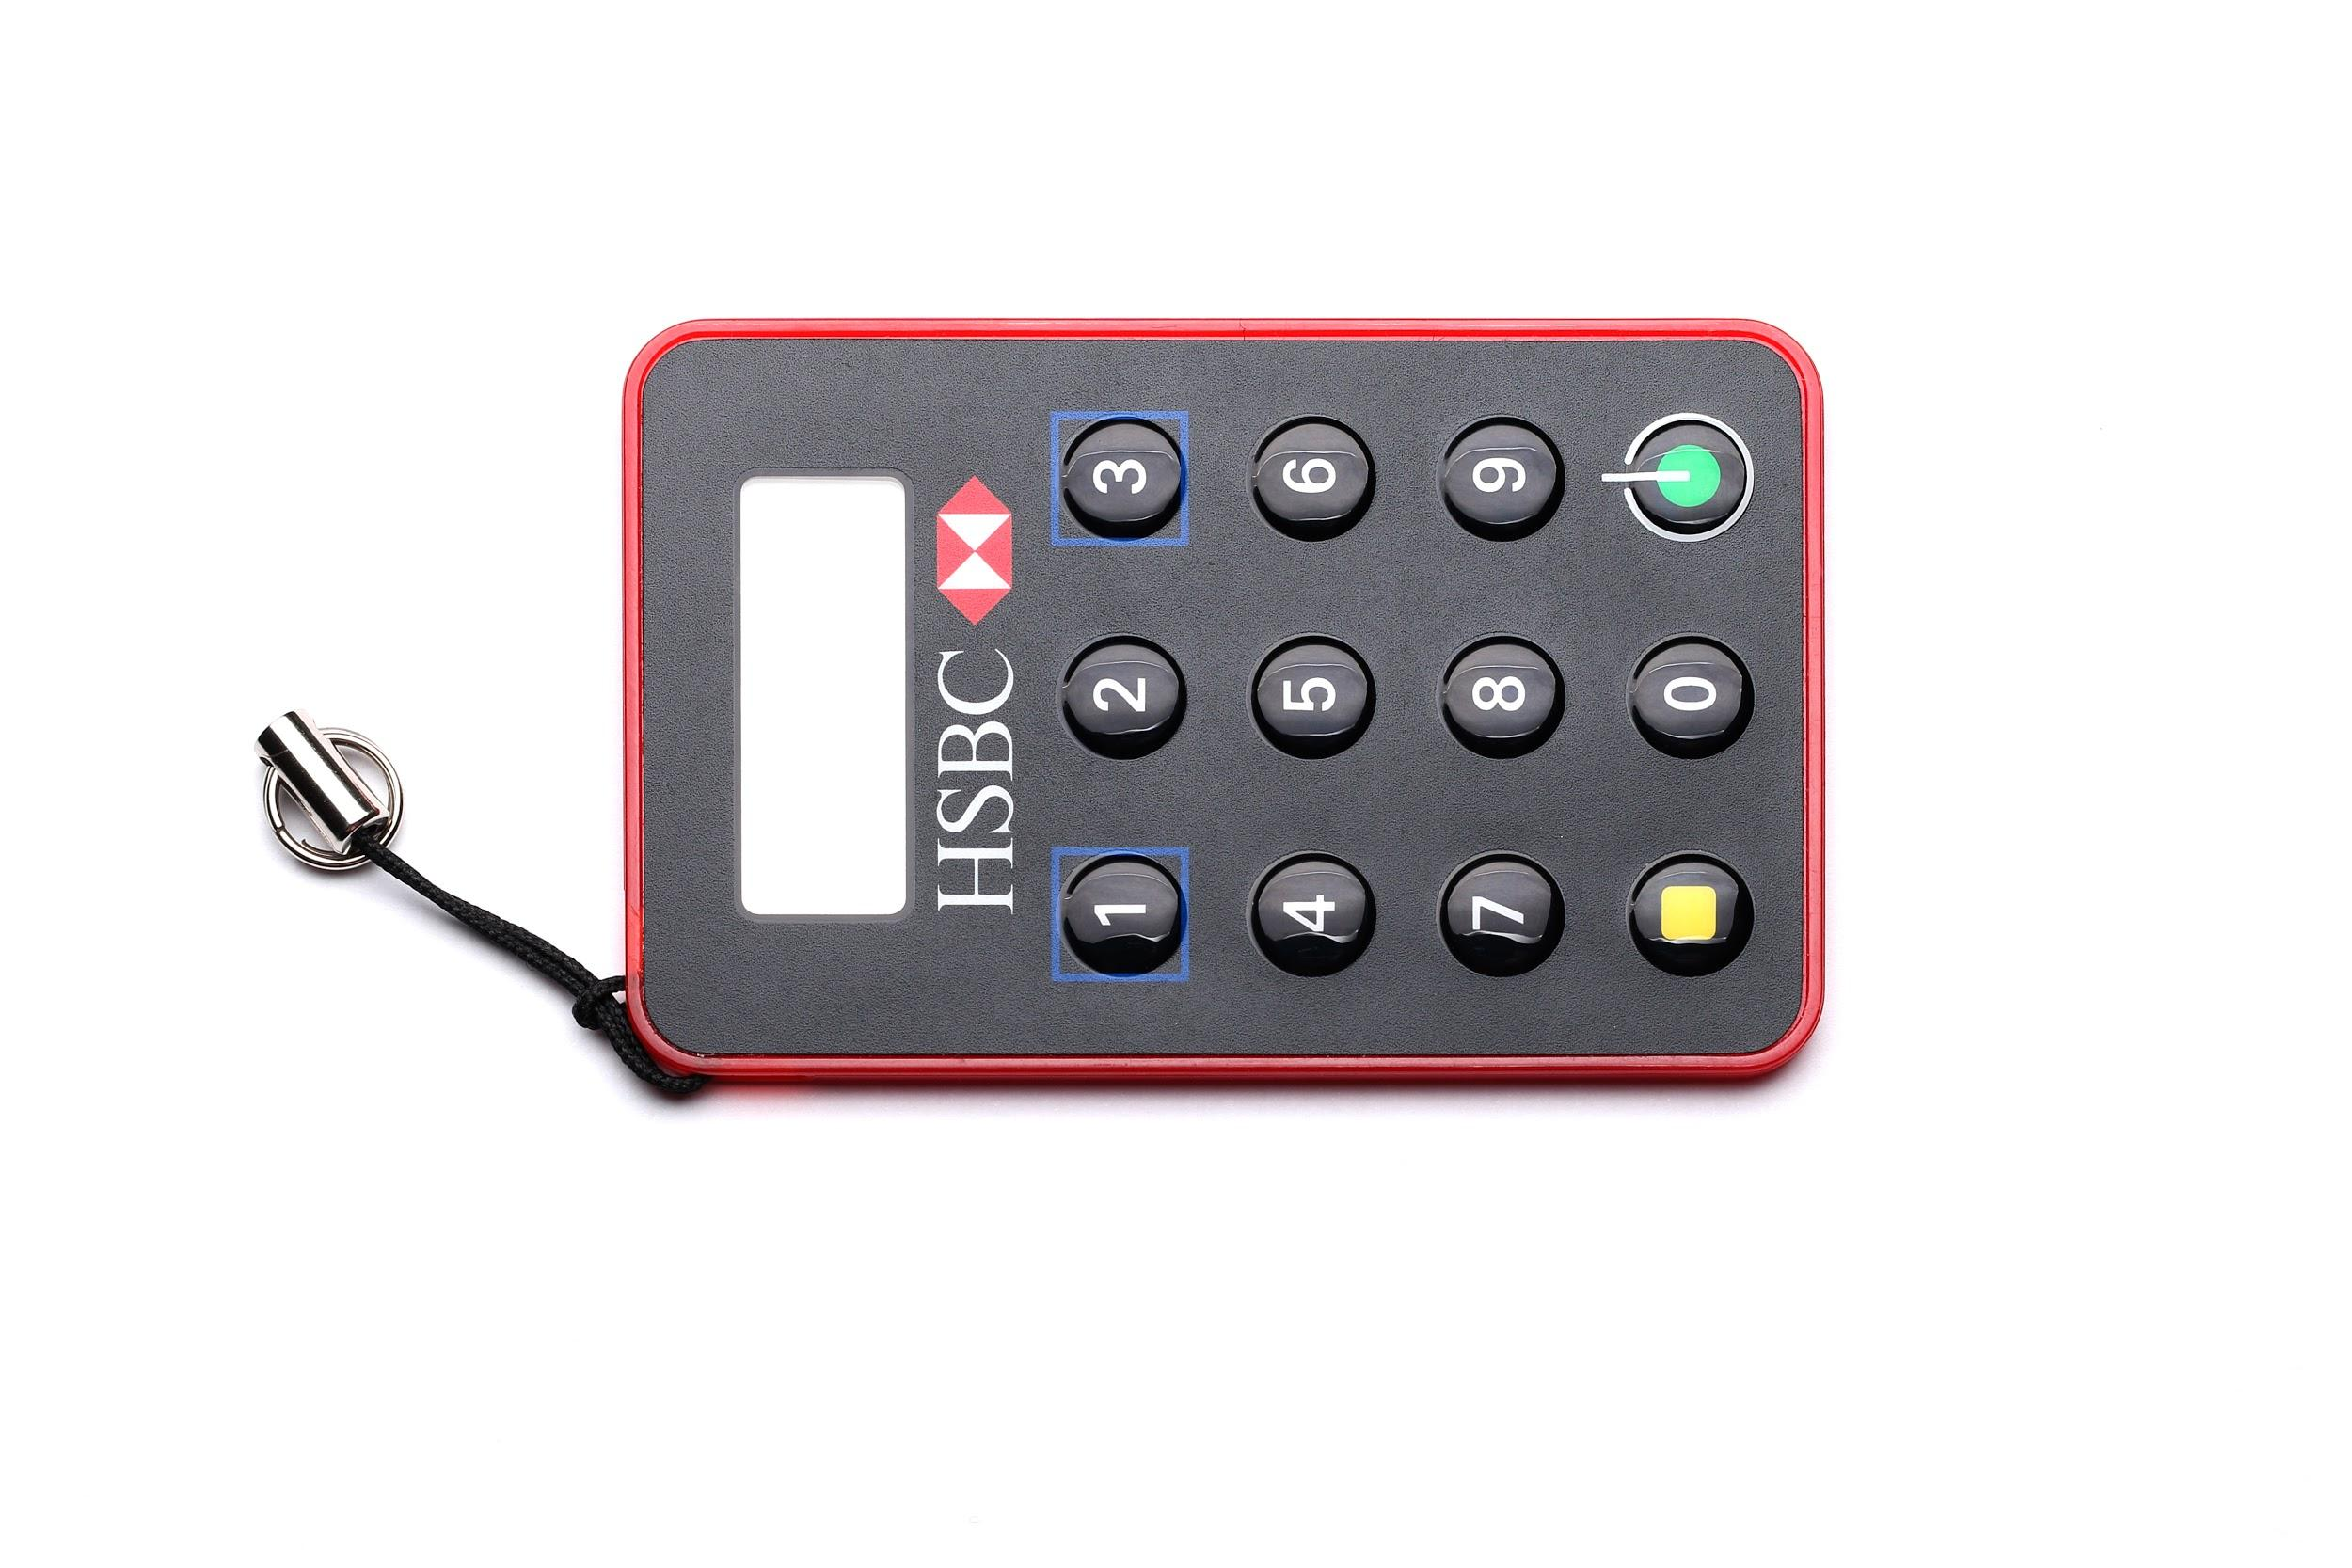
How can you remember all of your passwords?
By hiding it in a code,a book, or a thought.

Slide 5

Interesting facts.
A good hacker can hack a good password. Anyone can have a password, even baby’s.

Slide 6

How long should a password be.
A.3
B.5
C.7
D.8
Notes:
D

Slide 7
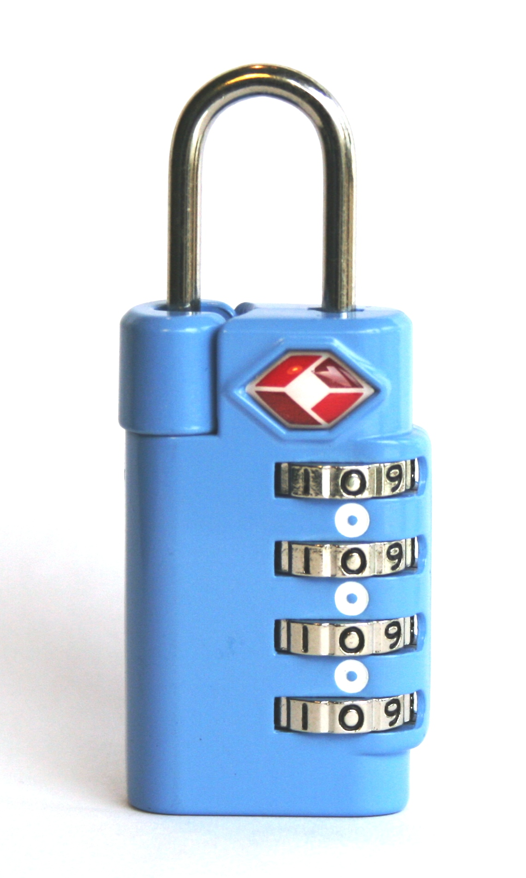
Which of following would be a good basis for a password.
A.your name
B.your birth date
C.your address
D.the name of your childhood best friend.
Notes:
D.

Slide 8

Which of the the following is arguably the weakest password you could use?
A.yu76#*jhn
B.b13B3r
C.w0nd3r0pol!s
D.password
Notes:
D

